Slide 1
CMRE - 2013
There is no remembrance of former things
Solomon

Slide 2
Fiat Currency is the Constitutional Elephant in the Room
There’s a Constitutional Elephant in the Room.
That Elephant is the Federal Reserve Note.
There is only one safe way to euthanize it.
Tom Selgas,
United States Bill of Rights Foundation
http://www.usbor.org
http://www.npn.net
tdselgas@usbor.org

Slide 3
The Constitution Prohibits Bills of Credit (Fiat-Currency)
Benjamin Franklin:
Since the federal constitution has removed all danger of our having a paper tender, our trade advanced fifty percent. Our moneyed people can trust their cash and have brought their coin into circulation… The Pennsylvania Gazette, December 16, 1789
Gold Commission Rpt. Public Law 96-389
“In addition to the compelling economic case for the gold standard, a case buttressed by both historical and theoretical arguments, there is a compelling argument based upon the Constitution. The present monetary arrangements of the United States are unconstitutional --even anti-constitutional-- from top to bottom.” (vol II, pg. 243, March 31, 1982)
Dr. Edwin Vieira, Jr. contribution to the Gold Commission, 1982.

Slide 4
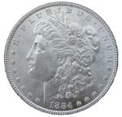
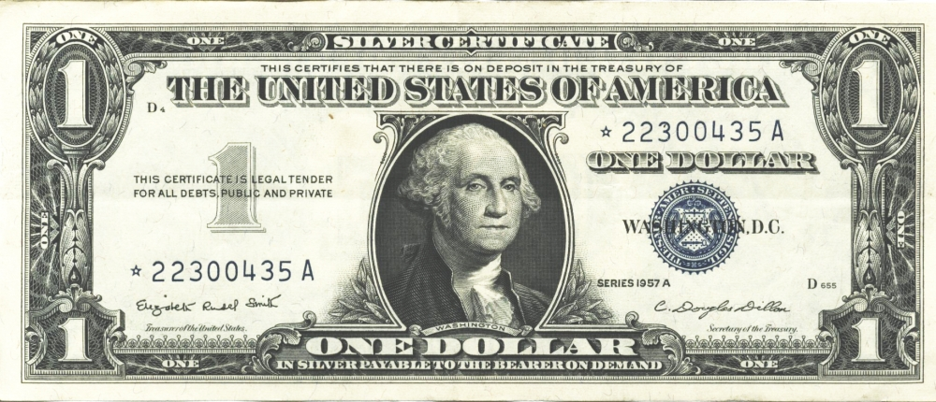
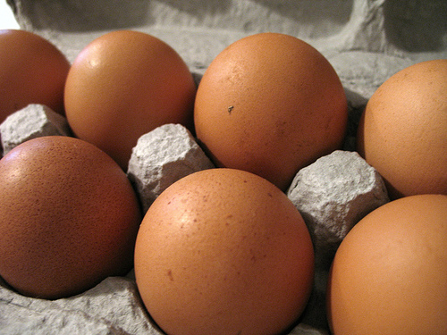
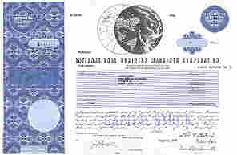


What is the problem with fiat-currencies, like the FRN?
Stock
=
# Egg Cartons (Brown Eggs)
=
# Lawful Money $
# Legal Tender $
1962
=
=
=
U.S. Silver Certificate
4 Shares IBM Stock
$1,942.00
$1,942.00
~5,424
=
No Lawful
Money Available
1982
Fed. Res. Bank Note
75 Shares IBM Stock after splits
~4,266
“$4,884”
2007
=
=
=
Fed. Res. Bank Note
300 Shares IBM Stock after splits
~6,571
$2,338.56
“$30,501.00”
IBM Stock Splits: 1964-05-18 [5:4], 1966-05-18 [3:2], 1968-04-23 [2:1], May 29, 1973 [5:4], Jun 1, 1979 [4:1], May 28, 1997 [2:1], May 27, 1999 [2:1]
Notes:
So now lets look at the effects of using unconstitutional legal tender Federal Reserve Notes.
Because Federal Reserve Notes have no value in or of themselves and no intrinsic value, they can be inflated in such a manner to make you believe that you made a gain or an accession to wealth, when in fact you had no such gain at all.
Because Federal Reserve Notes have no set fixed value, they can be used to “quietly” steal your wealth with the perception that you had a gain.
Because Federal Reserve Notes have no known or calculable value, they can be used to deceive the citizens into believing they will receive future benefits, such as social security, at today’s purchasing power.

Slide 5
Quiet Theft!
Stock
=
# Egg Cartons
(Brown Eggs)
=
# Lawful Money $
# Legal Tender $
Buy
1962
=
=
=
U.S. Silver Certificate
IBM Stock
~5,424
$1,942.00
$1,942.00
Sell
2007
=
=
=
Fed. Res. Bank Note
IBM Stock
~6,571
$2,338.56
“$30,501.00”
17% Gain in Eggs Cartons
17% Lawful Money Gain
Federal Reserve Note
“94% Gain” of $28,559
Tax Due ~172 Egg Cartons
Tax Due $59.48
Alleged Tax Due (15%)
~FRN$4283.85
After FRN Tax results in a
Physical Egg Carton Tax of
923 Cartons of Eggs
FRN Inflation results in a
83% tax rate or $328.45 of the
$396.56 of the purported gain
The purported Federal Reserve Note “Gain” is actually a “quiet theft” in that
it results in an 83% tax rate with the perception of 15% tax rate.
Notes:
So now let’s look at an example.
What are the effects of using unconstitutional legal tender notes?
An unrealized loss of capital and property;
A loss of real value;
The loss of the full economic impact of automation.
Brown Egg Data:
EGG ECONOMICS UPDATE reports by Donald Bell, Poultry Specialist (emeritus), University of California , Riverside, CA 92521
http://www.ams.usda.gov/poultry/mncs/ShellEgg/USDAEGGMARKETNEWSREPORT.html
http://www.pathtoinvesting.org/interactive/inflation/simulation_inflation.htm

Slide 6
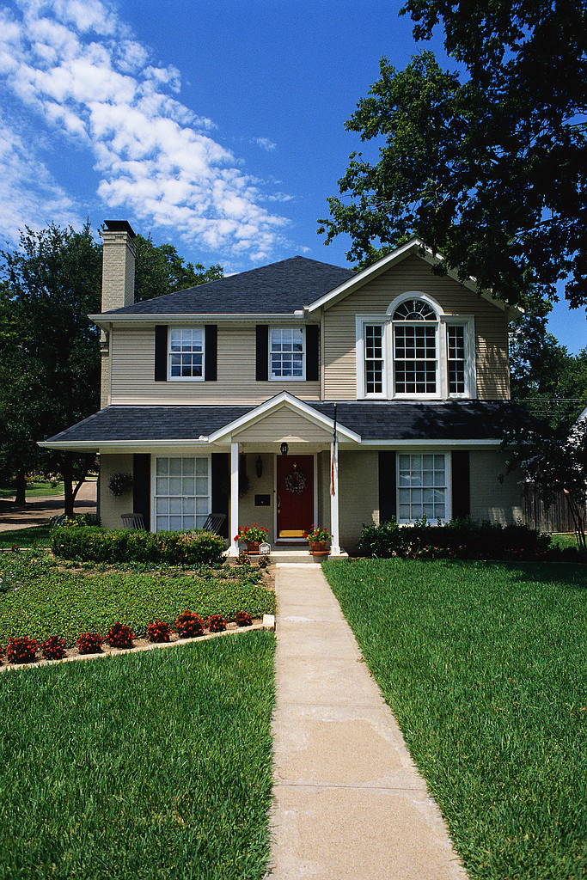
What is the effect of using unconstitutional legal tender?
Property
=
# Egg Cartons (Brown Eggs)
=
# Lawful Money ($)
# Legal Tender $
1957
=
=
=
U.S. Silver Certificate
1,600 Sq. Ft. Home
~37,700
($)13,500
$13,500
=
No Lawful
Money Available
1982
Fed. Res. Bank Note
1,600 Sq. Ft. Home
~37,700
“$85,400”
2007
=
=
=
Fed. Res. Bank Note
1,600 Sq. Ft. Home
~37,700
($)13,500
“$175,000”
Notes:
So now lets look at the effects of using unconstitutional legal tender Federal Reserve Notes.
Because Federal Reserve Notes have no value in or of themselves and no intrinsic value, they can be inflated in such a manner to make you believe that you made a gain or an accession to wealth, when in fact you had no such gain at all.
Because Federal Reserve Notes have no set fixed value, they can be used to “quietly” steal your wealth with the perception that you had a gain.
Because Federal Reserve Notes have no known or calculable value, they can be used to deceive the citizens into believing they will receive future benefits, such as social security, at today’s purchasing power.

Slide 7
Quiet Theft!
Property
=
# Egg Cartons
(Brown Eggs)
=
# Lawful Money ($)
# Legal Tender $
Buy
1957
=
=
=
U.S. Silver Certificate
1,600 Sq. Ft. Home
~37,700
($)13,500
$13,500
Sell
2007
=
=
=
Fed. Res. Bank Note
1,600 Sq. Ft. Home
~37,700
($)13,500
$175,000
No Cartons of Eggs Gain
No Lawful Money Gain
Federal Reserve Note
“Gain” of $161,500
No Gain No Tax Due
No Gain No Tax Due
Alleged Tax Due
~FRN$55,000
After FRN Tax results in a
Physical Egg Carton Loss of
11,922 Cartons of Eggs
After FRN Tax results in a
Lawful Money Property Loss of ($)4,269
The purported Federal Reserve Note “Gain” is actually a “quiet theft” in that
it results in a real Capital loss with the perception of an actual gain.
Notes:
So now let’s look at an example.
What are the effects of using unconstitutional legal tender notes?
An unrealized loss of capital and property;
A loss of real value;
The loss of the full economic impact of automation.
Brown Egg Data:
EGG ECONOMICS UPDATE reports by Donald Bell, Poultry Specialist (emeritus), University of California , Riverside, CA 92521
http://www.ams.usda.gov/poultry/mncs/ShellEgg/USDAEGGMARKETNEWSREPORT.html
http://www.pathtoinvesting.org/interactive/inflation/simulation_inflation.htm

Slide 8
What are our choices?
Do nothing and wait for the social and economic revolution that will ultimately result with the rise of the next Col. Juan Peron or a Robert Mugabe of Zimbabwe.
Have a Jubilee and wait for foreign bond holders to declare war in order to collect something for their bond purchases.
Restore constitutional currency by letting it co-exist with the fiat-system for a period of 2 – 3 years to establish market price stability.

Slide 9
To restore constitutional currency and safely euthanize the FRN
The Government must acknowledge:
The present monetary arrangements of the United States are unconstitutional -- even anti-constitutional -- from top to bottom.
The current monetary system, although unconstitutional, will be replaced with a Constitutional system within three years by:
Requiring all goods and services to be priced in both the FRN and a Constitutional Commodity Unit (CCU).
Requiring that (using an increasing percentage scale over time) a portion of all taxes collected are to paid in the CCU.
Setting a dated certain (henceforth three years) when the FRN will no longer be a legal tender.

Slide 10
History shows us the solution!
1786 – Paper Money (Articles of Confederation period)
Blood running in the streets. Mobs of rioters and demonstrators threatening banks and legislators. Looting of shop and home. Credit ruined. Strikes and unemployment. Trade and distribution paralyzed. Shortages of food. Bankruptcies everywhere. Court dockets overloaded. Kidnappings for heavy ransom. Sexual perversion, drunkenness, lawlessness rampant.
America, 1786: George Washington to James Madison
1791 – Coin Money (Constitutional Law reigns)
Tranquility reigns among the people with that disposition towards the general government which is likely to preserve it. Our public credit [with its foundation on solid money] stands on high ground which three years ago it would have been considered as a species of madness to have foretold.
July 20, 1791, George Washington to David Humphreys
“If anyone had predicted that our economic and social ills could have been solved by simply making nothing but gold and silver coin our money, he would have been call crazy” paraphrase George Washington taken from MOMS 7th Edition pg. 60

