Slide 1
C. M. R. E.
May 2012
Tom Selgas
Monetary Policy Expert
United States Bill of Rights Foundation

Slide 2
Take-away-points
The end of the latest era of Fiat Currency is here!
  Debt does not produce value – it produces chaos;
  The end of Western Civ., as we know it, is near.
  Economic collapse, political upheavals, and massive civil unrest are coming soon to a town near you;
  The need for an Alternative Currency is Now!
  Our founders understood the necessity of alternate currencies and allowed the states to use any gold and silver coin [or bullion], see Bronson v. Rodes, 74 US 229, 245-246] (1869) as tender in payments of debt.

Slide 3
Military–industrial complex Monetary Life Cycle
Stage 1: A Country starts with commodity backed money (gold/silver).
Stage 2: Economic burdens increase (public works & social programs).
Stage 3: As affluence grows, its military grows to protect its affluence.
Stage 4: Military is ultimately put to use and its expenditures explode.
Stage 5: To fund its wars the Country resorts to fiat currency.
Stage 6: The expansion of currency results in massive wealth transfer.
(Note: This is inflation felt by the general public, which ultimately triggers a loss of faith in the fiat-currency)
Stage 7: En masse movement back to precious metals takes place.
We are here!
(Between stages 6 & 7)

Slide 4

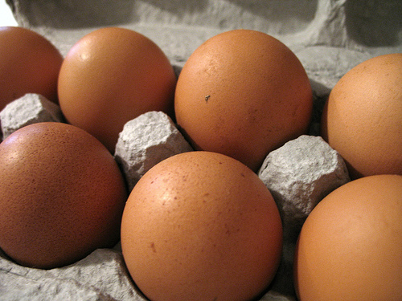
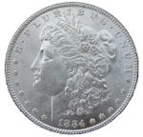
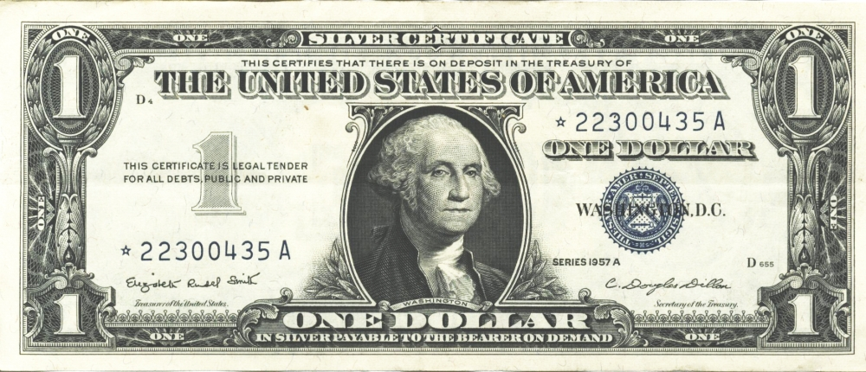


What is the effect of using an untethered fiat-currency?
Property
=
# Egg Cartons
(Brown Eggs)
=
# Lawful Money ($)
# Legal Tender $
1957
=
=
=
U.S. Silver Certificate
1,600 Sq. Ft. Home
~37,700
($)13,500
$13,500
=
No Lawful
Money Available
1982
Fed. Res. Bank Note
1,600 Sq. Ft. Home
~37,700
“$85,400”
2007
=
=
=
Fed. Res. Bank Note
1,600 Sq. Ft. Home
~37,700
($)13,500
“$175,000”
Notes:
So now lets look at the effects of using unconstitutional legal tender Federal Reserve Notes.
Because Federal Reserve Notes have no value in or of themselves and no intrinsic value, they can be inflated in such a manner to make you believe that you made a gain or an accession to wealth, when in fact you had no such gain at all.
Because Federal Reserve Notes have no set fixed value, they can be used to “quietly” steal your wealth with the perception that you had a gain.
Because Federal Reserve Notes have no known or calculable value, they can be used to deceive the citizens into believing they will receive future benefits, such as social security, at today’s purchasing power.

Slide 5
Quiet Theft!
Property
=
# Egg Cartons
(Brown Eggs)
=
# Lawful Money ($)
# Legal Tender $
Buy
1957
=
=
=
U.S. Silver Certificate
1,600 Sq. Ft. Home
~37,700
($)13,500
$13,500
Sell
2007
=
=
=
Fed. Res. Bank Note
1,600 Sq. Ft. Home
~37,700
($)13,500
$175,000
No Cartons of Eggs Gain
No Lawful Money Gain
Federal Reserve Note
“Gain” of $161,500
No Gain No Tax Due
No Gain No Tax Due
Alleged Tax Due
~FRN$55,000
After FRN Tax results in a
Physical Egg Carton Loss of
11,922 Cartons of Eggs
After FRN Tax results in a
Lawful Money Property
Loss of ($)4,269
The purported Federal Reserve Note “Gain” is actually a “quiet theft” in that
it results in a physical property loss with the perception of an actual gain.
Notes:
So now let’s look at an example.
What are the effects of using unconstitutional legal tender notes?
An unrealized loss of capital and property;
A loss of real value;
The loss of the full economic impact of automation.
Brown Egg Data:
EGG ECONOMICS UPDATE reports by Donald Bell, Poultry Specialist (emeritus), University of California , Riverside, CA 92521
http://www.ams.usda.gov/poultry/mncs/ShellEgg/USDAEGGMARKETNEWSREPORT.html
http://www.pathtoinvesting.org/interactive/inflation/simulation_inflation.htm

Slide 6
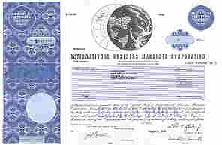
What is the effect of using fiat legal tender?
Stock
=
# Egg Cartons
(Brown Eggs)
=
# Lawful Money $
# Legal Tender $
1962
=
=
=
U.S. Silver Certificate
4 Shares IBM Stock
$1,942.00
$1,942.00
~5,424
=
No Lawful
Money Available
1982
Fed. Res. Bank Note
75 Shares IBM Stock after splits
~4,266
“$4,884”
2007
=
=
=
Fed. Res. Bank Note
300 Shares IBM Stock after splits
~6,571
$2,338.56
“$30,501.00”
IBM Stock Splits: 1964-05-18 [5:4], 1966-05-18 [3:2], 1968-04-23 [2:1], May 29, 1973 [5:4], Jun 1, 1979 [4:1], May 28, 1997 [2:1], May 27, 1999 [2:1]
Notes:
So now lets look at the effects of using unconstitutional legal tender Federal Reserve Notes.
Because Federal Reserve Notes have no value in or of themselves and no intrinsic value, they can be inflated in such a manner to make you believe that you made a gain or an accession to wealth, when in fact you had no such gain at all.
Because Federal Reserve Notes have no set fixed value, they can be used to “quietly” steal your wealth with the perception that you had a gain.
Because Federal Reserve Notes have no known or calculable value, they can be used to deceive the citizens into believing they will receive future benefits, such as social security, at today’s purchasing power.

Slide 7
Quiet Theft!
Stock
=
# Egg Cartons
(Brown Eggs)
=
# Lawful Money $
# Legal Tender $
Buy
1962
=
=
=
U.S. Silver Certificate
IBM Stock
~5,424
$1,942.00
$1,942.00
Sell
2007
=
=
=
Fed. Res. Bank Note
IBM Stock
~6,571
$2,338.56
“$30,501.00”
17% Gain in Eggs Cartons
17% Lawful Money Gain
Federal Reserve Note
“94% Gain” of $28,559
Tax Due ~172 Egg Cartons
Tax Due $59.48
Alleged Tax Due (15%)
~FRN$4283.85
After FRN Tax results in a
Physical Egg Carton Loss of
923 Cartons of Eggs
FRN Inflation results in a
83% tax rate or $328.45 of the
$396.56 of the purported gain
The purported Federal Reserve Note “Gain” is actually a “quiet theft” in that
it results in an 83% tax rate with the perception of 15% tax rate.
Notes:
So now let’s look at an example.
What are the effects of using unconstitutional legal tender notes?
An unrealized loss of capital and property;
A loss of real value;
The loss of the full economic impact of automation.
Brown Egg Data:
EGG ECONOMICS UPDATE reports by Donald Bell, Poultry Specialist (emeritus), University of California , Riverside, CA 92521
http://www.ams.usda.gov/poultry/mncs/ShellEgg/USDAEGGMARKETNEWSREPORT.html
http://www.pathtoinvesting.org/interactive/inflation/simulation_inflation.htm

Slide 8
Facts about Fiat Currency
No currency in history has lasted longer than 42 years after its intrinsic backing has been abandoned. John Tamny, 9/9/2010¹
  It was 40+ years ago (8/15/1971) that President Nixon severed the Federal Reserve Note’s link to gold.
The Continental was America’s first fiat currency and it only lasted 6 years.
The graduated income tax system has allowed modern fiat currencies, such as the Federal Reserve Note, to last ~40+ years
1: http://www.forbes.com/2010/09/07/dollar-currency-gold-standard-2020-opinions-columnists-john-tamny.html

Slide 9
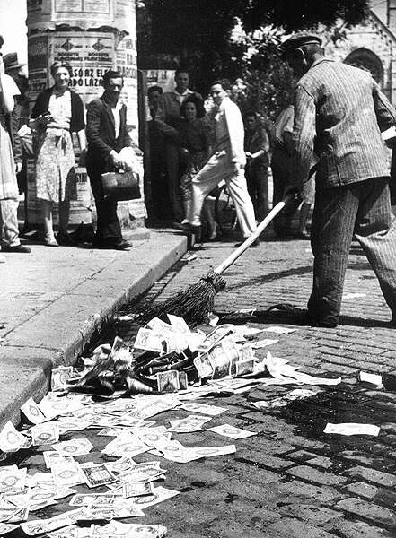
The end of the latest era of
Fiat Currency is here!
Without exceptions, the history of irredeemable legal tender paper & electronic money is that its purchasing power always approaches its cost of production: ZERO
A lifetime’s worth of savings – literally down the sewer!

Slide 10
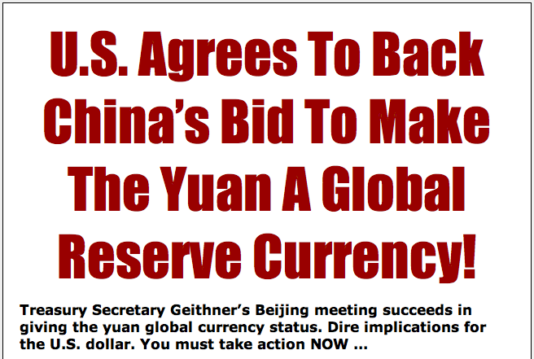
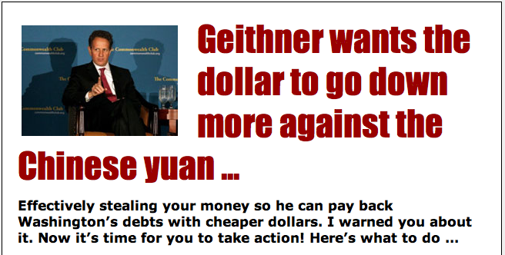
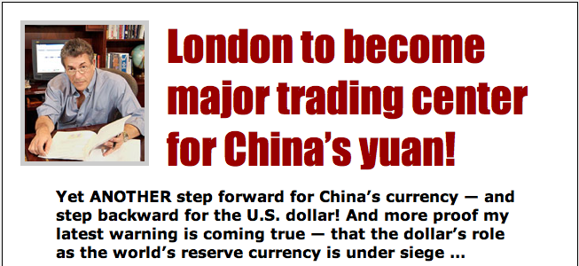
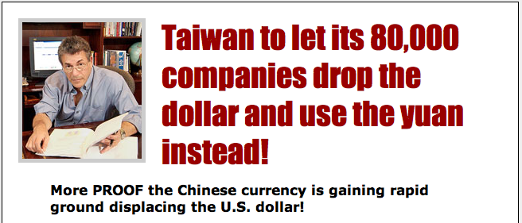
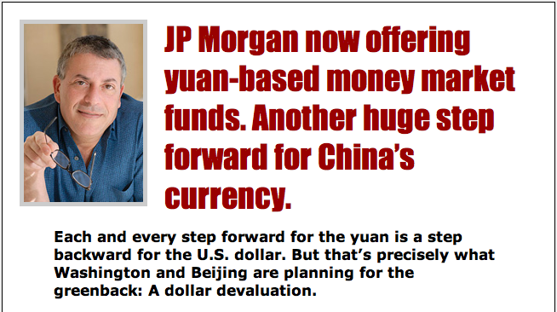
The end of Western Civilization
(as we know it) is near!

Slide 11
The sleeping giant has awaked
“Ici repose un géant endormi, laissez le dormir, car quand il s’éveillera, il étonnera le monde”
“here lies a sleeping giant, let him sleep, for when he wakes up, he will shock the world”
(Napoleon Bonaparte, 1803, [before he became emperor] speaking of China)

Slide 12
The need for an Alternative Currency is Now!
Fiat Legal Tender
  Pro: relatively cheap to implement
  Con: dishonest, ultimately hyper-inflates
  Gold and Silver Coin
  Pro: honest, retains value
  Con: expensive to implement
Electronic Gold and Silver bullion or coin
  Pro: honest, retains value, cheap to implement
  Con: requires frequent audits (~quarterly)

Slide 13


Which alternative currency?
Intangible
fiat currency
Commodity based currency
Without exception, history shows us that the purchasing power of money always approaches its cost of production. And Electronic money’s cost of production is “ZERO”
Tender laws, of any kind, operate to destroy morality, and to dissolve by the pretense of law what ought to be the principle of law to support, reciprocal justice between man and man; and the punishment of a member who should move for such a law ought to be death. Thomas Paine 1786

Slide 14
Constitutional and Statutory Monetary Laws of the United States
Constitution
United States Code
Article I Section 8, Clause 5
  [The Congress shall have Power] To coin Money, regulate the Value thereof, and of foreign Coin, and fix the Standard of Weights and Measures;
Article I Section 9, Clause 1
  … a Tax or duty may be imposed on such Importation, not exceeding ten dollars for each Person.
Article I Section 10, Clause 1
  No State shall … make any Thing but gold and silver coin a Tender in Payments of Debts.
Amendment VII
  In Suits at common law, where the value in controversy shall exceed twenty dollars, the right of trial by jury shall be preserved, and no fact tried by a jury, shall be otherwise re-examined in any Court of the United States, than according to the rules of the common law.
31 USC 5101: United States money is expressed in dollars …
31 USC 5103: United States coins and currency are legal tender …
31 USC 5112(a)(9): The Secretary of the Treasury may mint and issue [a] ten dollar gold coin that is 22.0 millimeters in diameter, weighs 8.483 grams, and contains one-fourth troy ounce of fine gold.
31 USC 5116(b)(2): Secretary shall sell silver under conditions the Secretary considers appropriate for at least $1.292929292 a fine troy ounce.
31 USC 5117(b): The Secretary may prescribe the form and denominations of the certificates. The amount of outstanding certificates may be not more than the value (for the purpose of issuing those certificates, of 42 and two-ninths dollars a fine troy ounce) of the gold held against gold certificates.
31 USC 5119(a): However, the Secretary shall redeem gold certificates owned by the Federal reserve banks at times and in amounts the Secretary decides are necessary to maintain the equal purchasing power of each kind of United States currency.

Slide 15
U.S. Dollar Denomination Laws
Title 31 U.S.C. §§ 5112(a)
Title 31 U.S.C. § 5112(e)
(7) A fifty dollar gold coin that is 32.7 millimeters in diameter, weighs 33.931 grams, and contains one troy ounce of fine gold.
(8) A twenty-five dollar gold coin that is 27.0 millimeters in diameter, weighs 16.966 grams, and contains one-half troy ounce of fine gold.
(9) A ten dollar gold coin that is 22.0 millimeters in diameter, weighs 8.483 grams, and contains one-fourth troy ounce of fine gold.
(10) A five dollar gold coin that is 16.5 millimeters in diameter, weighs 3.393 grams, and contains one-tenth troy ounce of fine gold.
(e) Notwithstanding any other provision of law, the Secretary shall mint and issue, in quantities sufficient to meet public demand, coins which -
  are 40.6 millimeters in diameter and weigh 31.103 grams;
  contain .999 fine silver;
  have a design -
    symbolic of Liberty on the obverse side; and
    of an eagle on the reverse side;
  have inscriptions of the year of minting or issuance, and the words "Liberty", "In God We Trust", "United States of America", "1 Oz. Fine Silver", "E Pluribus Unum", and "One Dollar"; and
  (5) have reeded edges.

Slide 16
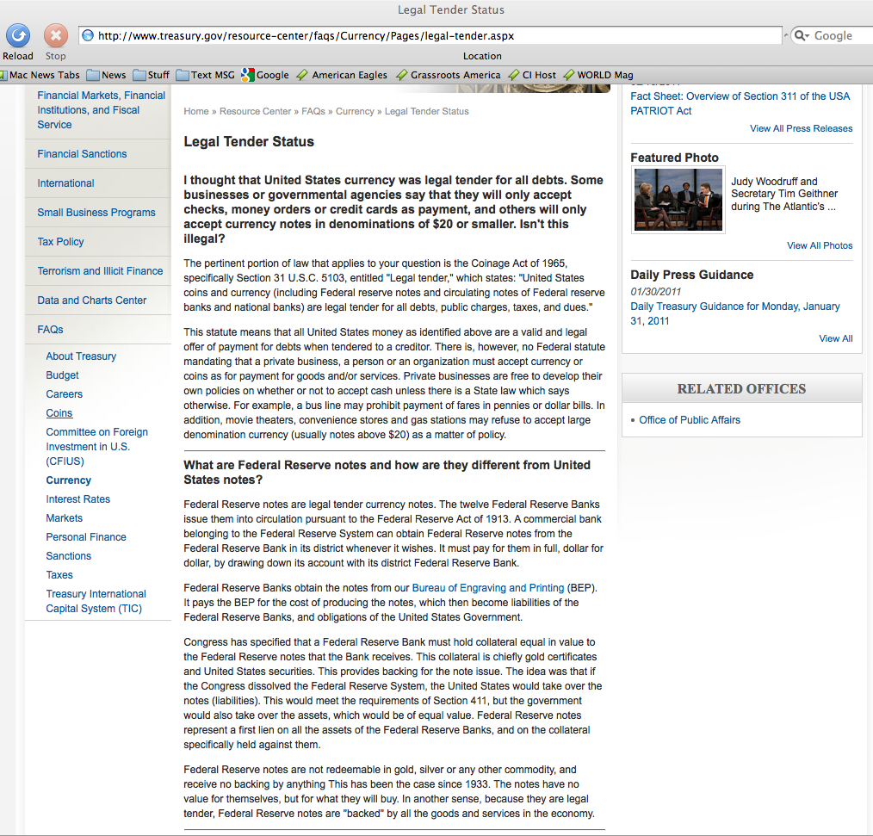
There is, however, no Federal statute mandating that a private business, a person or an organization must accept currency or coins as for payment for goods and/or services. This means you get to choose the currency you use and accept.
Congress has specified that a Federal Reserve Bank must hold collateral equal in value to the Federal Reserve notes that the Bank receives. This collateral is chiefly gold certificates and United States securities. This provides backing for the note issue. The idea was that if the Congress dissolved the Federal Reserve System, the United States would take over the notes (liabilities). This would meet the requirements of Section 411, but the government would also take over the assets, which would be of equal value. Federal Reserve notes represent a first lien on all the assets of the Federal Reserve Banks, and on the collateral specifically held against them.
Notes:
“The Federal Reserve Bank is no more ‘Federal’ than Federal Express”,
G. Edward Griffin (Author)
Federal Reserve Banks are quasi-private banks that are part of the Federal Reserve System. (http://www.stlouisfed.org/news/speeches/2006/03_30_06.htm)
What are Federal Reserve bank notes?
Federal Reserve bank notes are promissory notes issued by the Federal Reserve Banks.
The Federal Reserve bank notes, by law – Title 12 U.S.C. 411, are [supposed to be] redeemable for lawful money on demand, which Constitutionally speaking are minted coins containing 371 ¼ grains of pure silver or its gold equivalent as regulated by Congress pursuant to Article I Section 8, Clause 5.
The United States Supreme Court stated – United States v. Marigold – a still valid opinion:
“[Congress has the] obligation to fulfill that trust on the part of the government, namely, the trust and the duty of creating and maintaining a uniform and pure metallic standard of value throughout the Union. The power of coining money and of regulating its value was delegated to Congress by the Constitution for the very purpose, as assigned by the framers of that instrument, of creating and preserving the uniformity and purity of such standard of value … If the medium which the government was authorized to create and establish could immediately be expelled, and substituted by one it had neither created, estimated, nor authorized ­­ one possessing no intrinsic value ­­ then the power conferred by the Constitution would be useless ­­ wholly fruitless of every end it was designed to accomplish. …” United States v. Marigold, 50 U.S. (9 How.) 560, 567-68 (1850)
Federal Reserve Notes are UNCONSTITUTIONAL:
They are not a pure metallic standard of value;
They have no intrinsic value;
They are not created by Congress;
They expelled constitutional money from regular use in commerce.

Slide 17
Right to use Gold or Silver Coin
The Constitution guarantees Citizens the right to use Gold and Silver as
  Money,
  Repayment of debts and
  Security in Gold Clause Contracts
Note:
  It wasn’t until Oct. 27, 1977 that Americans were statutorily allowed, once again to engage in Gold clause contracts (see Title 31 USC 5118(d)(2)) since Roosevelt and Congress banned them first by Exec Order 6102 signed April 5, 1933 and then by Statute, under the Gold Reserve Act of January 30, 1934.
  This right to use Gold is Silver Coin is why the Sec. of Treasury had to admit on his web site that a private business, a person or an organization can use any U.S. currency or coins as for payment for goods and/or services.
31 U.S.C Sec. 5118
Gold clauses and consent to sue
  (a) In this section –
    (1) "gold clause" means a provision in or related to an obligation alleging to give the obligee a right to require payment in:
    gold;
    a particular United States coin or currency; or
    United States money measured in gold or a particular United States coin or currency.
(d) (1) In this subsection, "obligation" means any obligation (except United States currency) payable in United States money.
(2) An obligation issued containing a gold clause or governed by a gold clause is discharged on payment (dollar for dollar) in United States coin or currency that is legal tender at the time of payment. This paragraph does not apply to an obligation issued after October 27, 1977.

Slide 18
The Supreme Court ruled on the validity of a bullion based currency
Bronson v. Rodes, 74 US 229, 245-246 (1869)
United States v. Marigold, 50 U.S. 560, 567-568 (1850)
Payment of money is delivery by the debtor to the creditor of the amount due. A contract to pay a certain number of dollars in gold or silver coins is, therefore, in legal import, nothing else than an agreement to deliver a certain weight of standard gold, to be ascertained by a count of coins, each of which is certified to contain a definite proportion of that weight. It is not distinguishable, as we think, in principle, from a contract to deliver an equal weight of bullion of equal fineness. It is distinguishable, in circumstance, only by the fact that the sufficiency of the amount to be tendered in payment must be ascertained, in the case of bullion, by assay and the scales, while in the case of coin it may be ascertained by count.
“They [Congress] appertain rather to the execution of an important trust invested by the Constitution, and to the obligation to fulfill that trust on the part of the government, namely, the trust and the duty of creating and maintaining a uniform and pure metallic standard of value throughout the Union. The power of coining money and of regulating its value was delegated to Congress by the Constitution for the very purpose, as assigned by the framers of that instrument, of creating and preserving the uniformity and purity of such standard of value

Slide 19
The Supreme Court ruled on taxation of a bullion based currency
Lane County v. Oregon, 74 US 71, 78 (1869)
Hagar v. Reclamation District No. 108, 111 U.S. 701, 706-07 (1884)
If, therefore, the condition of any State, in the judgment of its legislature, requires the collection of taxes in kind, that is to say, by the delivery to the proper officers of a certain proportion of products, or in gold and silver bullion, or in gold and silver coin, it is not easy to see upon what principle the national legislature can interfere with the exercise, to that end, of this power, original in the States, and never as yet surrendered. If this be so, it is, certainly a reasonable conclusion that Congress did not intend, by the general terms of the currency acts, to restrain the exercise of this power in the manner shown by the statutes of Oregon.
The acts of Congress making the notes of the United States a legal tender do not apply to involuntary contributions exacted by a State, but only to debts, in the strict sense of that term, that is, to obligations for the payment of money founded on contracts, express or implied … First, that it was the right of each State to collect its taxes in such material as it might deem expedient, either in kind, that is to say, by a certain proportion of products, or in bullion, or in coin, the court observing that the extent to which the power of taxation of the State should be exercised, the subjects upon which it should be exercised, and the mode in which it should be exercised were all equally within the discretion of its Legislature, except as restrained by its own constitution and that of the United States

Slide 20
Conclusion: An alternative currency system can be implemented today
The constitution guarantees us the right to use gold & silver as an alternative currency.
The law (Title 31 U.S.C. § 5118) allows us to specify payments in gold, or a particular U.S. coin.
To preserve our republican form of government, and save Western Civilization from the awakening giant China, requires we implement a sound alternative currency system now.

