Slide 1
Coker House
July 14, 2015

Slide 2
The Lifecycle of Civilizations
1. From bondage to spiritual faith;
2. From spiritual faith to great courage;
3. From courage to liberty;
4. From liberty to abundance;
5. From abundance to complacency;
6. From complacency to apathy;
7. From apathy to dependence;
8. From dependence back into bondage
We are here!

Slide 3
S&P 500 companies with the most long-term debt
Company Symbol LT debt LT debt/cap. Total debt/EBITDA
Actavis ACT $42.7 36.9 9.4
Apple AAPL $40.1 23.2 0.6
AT&T T $92.2 49.2 3.4
Comcast CMCSA $42.95 42.6 2
Duke Energy DUK $37.2 43.8 5
General Electric GE $190.4 50.7 14.9
Int’l Bus. Machines IBM $34.3 67.1 1.7
Kinder Morgan KMI $41.8 51.9 6.9
Medtronic MDT $33.8 37.7 6.2
Oracle ORCL $30.3 37.5 1.9
Verizon VZ $109.3 87.8 3.1
Wal-Mart WMT $38.9 33 1.4
Key:
LT: Long Term
EBITDA: Earnings Before Interest, Taxes, Depreciation and Amortization
Source http://www.cnbc.com/2015/06/04/12-big-companies-heap-on-the-most-debt.html

Slide 4
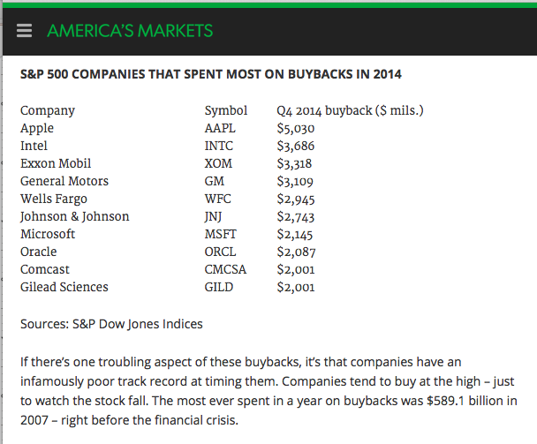
Source: http://americasmarkets.usatoday.com/2015/03/23/10-companies-buy-up-their-own-stock/

Slide 5
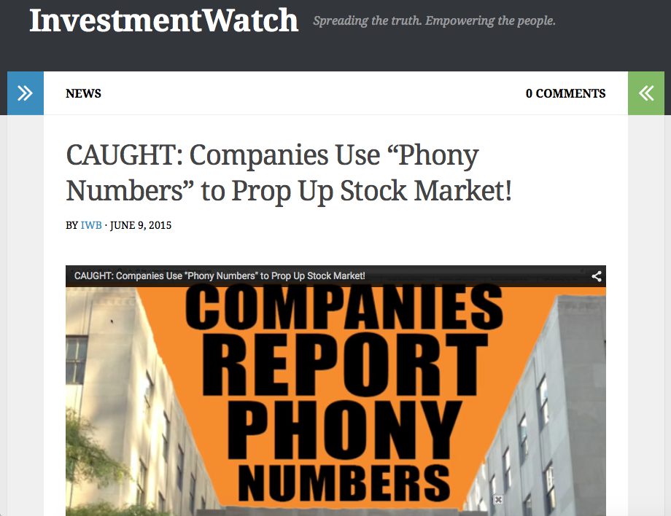

Slide 6
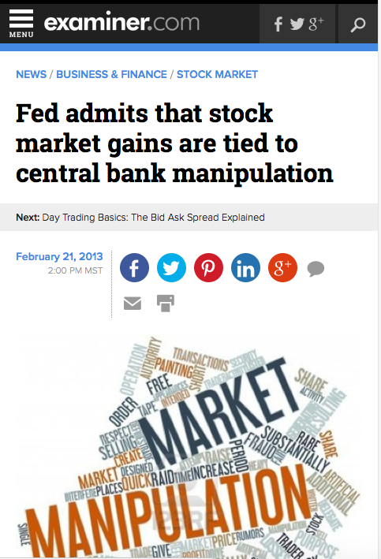
Bottom Line:
The Stock Markets are manipulated
Market Manipulation Still Ignored by Mainstream Media by the Curmudgeon and Victor Sperandeo
http://www.fiendbear.com/Curmudgeon62.htm
Feds loan money at near zero interest to Fortune 500 to by their own stock to prop up markets. Victor Sperandeo, July 13, 2015

Slide 7
What happens when Constitutional monetary standards are forsaken?
An unrealized loss of capital and property;
A loss of real economic value;
The loss of the full economic impact of automation;

Slide 8
The Dollar is but one of several Constitutional Units of Measure:
Unit of Measure | Times Stated | Definition when the Constitution was Ratified
Year | 33 | One revolution of the earth around the sun’s axis
Day | 21 | One revolution of the earth around it’s own axis
Hour | 1 | 15 degree rotation of the earth around it’s own axis
Mile | 1 | A unit of linear measure equal to 5,280 feet
Dollar | 2 | A coin containing 371.25 grains of silver
Eisner v. Macomber, 252 U.S. 189, 206 (1920)
  Congress cannot by legislation alter the Constitution, from which alone it derives its power to legislate, and within whose limitations alone that power can be lawfully exercised.
Notes:
Think about it: Can Congress declare a year to be ten revolutions of the earth around the sun’s axis (e.g. ~3,650 days per year) or declare a mile to be the circumference of the earth at the equator?

Slide 9
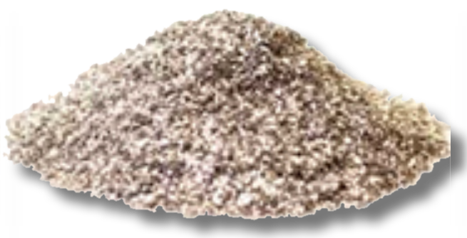
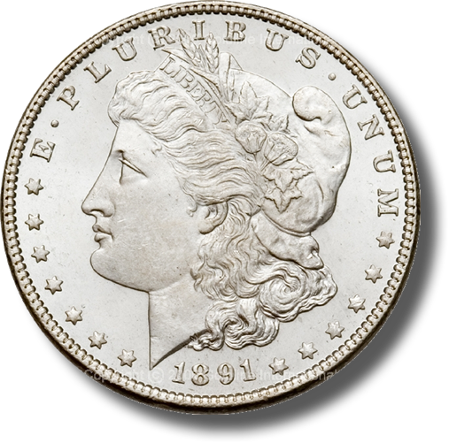

What is One Dollar?
One Dollar is a standard unit of measurement
Money:
371 ¼ grains of Silver minted
= $1.00
Analogous
Time:
24 Hours = 1 Day * 7 = 1 Week
Weight:
16 Ounces = 1 Pound * 2000 = 1 Ton
Length:
1 Inch * 12 = 1 Foot * 3 = 1 Yard
Notes:
The word Dollar is in fact a standard unit of measurement of money; it is analogous to an “hour” for time, an “ounce” for weight, and an “inch” for length.
The Dollar is our Country’s standard unit of measurement for money.
How do you feel when you go to a gas station and pump “15 gallons of gas” into your 12 gallon tank?
Or you went to the lumber yard and purchased an eight foot piece of lumber, and when you got home you discovered that it was actually only 7 ½ feet long?
How would you feel if you went to the grocery store and purchased what you believed were 2 lbs. of bananas, but when you got home you found out that you actually only purchased 1 ¾ of a pound of bananas?
I bet you would feel ripped off.
Now what if I told you that the green Federal Reserve Notes that you have in your pocket, which purports to be of some “dollar” value, are currently worth less than 1/20 the constitutionally guaranteed value in lawful money. I bet you would be really ticked off.
Well folks, be prepared to be very ticked off.

Slide 10
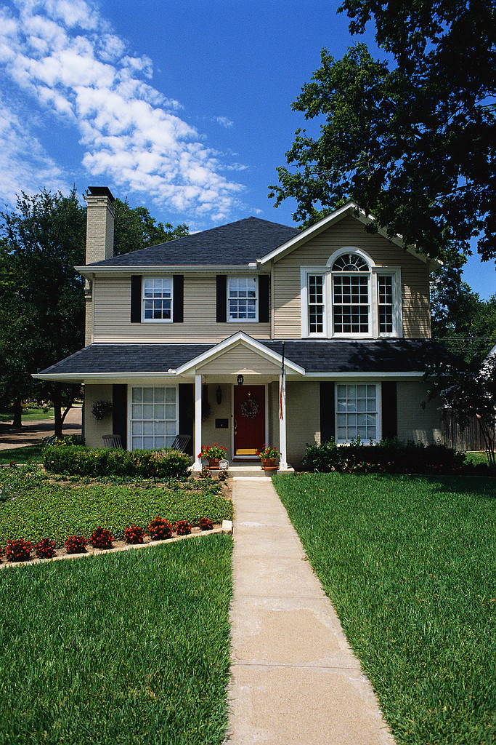
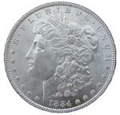
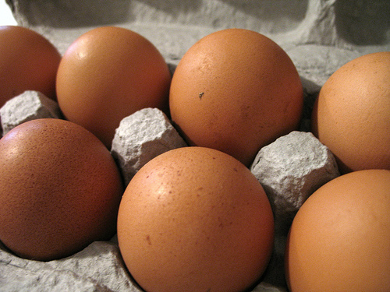
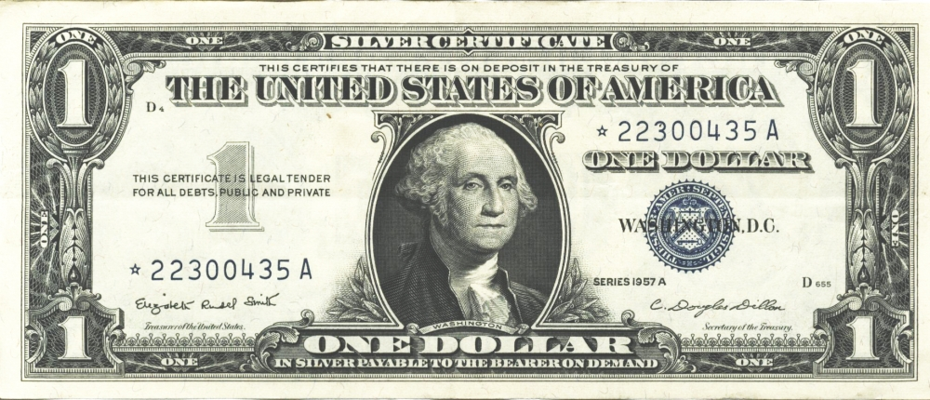


Unrealized losses of capital and property
Property
=
# Egg Cartons
(Brown Eggs)
=
# Lawful Money $
# Legal Tender $
Buy
1957
=
=
=
U.S. Silver Certificate
1,600 Sq. Ft. Home
~37,700
($)13,500
$13,500
Sell
2007
=
=
=
Fed. Res. Bank Note
1,600 Sq. Ft. Home
~37,700
($)13,500
$175,000
No Cartons of Eggs Gain
No Lawful Money Gain
Federal Reserve Note
“Gain” of $161,500
No Gain No Tax Due
No Gain No Tax Due
Alleged Tax Due
~FRN$55,000
After FRN Tax results in a
Physical Egg Carton Loss of
11,922 Cartons of Eggs
After FRN Tax results in a
Lawful Money Property
Loss of ($)4,269
The purported Federal Reserve Note “Gain” is actually a “quiet theft” in that
it results in a physical property loss with the perception of an actual gain.
Notes:
So now let’s look at an example.
What are the effects of using unconstitutional legal tender notes?
An unrealized loss of capital and property;
A loss of real value;
The loss of the full economic impact of automation.
Brown Egg Data:
EGG ECONOMICS UPDATE reports by Donald Bell, Poultry Specialist (emeritus), University of California , Riverside, CA 92521
http://www.ams.usda.gov/poultry/mncs/ShellEgg/USDAEGGMARKETNEWSREPORT.html
http://www.pathtoinvesting.org/interactive/inflation/simulation_inflation.htm

Slide 11
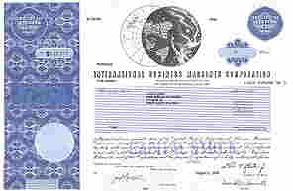
A loss of real economic value
Stock
=
# Egg Cartons
(Brown Eggs)
=
# Lawful Money $
# Legal Tender $
Buy
1962
=
=
=
U.S. Silver Certificate
IBM Stock
~5,424
$1,942.00
$1,942.00
Sell
2007
=
=
=
Fed. Res. Bank Note
IBM Stock
~6,571
$2,338.56
“$30,501.00”
17% Gain in Eggs Cartons
17% Lawful Money Gain
Federal Reserve Note
“94% Gain” of $28,559
Tax Due ~172 Egg Cartons
Tax Due $59.48
Alleged Tax Due (15%)
~FRN$4283.85
After FRN Tax results in a
Physical Egg Carton Loss of
923 Cartons of Eggs
FRN Inflation results in a
83% tax rate or $328.45 of the
$396.56 of the purported gain
The purported Federal Reserve Note “Gain” is actually a “quiet theft” in that
it results in an 83% tax rate with the perception of 15% tax rate.
Notes:
So now let’s look at an example.
What are the effects of using unconstitutional legal tender notes?
An unrealized loss of capital and property;
A loss of real value;
The loss of the full economic impact of automation.
Brown Egg Data:
EGG ECONOMICS UPDATE reports by Donald Bell, Poultry Specialist (emeritus), University of California , Riverside, CA 92521
http://www.ams.usda.gov/poultry/mncs/ShellEgg/USDAEGGMARKETNEWSREPORT.html
http://www.pathtoinvesting.org/interactive/inflation/simulation_inflation.htm

Slide 12
The loss of the full economic impact of automation.
Automation lowers the cost of production.
Inflation however ensures the appearance of increased revenue while providing bankers unearned profits (red)
■ Inflated Sale price
■ Sale price
However, lower cost of production often results in lower revenue. Thus, to increase revenue a manufacture either has to increase sales or add more features to maintain revenue.
Notes:
http://goldnews.bullionvault.com/silver-money-013120143
http://www.transtutors.com/questions/tts-1700-142914.htm
http://cdn.promatshow.com/seminars/assets/686.pdf
http://www.nytimes.com/2012/08/19/business/new-wave-of-adept-robots-is-changing-global-industry.html?pagewanted=all&_r=0
http://www.bls.gov/data/inflation_calculator.htm

Slide 13
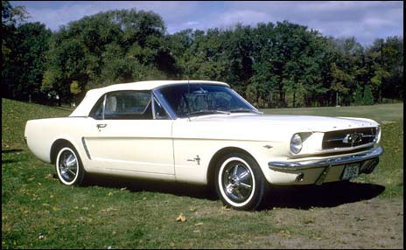
Example – Ford Mustang
1965
Features
Convertible
170 CID /101 HP
6 cylinder engine
Drum brakes
Bucket Seats with lap belt restraint
No air conditioner
AM Radio
$2,557
Notes:
1965 Ford Mustang base list price was $2,557
(http://www.sportscarmarket.com/affordable-classics/2000-August/1965-mustang-convertible.html & http://www.mustangspecs.com/years/64-65.shtml)
2007 Ford Mustang base list price is $31,700 FRNs or ~$2,557 lawful money dollars
(http://autos.yahoo.com/ford_mustang_gt_premium_convertible/ & http://www.edmunds.com/ford/mustang/2007/features-specs.html?style=100744690)

Slide 14
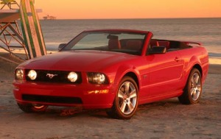
Example – Ford Mustang
2007
Features
Convertible
4.0 L /210 HP
6 cylinder engine SOHC
Ventilated disc brakes
Bucket Seats with Air Bags
Air conditioner
120W Stereo / iPod input
$31,700
Notes:
1965 Ford Mustang base list price was $2,557
(http://www.sportscarmarket.com/affordable-classics/2000-August/1965-mustang-convertible.html & http://www.mustangspecs.com/years/64-65.shtml)
2007 Ford Mustang base list price is $31,700 FRNs or ~$2,557 lawful money dollars
(http://autos.yahoo.com/ford_mustang_gt_premium_convertible/ & http://www.edmunds.com/ford/mustang/2007/features-specs.html?style=100744690)

Slide 15
The Lawful Money Cost of a Ford Mustang has Remained Constant
1965
=
=
U.S. Silver Certificate
($) 2,557
($) 2,557
2007
=
=
Fed. Res. Bank Note
($)2,557
$31,700
It’s only inflation that has given the appearance that the sales price and Ford’s revenues have been increasing.
Notes:
1965 Ford Mustang base list price was $2,557
(http://www.sportscarmarket.com/affordable-classics/2000-August/1965-mustang-convertible.html & http://www.mustangspecs.com/years/64-65.shtml)
2007 Ford Mustang base list price is $31,700 FRNs or ~$2,557 lawful money dollars
(http://autos.yahoo.com/ford_mustang_gt_premium_convertible/ & http://www.edmunds.com/ford/mustang/2007/features-specs.html?style=100744690)

Slide 16
What happens when Constitutional monetary standards are forsaken?
Citizens are unknowingly defrauded.
Government becomes tyrannical.
A massive redistribution of wealth occurs.
Notes:
http://www.dailypaul.com/145854/the-wonderful-advantages-of-fiat-money-republicae
http://neweconomicperspectives.org/2013/01/the-strange-reality-of-fiat-money.html
http://www.dslreports.com/forum/r22797529-The-benefits-of-fiat-currency
http://www.gold-eagle.com/article/gold-standard-fiat-disguise
http://fofoa.blogspot.com/2011/04/deflation-or-hyperinflation.html
http://sunsoflibertymint.com/top-five-silver-producing-countries/
http://politicalehconomy.wordpress.com/2014/01/10/myths-of-central-banking/
http://www.cato.org/multimedia/daily-podcast/myths-central-bank-independence
http://finance.yahoo.com/news/5-ways-student-loans-hurt-110002219.html

Slide 17
What should we do?
Don’t Panic!
  Lawful money (silver and gold) coins exist. Start using them!
  Viable economic transition models exist (i.e. the Euro).
Implement a dual monetary system
  Price goods and services throughout the state in both Federal Reserve note (FRN)$ and Lawful Money $.
  Use the European model to transition all prices, taxes, fines and other debts to Lawful Money $ units over 24 – 36 months.
Implement Lawful Money State Banks
  All deposits and interest are paid in Lawful Money silver or gold coin.
Article I Section 10, Clause 1
  No State shall … make any Thing but gold and silver coin a Tender in Payments of Debts.
Notes:
This legislative body should give serious consideration to passing legislation that would require all financial transactions within 36 month from the date of enactment to be made in constitutional lawful money of the United States (American Eagle coins) or in sound monetary units of silver, gold, gold and silver coin, or electronic gold currency.
Further, for the period between the 90th day after enactment to the end of the 36th month all financial transactions shall be indicated in both Federal Reserve Note units as well as the chosen sound money unit.
Furthermore all financial transactions between the state and other persons involving certain taxes, fees, and charges on cigarettes and tobacco products be conducted in the chosen sound money unit; requiring the state treasurer to adopt rules for the administration of payment by and receipt by the state and political subdivisions in gold, gold and silver coin, or electronic gold currency.
This can be done and done successfully! Look at Europe; it went from 16 independent currencies to one currency in 36 months by implementing a dual pricing system to facilitate a smooth transition to the new monetary unit over a 36 month period.

