Slide 1
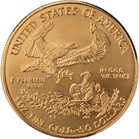
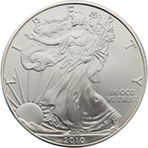
The Mechanics of Using
Gold & Silver

Slide 2
Definitions
Lawful Money
  Constitutionally authorized gold and silver coin
  Currently minted coins are authorized at Title 31 U.S.C §5112
Legal Tender
  a medium of payment allowed by law to be valid for meeting a financial obligation.
  See Title 31 U.S.C §5103
One ($1) Dollar
  A minted silver coin containing at least 371¼ gains of fine (pure) silver. (Note 1 troy ounce = 480 grains)
Gold or Silver Clause Contract
  A contract for payment in gold or silver coin.
  Authorized by law at Title 31 U.S.C §5118
ETF - Exchange Traded Fund
  a mutual fund that is traded on an exchange having as its principle a particular commodity (such as gold or silver) or shares of stock.
ETN - Exchange Traded Note
  is a senior, unsecured, unsubordinated debt security issued by an underwriting bank
  are designed to provide investors access to the returns of various market benchmarks

Slide 3
What we learned last week
One ($1) Dollar is a minted silver coin containing at least 371¼ grains of fine (pure) silver
The Gold and Silver coins defined in Title 31 USC §5112 are legal tender and lawful money of the United States
Federal Reserve Bank notes are NOT dollars NOR are they lawful money
The Secretary of Treasury FAILED in his duty to maintain the equal purchasing of to maintain the equal purchasing power of each kind of United States currency pursuant to Title 31 USC §5119(a)

Slide 4
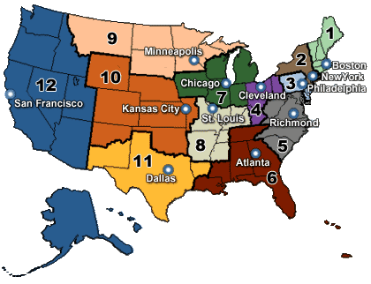
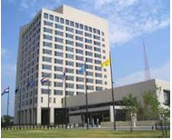
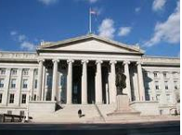
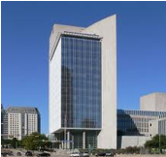
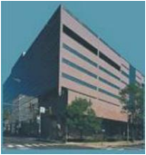
How the acquisition of American Eagle & Liberty coins should work
Title 12 USC Sec. 411
Federal reserve notes, to be issued at the discretion of the Board of Governors of the Federal Reserve System for the purpose of making advances to Federal reserve banks through the Federal reserve agents as hereinafter set forth and for no other purpose, are authorized. The said notes shall be obligations of the United States and shall be receivable by all national and member banks and Federal reserve banks and for all taxes, customs, and other public dues. They shall be redeemed in lawful money on demand at the Treasury Department of the United States, in the city of Washington, District of Columbia, or at any Federal Reserve bank.
FRB Kansas City
Federal Reserve Bank
Districts Map
US Treasury
Washington D.C.
FRB Dallas
We the People
FRB Philadelphia

Slide 5

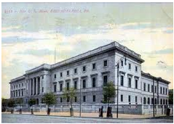

How the acquisition of American Eagle & Liberty coins does work
American Century
4500 Main Street, 4th Floor
Kansas City, MO 64111
1-888-345-2071
www.americancentury.com
US Mint
Dillon Gage, Inc.
15301 Dallas Parkway
Suite 200
Addison, TX 75001
1-800-375-4653
www.dillongage.com
FideliTrade
3601 N. Market Street
Wilmington, DE 19802
1-800-223-1080
www.fidelitrade.com
Retail Gold Dealer
We the People
Authorized National Dealers
(Market Makers)

Slide 6
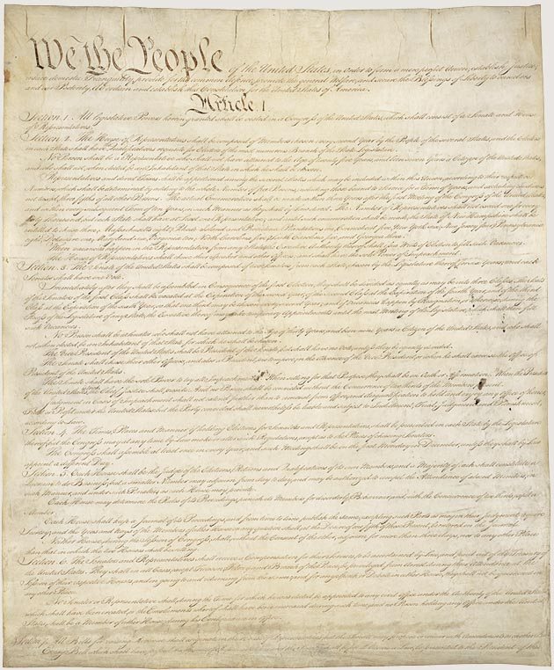
Uses of Gold and Silver
Money
  In the United States gold & silver coins are the only lawful constitutional money
Investments
  Gold & silver can be used as a hedge against inflation created by fiat currencies
Industrial
  Gold & silver are used throughout the electronics, medical and photographic industries
Article I Section 8, Clause 5
  [The Congress shall have Power] To coin Money, regulate the Value thereof, and of foreign Coin, and fix the Standard of Weights and Measures;
Article I Section 10, Clause 1
  No State shall … make any Thing but gold and silver coin a Tender in Payments of Debts.

Slide 7
How to use American Eagle & Liberty coins as money
Use a Gold and Silver
Clause Contract
The contract specifies that the coins are the exclusive legal tender medium of payment so there is no confusion about their legal value
The contract removes the ambiguity in the disparate purchasing power between Federal Reserve Bank notes and Lawful Money Coin
The contract reduces the risk of the IRS making frivolous claim that you received something other than the the face value of the gold or silver coin

Slide 8
Elements of a Gold Contract
Preamble
  Lists the parties and date of the contract
Authorization and Construction
  Cites the laws and supreme court decisions
Valuation of Payment
  Sets out the weight and face-values of the coins tendered as payment
Delivery and Satisfaction of Payment
  Specifies that the delivery of coins as the exclusive form of payment
Receipt of Full Payment
  Acknowledges full payment has been made

Slide 9
Preamble Element
This Medical Services Payment Clause, “Agreement”, made effective this 17th day of February, 2011, by and between Dr. Seuss, “Doctor” and John Doe, “Patient”.

Slide 10
Authorization and Construction
(a) Authorization and Construction. This Agreement is authorized by, relies upon, and must be construed and implemented according to:
(i) Section 4(c) of the Act of 28 October 1977, Public Law 95-147, 91 Statutes at Large 1227, 1229, now codified in 31 United States Code, Section 5118(d)(2);
(ii) Section 2(a)(7) of the Act of 17 December 1985, Public Law 99-185, 99Statutes at Large 1177, 1177,now codified in Title 31, United State Code, Section 5112(a)(7);
(iii) Title II, Section 202(h) of the Act of 9 July 1985, Public Law 99-61, 99 Statutes at Large 113, 116, now codified in Title 31, United States Code, Section 5112(h);
(iv) the decisions of the Supreme Court of the United States in New York ex rel. Bunk of New York v. Board of Supervisors, 74 U.S. (7 Wallace) 26 (1869); Bronson v. Rodes, 74 U.S. (7 Wallace) 229 (1869); Butler v. Horowitz, 74 U.S. (7 Wallace) 258 (1869); and Thompson v. Butler, 95 U.S. 694 (1878); and
(v) such other authorities as the Doctor, the Patient, or both may invoke in the event of any challenge, by any third party and for any reason, to the propriety, sufficiency, or effect of any part of this Agreement.

Slide 11
Valuation of Payment
b) Valuation of Payment. Payment for the sale and purchase of medical and surgical services shall be valued at Fifty ($50.00) "dollars" of coined gold, each such "dollar" to consist of two one-hundredths (0.02) of a Troy ounce of fine gold in the form of the coins hereinafter specified in Section (c) of this Agreement, as authorized pursuant to:
(i) the valuation of "fifty dollar [s]" in gold coin as "contain[ing] one (1) troy ounce of fine gold", established and implemented by the Congress of the United States in Section 2(a)(7) of the Act of 17 December 1985, Public Law 99-185, 99 Statutes at Large 1177, 1177, now codified in Title 31, United State Code, Section 5112 (a)(7), enacted under Congress's exclusive power " [t]o coin Money, [and] regulate the Value thereof' in Article I, Section 8, Clause 5 of the Constitution of the United States; and
(ii) the rule set down by the Supreme Court of the United States in Thompson v. Butler, 95 U.S. 694,696 (1878). that:
[o]ne owing a debt may pay it in gold coin or legal-tender notes of the United States, as he chooses, unless there is something to the contrary in the obligation out of which the debt arises. A coin dollar is worth no more for the purposes of tender in payment of an ordinary debt than a note dollar. The law has not made the note a standard of value any more than coin. It is true that in the market, as an article of merchandise, one is of greater value than the other; but as money, that is to say, as a medium of exchange, the law knows no difference between them.

Slide 12
Delivery and Satisfaction of Payment
Delivery and Satisfaction of Payment. Payment for the sale and purchase of medical and surgical services shall consist only, and be executed exclusively through physical delivery by the Patient (or his authorized agent) to the Doctor (or his authorized agent), of one (1) American Eagle "fifty dollar gold coin[s]” –
(i) each of which "contains one (1) troy ounce of fine gold, pursuant to Section 2(a)(7) of the Act of 17 December 1985, Public Law 99-185, 99 Statutes at Large 1177, 1177, now codified in Title 31, United States Code, Section 5112(a)(7);
(ii) each of which has been designated "legal tender" by Congress under Title II, Section 202(h) of the Act of 9 July 1985, Public Law 99-61, 99 Statutes at Large 113, 116, now codified in Title 31, United States Code, Sections 5112 (h) and 5103; and
(iii) which collectively shall constitute the sole and exclusive medium of exchange, money, currency, and legal tender for the purposes of this Agreement.

Slide 13
Receipt of Full Payment
Receipt of Full Payment. The Doctor hereby acknowledges that the Patient has tendered and the Doctor has accepted and received the full payment specified in Section (c) of this Agreement.
Initialed as acknowledgement of receipt of full payment ________________

Slide 14
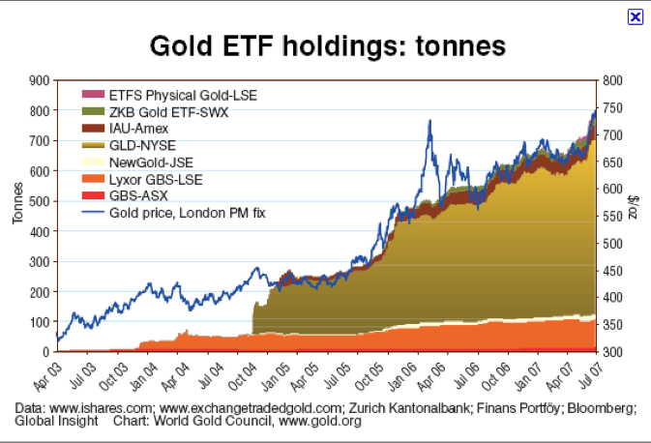
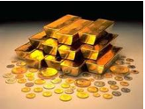
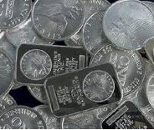
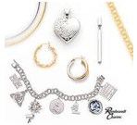
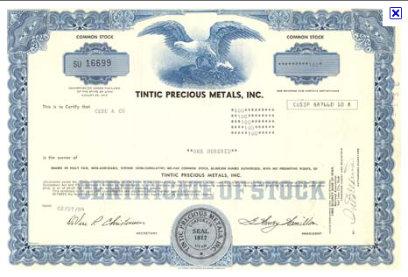
Gold & Silver as Investments
Three Types of Gold & Silver Investments
  Physical Ownership
    Bars, Coins and Jewelry
      These physical items can be held in IRA accounts
  Exchange Traded Fund (ETF) or ETN
  Common stock ownership in Mining or other types of precious metal related companies
    Note: many mining companies do not own the gold they are mining and receive a percentage of revenue from the gold or silver they mine

Slide 15
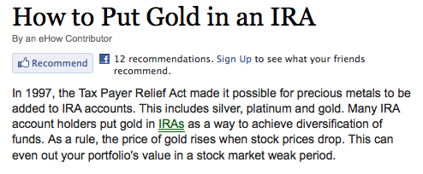
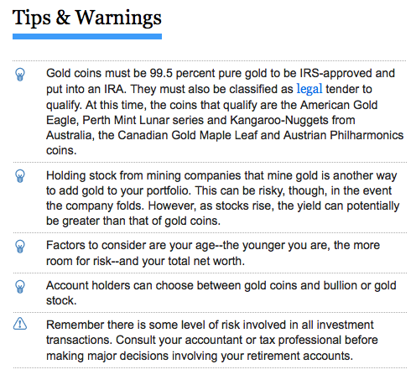
Holding Gold and Silver Coins in Individual Retirement Accounts
You are allowed to acquire and hold gold and silver in your IRA accounts – this includes coins, bullion and stock
Holding American Eagles and Liberty Coins has tax advantages
  Pursuant to IRC §408(m)(3)(A) the coins shall not be treated as "collectible[s]” at the time of distribution.
  The coins are to be distributed at their face-value.

Slide 16
Six Types of Gold ETFs
Gold ETFs That Contain Gold Products
Gold ETFs That Contain Gold Futures
Gold Industry ETFs
Gold ETNs
More Than Gold ETFs
Short Gold ETFs

Slide 17
Suggested Reading
"GOLD CLAUSES” AND “SILVER CLAUSES” IN FINANCIAL TRANSACTIONS
A PRACTICAL STUDY CONCERNING THEIR ORIGIN AND USE
http://www.edwinvieira.com/edwin202.htm
Bernanke’s Secret Debt Solution to the Global Financial Crisis
http://withchrist.org/SecretDebtSolution.pdf
Pieces of Eight
http://www.edwinvieira.com/edwin230.htm

