Slide 1
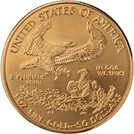
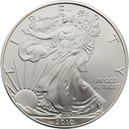
The Lawful Money of The United States

Slide 2
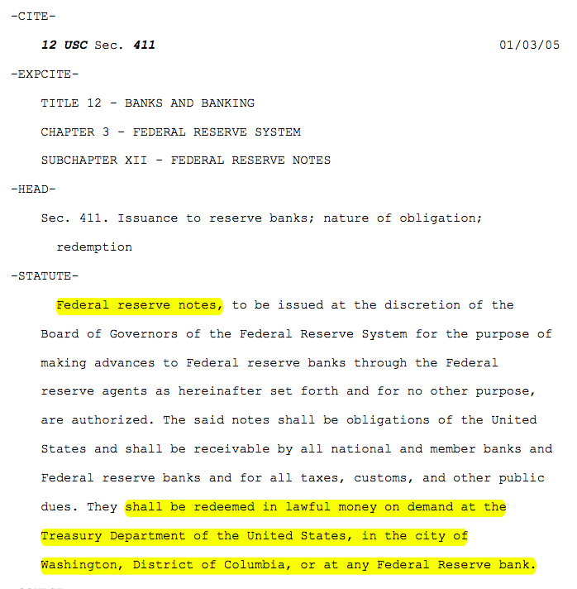
What is lawful money?

Slide 3
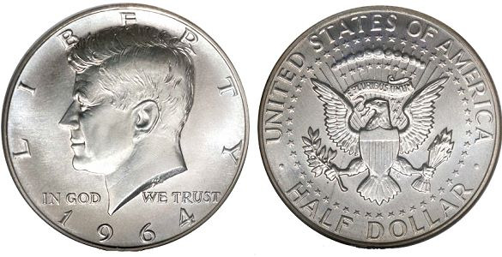
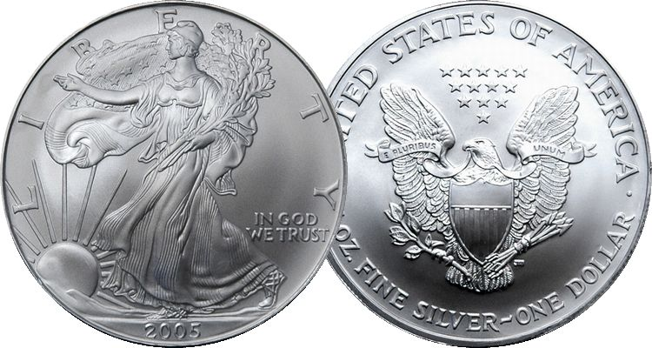

One of these things in not like the others
Congress Declared this to be a Half Dollar of Lawful Money and Legal Tender
Congress Never Declared this to be One Dollar but made it a Legal Tender redeemable for Lawful Money
Congress Declared this to be One Dollar of Lawful Money and Legal Tender
An Examination of the Law will Prove that Federal Reserve Notes are
NOT dollars nor lawful money of the United States

Slide 4

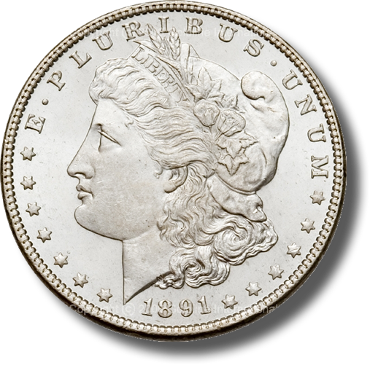

What is One Dollar?
One Dollar is a standard unit of measurement
Money:
371 ¼ grains of Silver minted
= $1.00
Analogous
Time:
24 Hours = 1 Day * 7 = 1 Week
Weight:
16 Ounces = 1 Pound * 2000 = 1 Ton
Length:
1 Inch * 12 = 1 Foot * 3 = 1 Yard
Notes:
The word Dollar is in fact a standard unit of measurement of money; it is analogous to an “hour” for time, an “ounce” for weight, and an “inch” for length.
The Dollar is our Country’s standard unit of measurement for money.
How do you feel when you go to a gas station and pump “15 gallons of gas” into your 12 gallon tank?
Or you went to the lumber yard and purchased an eight foot piece of lumber, and when you got home you discovered that it was actually only 7 ½ feet long?
How would you feel if you went to the grocery store and purchased what you believed were 2 lbs. of bananas, but when you got home you found out that you actually only purchased 1 ¾ of a pound of bananas?
I bet you would feel ripped off.
Now what if I told you that the green Federal Reserve Notes that you have in your pocket, which purports to be of some “dollar” value, are currently worth less than 1/20 the constitutionally guaranteed value in lawful money. I bet you would be really ticked off.
Well folks, be prepared to be very ticked off.

Slide 5
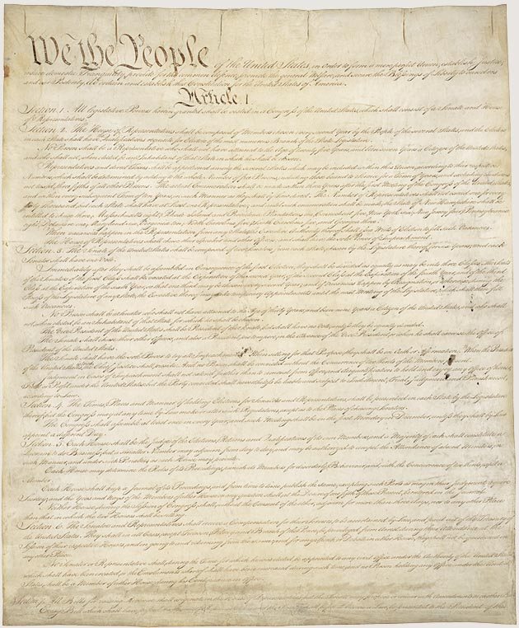
The Dollar of the Constitution
Article I Section 9, Clause 1
  … a Tax or duty may be imposed on such Importation, not exceeding ten dollars for each Person.
Amendment VII
  In Suits at common law, where the value in controversy shall exceed twenty dollars, the right of trial by jury shall be preserved, and no fact tried by a jury, shall be otherwise re-examined in any Court of the United States, than according to the rules of the common law.
Article I Section 8, Clause 5
  [The Congress shall have Power] To coin Money, regulate the Value thereof, and of foreign Coin, and fix the Standard of Weights and Measures;
Article I Section 10, Clause 1
  No State shall … make any Thing but gold and silver coin a Tender in Payments of Debts.
Notes:
It is rather ironic that during the first 124 years of our Republic’s existence (1789 – 1913), it was well understood by the general public that the word “Dollar” means a pure metallic silver coin of a known fixed unit of measurement for money, value and wealth.
Over the next 55 years (1913 – 1968), the definition of the Dollar was slowly removed from public education, dictionaries and our court rooms to the point that in 1968 Congress unconstitutionally eliminated the fundamental and necessary requirement of silver from the “public” definition of the word “Dollar”. Hence our constitutionally guaranteed fixed standard unit of measure of money and wealth was hijacked.
Finally, on 15 August 1971, President Richard Nixon unconstitutionally terminated redemption of Federal Reserve Notes in gold internationally, ending the connection between the Federal Reserve System and any “constitutional” money whatsoever.

Slide 6
Constitutional Units of Measure
Unit of Measure | Times Stated | Existing Definition When Constitution Ratified
Year | 33 | One revolution of the earth around the sun’s axis
Day | 21 | One revolution of the earth around it’s own axis
Hour | 1 | 15 degree rotation of the earth around it’s own axis
Mile | 1 | A unit of linear measure equal to 5,280 feet
Dollar | 2 | A coin containing 371.25 grains of silver
Think about it: Congress can no more declare a year to be ten revolutions of the earth around the sun’s axis (e.g. ~3,650 days per year) as it can to declare a mile to be the circumference of the earth at the equator without a constitutional amendment (an agreement with “We the People”).

Slide 7
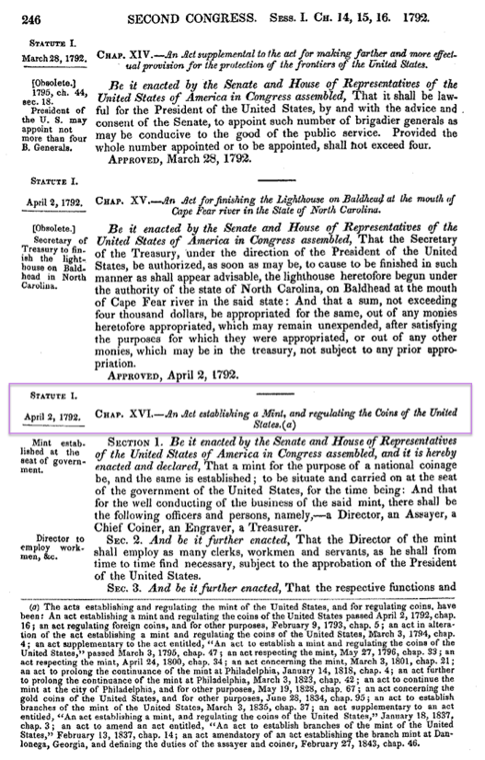
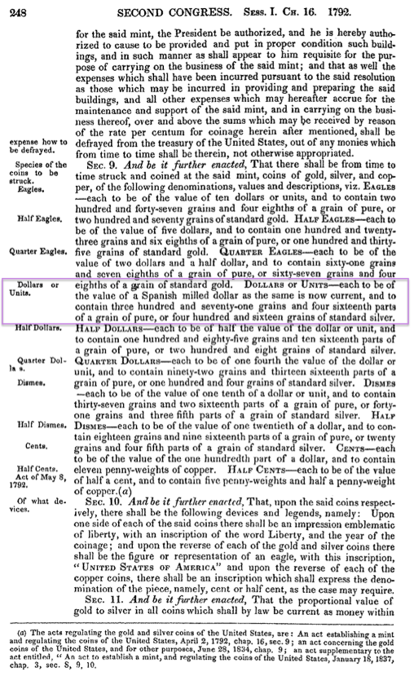


Slide 8
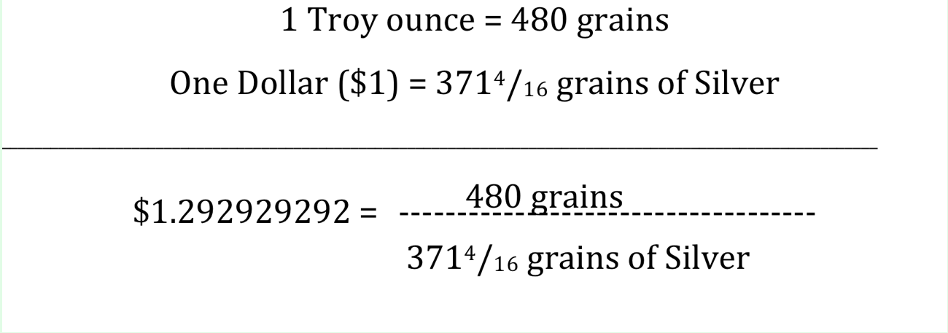
Does the Constitutional Dollar standard exist today?
Yes! How do we know?
The number $1.292929292.
It is derived from the constitutional dollar unit.
Title 31 U.S.C. §5116(b)(2):
The Secretary shall sell silver under conditions the Secretary considers appropriate for at least $1.292929292 a fine troy ounce.
SHORT TITLE OF 2002 AMENDMENT Pub. L. 107-201, Sec. 1, July 23, 2002, 116 Stat. 736, provided that: "This Act [amending section 5116 of this title and enacting provisions set out as notes under sections 5112 and 5116 of this title] may be cited as the 'Support of American Eagle Silver Bullion Program Act'."

Slide 9
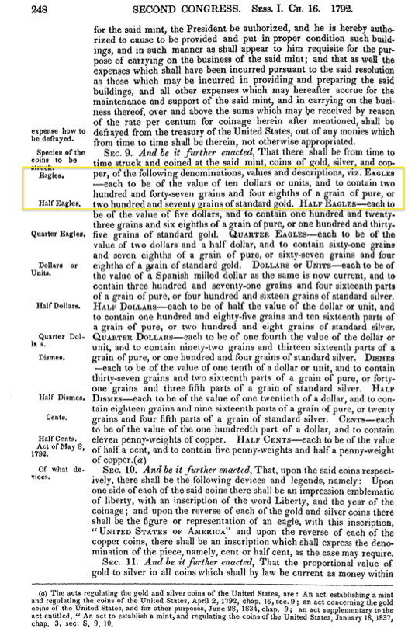
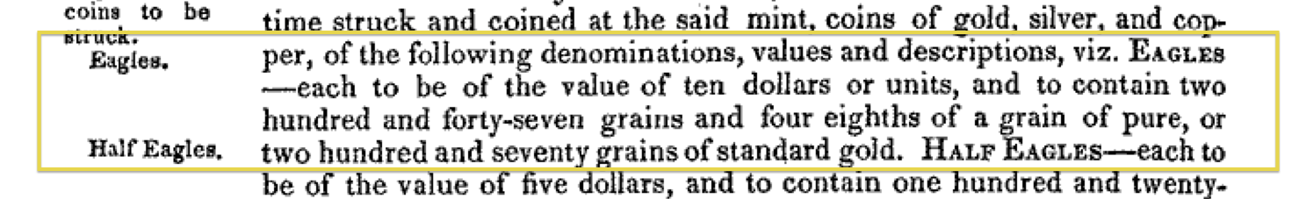
Gold coins are NOT “Dollars”
Gold coins are Eagles whose value
is measured in “dollars” set by Congress under its authority granted at Art. I, Sec.8, Cl. 5 of the U.S. Constitution.

Slide 10
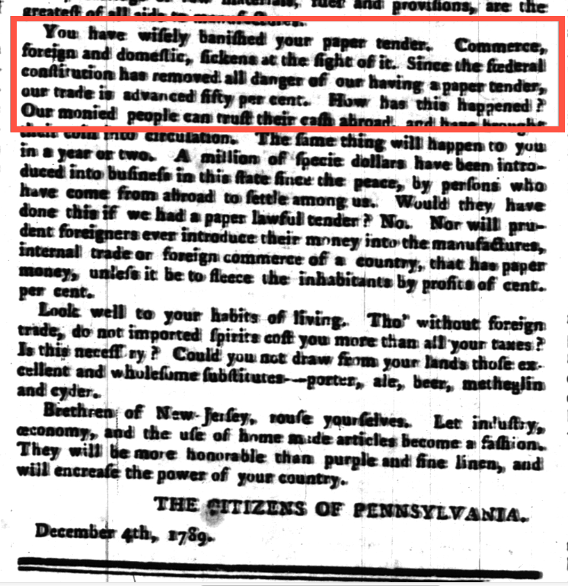
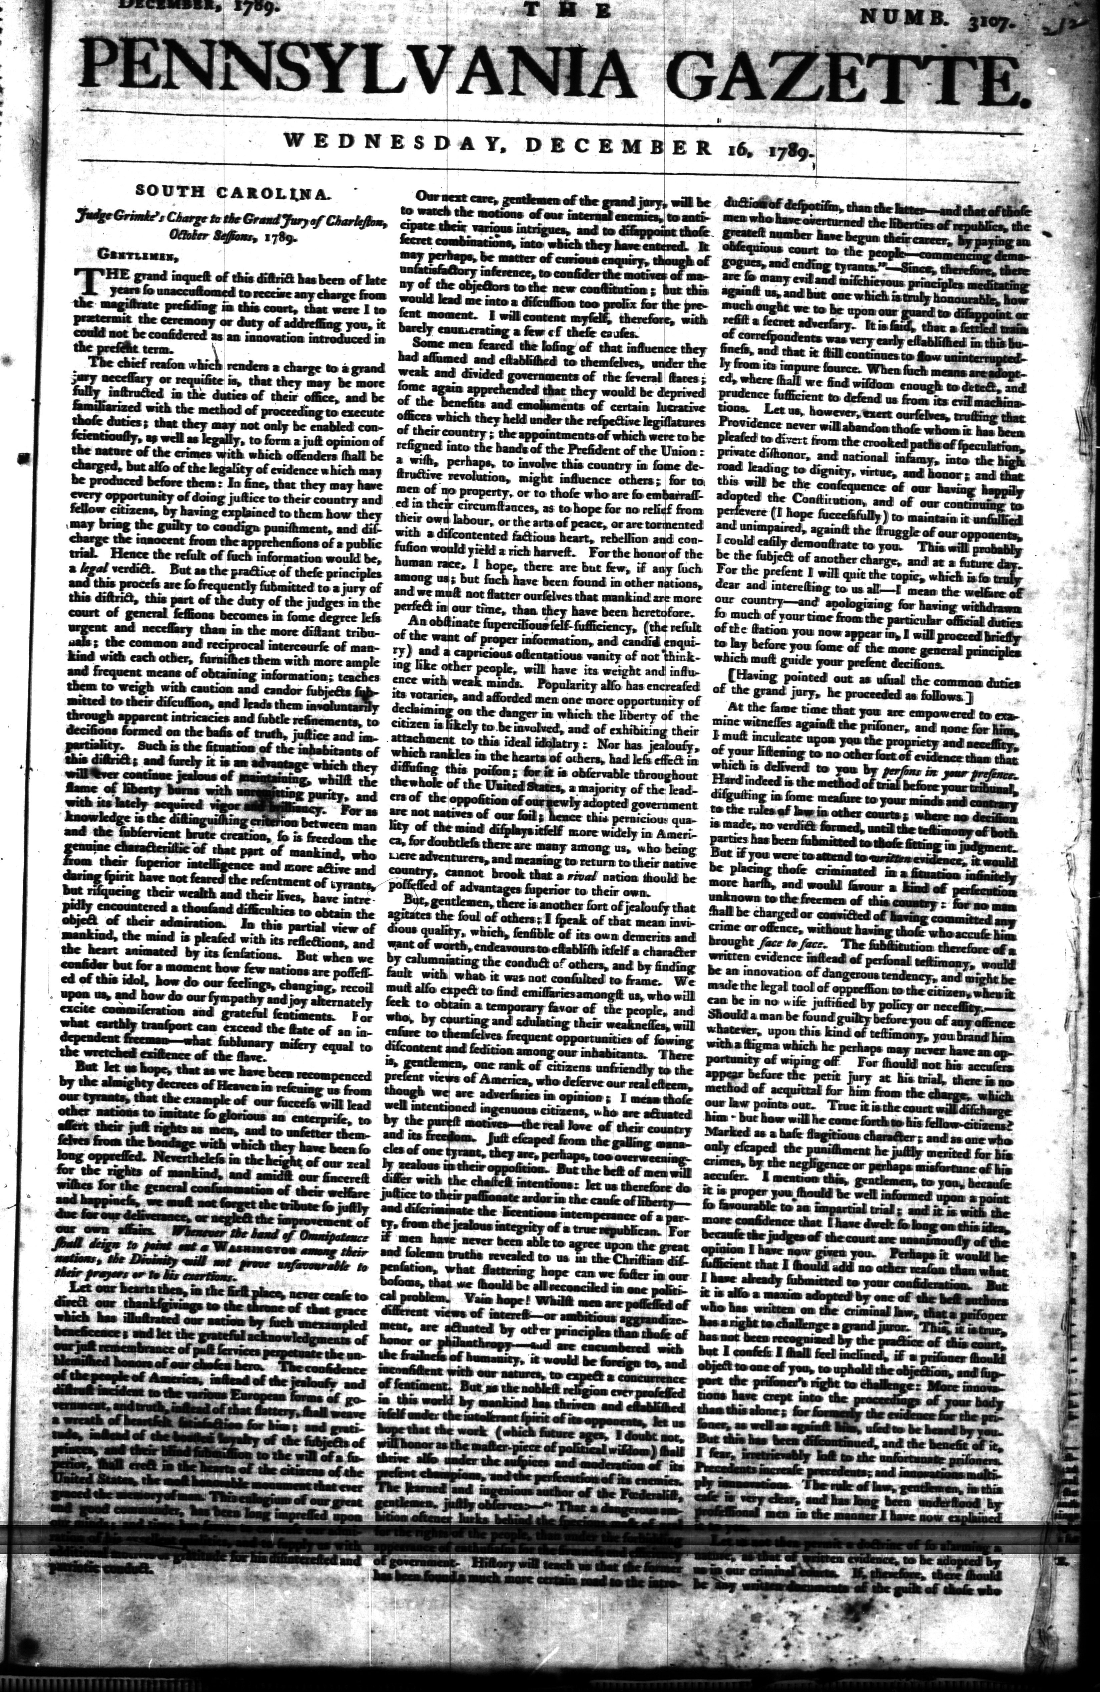
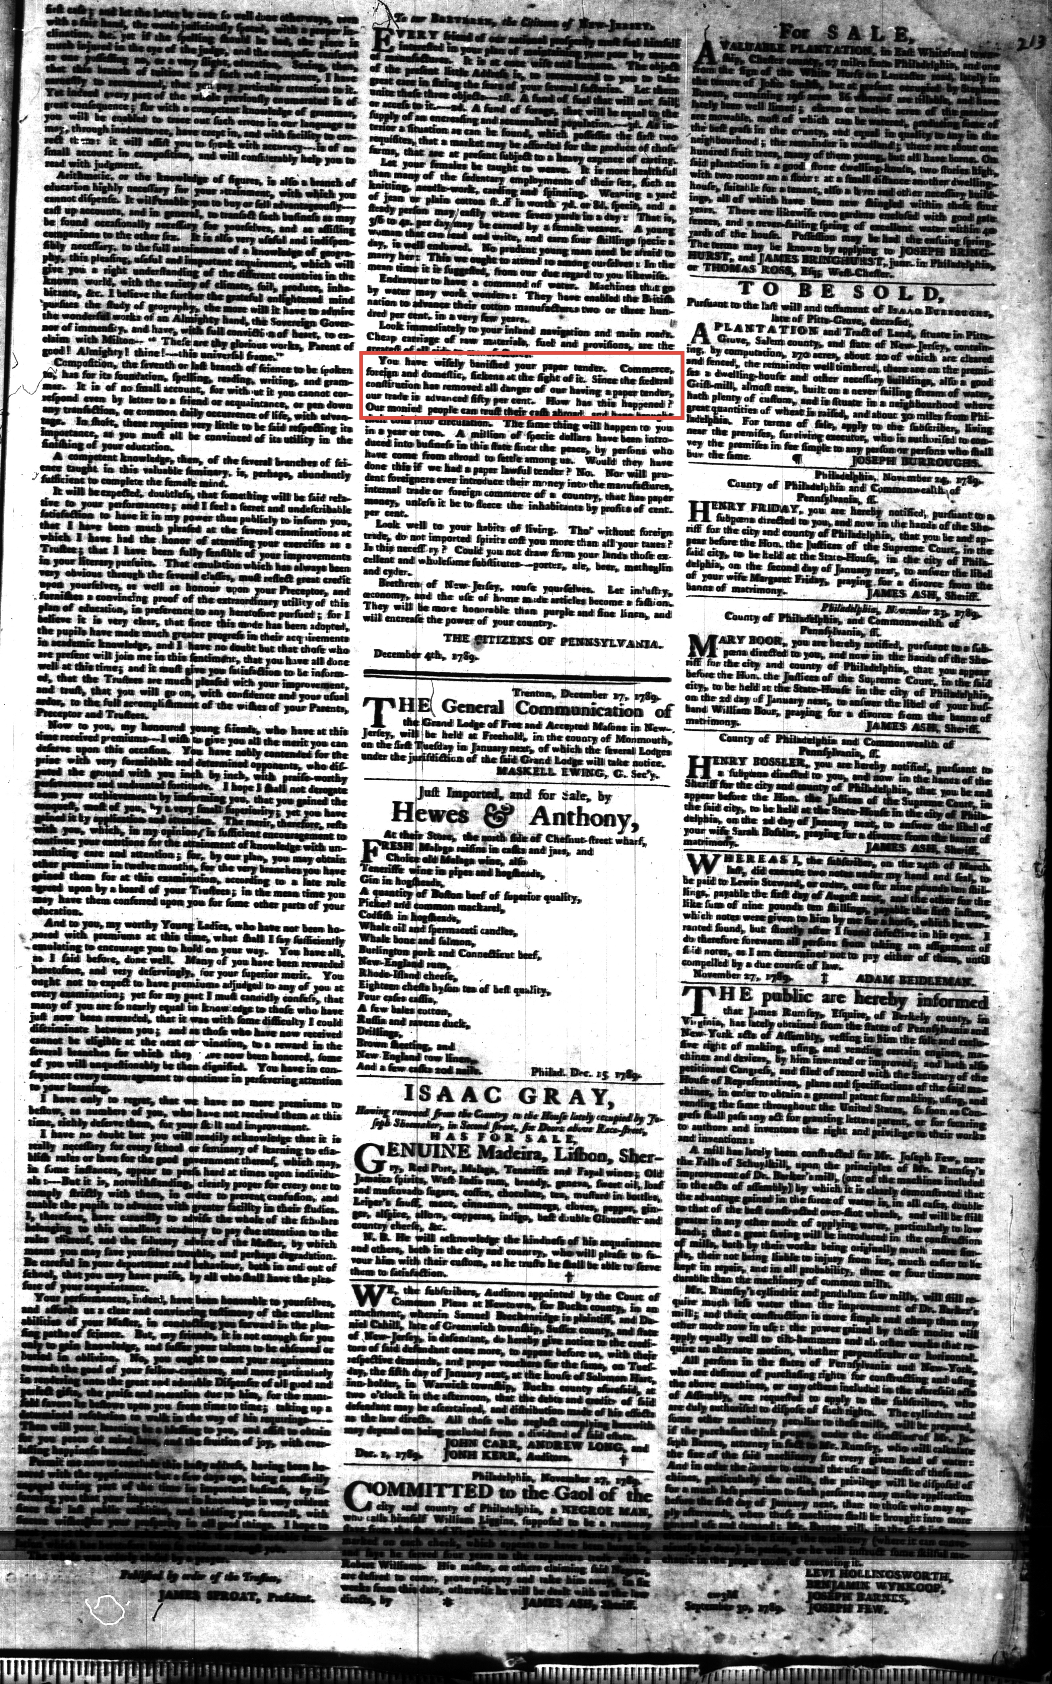
“Since the federal constitution has removed all danger of our having a paper tender …”
You have wisely banished your paper tender. Commerce, foreign and domestic, sickens at the sight of it. Since the federal constitution has removed all danger of our having a paper tender, our trade is advanced fifty per cent. How has this happened? Our monied people can trust their cash abroad and have brought their coin into circulation.

Slide 11
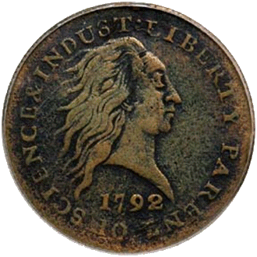
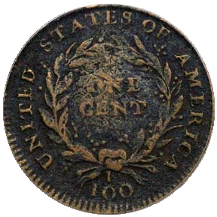
Supreme Court - Coin Money is a Constitutional Requirement
United States v. Marigold, 50 U.S. (9 How.) 560, 567-568 (1850):
  “They [Congress] appertain rather to the execution of an important trust invested by the Constitution, and to the obligation to fulfill that trust on the part of the government, namely, the trust and the duty of creating and maintaining a uniform and pure metallic standard of value throughout the Union. The power of coining money and of regulating its value was delegated to Congress by the Constitution for the very purpose, as assigned by the framers of that instrument, of creating and preserving the uniformity and purity of such standard of value * * *
  "If the medium which the government was authorized to create and establish could immediately be expelled, and substituted by one it had neither created, estimated, nor authorized ­­ one possessing no intrinsic value ­­ then the power conferred by the Constitution would be useless ­­ wholly fruitless of every end it was designed to accomplish. Whatever functions Congress are, by the Constitution, authorized to perform, they are, when the public good requires it, bound to perform; and on this principle, having emitted a circulating medium, a standard of value indispensable for the purposes of the community, and for the action of the government itself, they are accordingly authorized and bound in duty to prevent its debasement and expulsion, and the destruction of the general confidence and convenience …."
Marigold was cited as recently as 2003: International Bancorp Llc v. Societe Des Bains De Mer et Du Cercle Des, 329 F. 3d 359, May 19, 2003 for a slightly different reason but still affirming congressional responsibility to maintain a pure metallic monetary standard;
1792 Penny
Notes:
Let’s take a moment to review the Constitutional lawful money requirements of the United States:
The Supreme Court understood that our Constitution was ratified with the understanding that the legislature was bound in duty to maintain a pure metallic standard of value and to prevent our monetary unit’s debasement and expulsion. Federal Reserve Notes have done just the opposite and have now caused us great harm.
Federal Reserve Notes are UNCONSTITUTIONAL:
They are not a pure metallic standard of value;
They have no intrinsic value;
They are not created by Congress;
They expelled constitutional money from regular use in commerce.
“If the American people ever allow private banks to control the issue of their money, first by inflation and then by deflation, the banks and corporations that will grow up around them will deprive the people of their property until their children will wake up homeless on the continent their fathers conquered.”,
Thomas Jefferson

Slide 12
The U.S. Monetary Laws Today
Title 31 U.S.C. §§ 5112(a)
Title 31 U.S.C. §§ 5112(e)
(7) A fifty dollar gold coin that is 32.7 millimeters in diameter, weighs 33.931 grams, and contains one troy ounce of fine gold.
(8) A twenty-five dollar gold coin that is 27.0 millimeters in diameter, weighs 16.966 grams, and contains one-half troy ounce of fine gold.
(9) A ten dollar gold coin that is 22.0 millimeters in diameter, weighs 8.483 grams, and contains one-fourth troy ounce of fine gold.
(10) A five dollar gold coin that is 16.5 millimeters in diameter, weighs 3.393 grams, and contains one-tenth troy ounce of fine gold.
(e) Notwithstanding any other provision of law, the Secretary shall mint and issue, in quantities sufficient to meet public demand, coins which -
  are 40.6 millimeters in diameter and weigh 31.103 grams;
  contain .999 fine silver;
  have a design -
    symbolic of Liberty on the obverse side; and
    of an eagle on the reverse side;
  have inscriptions of the year of minting or issuance, and the words "Liberty", "In God We Trust", "United States of America", "1 Oz. Fine Silver", "E Pluribus Unum", and "One Dollar"; and
  (5) have reeded edges.

Slide 13
Fact vs. Myth
Fact: All United States Coins and Currency are a legal tender - Title 31 U.S.C §5103 states:
  United States coins and currency (including Federal Reserve notes …) are legal tender for all debts, public charges, taxes, and dues. Foreign gold or silver coins are not legal tender for debts.
Myth: Gold Eagle and Silver Dollar coins have a legal value greater than that shown on their face.
  “A coin dollar is worth no more for the purposes of tender in payment of an ordinary debt than a note dollar. The law has not made the note a standard of value any more than coin. It is true that in the market, as an article of merchandise, one is of greater value than the other; but as money, that is to say, as a medium of exchange, the law knows no difference between them.”
  Thompson v. Butler, 95 U.S. 694, 696 (1878)

Slide 14
Tradition vs. Reality
Tradition: All monetary transactions must be made [or valued] using Federal Reserve Notes.
  http://www.treasury.gov/resource-center/faqs/currency/pages/legal-tender.aspx:
  “There is, however, no Federal statute mandating that a private business, a person or an organization must accept currency or coins as for payment for goods and/or services.”
Reality: Only a gold clause contract can be used to demand payment in a particular coin or currency
Title 31 U.S.C §5118(a) states:
    Gold clauses and consent to sue (a) In this section –
        (1) "gold clause" means a provision in or related to an obligation alleging to give the obligee a right to require payment in:
        gold;
        a particular United States coin or currency; or
        United States money measured in gold or a particular United States coin or currency.

Slide 15
Old Case – New Law
Thompson v. Butler,
95 U.S. 694, 696 (1878)
Title 31 USC §§5119(a) and 5117(b)
A coin dollar is worth no more for the purposes of tender in payment of an ordinary debt than a note dollar. The law has not made the note a standard of value any more than coin. It is true that in the market, as an article of merchandise, one is of greater value than the other; but as money, that is to say, as a medium of exchange, the law knows no difference between them.
§5119 However, the Secretary shall redeem gold certificates owned by the Federal reserve banks at times and in amounts the Secretary decides are necessary to maintain the equal purchasing power of each kind of United States currency
§5117 The Secretary may prescribe the form and denominations of the certificates. The amount of outstanding certificates may be not more than the value (for the purpose of issuing those certificates, of 42 and two-ninths dollars a fine troy ounce) of the gold held against gold certificates.
Thompson v. Butler was recently cited in: Crummey v. Klein Independent School District (Unpublished Opinion, U.S. Ct. App. for the 5th Circuit, No. 08-20133, 2 October 2008). However there was no mention by the Petitioner, Crummey, of the Secretary’s duty to maintain the equal purchasing of each kind of United States Currency. Nor was there any mention of the responsibility of the Secretary to maintain gold bullion at 42 and two-ninths dollars a fine troy ounce, which with minting, assaying and distribution costs is equal to the 50 dollar coin defined at Title 31 U.S.C. §5112(a)(7).
Notes:
31 USC Sec. 5119 (a): Except to the extent authorized in regulations the Secretary of the Treasury prescribes with the approval of the President, the Secretary may not redeem United States currency (including Federal reserve notes and circulating notes of Federal reserve banks and national banks) in gold. However, the Secretary shall redeem gold certificates owned by the Federal reserve banks at times and in amounts the Secretary decides are necessary to maintain the equal purchasing power of each kind of United States currency. …
The Supreme Court in Thompson v. Butler, 95 U.S. 694 (1878) stated:
A coin dollar is worth no more for the purposes of tender in payment of an ordinary debt than a note dollar. The law has not made the note a standard of value any more than coin. It is true that in the market, as an article of merchandise, one is of greater value than the other; but as money, that is to say, as a medium of exchange, the law knows no difference between them.
However, this decision was rendered prior to the creation of the Federal Reserve System and the enactment of 31 USC 5119(a).

Slide 16
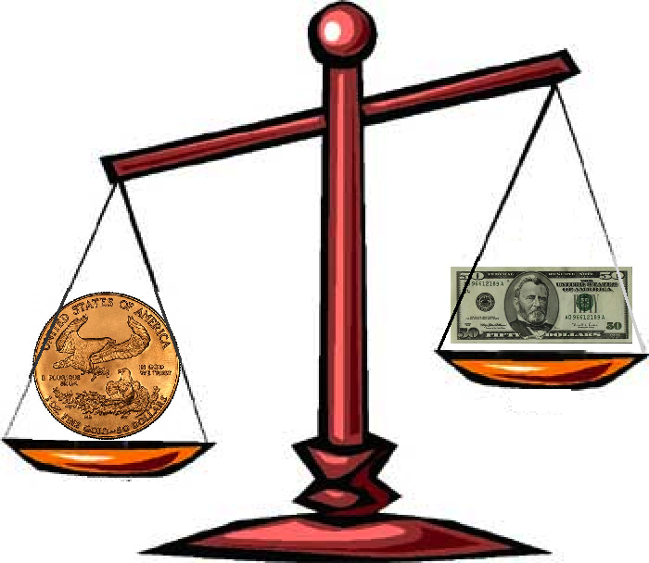
Secretary of Treasury’s has failed in his duty under Title 31 U.S.C. §5119(a)
Title 31 U.S.C §5119(a):
… [T]he Secretary shall redeem gold certificates owned by the Federal reserve banks at times and in amounts the Secretary decides are necessary to maintain the equal purchasing power of each kind of United States currency.
The legal tender $50 dollar gold coin has
significantly more purchasing power than
the $50 Federal Reserve Note.
Notes:
The Secretary of the United States Treasury has broken the law and failed in his duty to maintain the equal purchasing power of each kind of United States currency as required by law pursuant to Title 31 U.S.C. Sec. 5119(a).

Slide 17
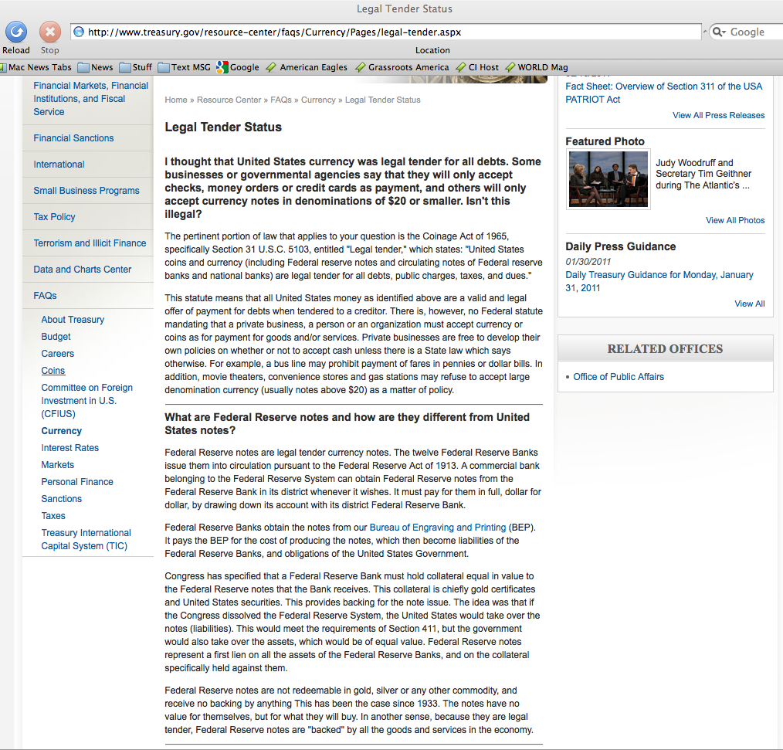
There is, however, no Federal statute mandating that a private business, a person or an organization must accept currency or coins as for payment for goods and/or services. This means you get to choose the currency you use and accept.
Congress has specified that a Federal Reserve Bank must hold collateral equal in value to the Federal Reserve notes that the Bank receives. This collateral is chiefly gold certificates and United States securities. This provides backing for the note issue. The idea was that if the Congress dissolved the Federal Reserve System, the United States would take over the notes (liabilities). This would meet the requirements of Section 411, but the government would also take over the assets, which would be of equal value. Federal Reserve notes represent a first lien on all the assets of the Federal Reserve Banks, and on the collateral specifically held against them.
Notes:
“The Federal Reserve Bank is no more ‘Federal’ than Federal Express”,
G. Edward Griffin (Author)
Federal Reserve Banks are quasi-private banks that are part of the Federal Reserve System. (http://www.stlouisfed.org/news/speeches/2006/03_30_06.htm)
What are Federal Reserve bank notes?
Federal Reserve bank notes are promissory notes issued by the Federal Reserve Banks.
The Federal Reserve bank notes, by law – Title 12 U.S.C. 411, are [supposed to be] redeemable for lawful money on demand, which Constitutionally speaking are minted coins containing 371 ¼ grains of pure silver or its gold equivalent as regulated by Congress pursuant to Article I Section 8, Clause 5.
The United States Supreme Court stated – United States v. Marigold – a still valid opinion:
“[Congress has the] obligation to fulfill that trust on the part of the government, namely, the trust and the duty of creating and maintaining a uniform and pure metallic standard of value throughout the Union. The power of coining money and of regulating its value was delegated to Congress by the Constitution for the very purpose, as assigned by the framers of that instrument, of creating and preserving the uniformity and purity of such standard of value … If the medium which the government was authorized to create and establish could immediately be expelled, and substituted by one it had neither created, estimated, nor authorized ­­ one possessing no intrinsic value ­­ then the power conferred by the Constitution would be useless ­­ wholly fruitless of every end it was designed to accomplish. …” United States v. Marigold, 50 U.S. (9 How.) 560, 567-68 (1850)
Federal Reserve Notes are UNCONSTITUTIONAL:
They are not a pure metallic standard of value;
They have no intrinsic value;
They are not created by Congress;
They expelled constitutional money from regular use in commerce.

Slide 18
Right to use Gold or Silver Coin
The Constitution guarantees Citizens the right to use Gold and Silver as
  Money,
  Repayment of debts and
  Security in Gold Clause Contracts
It wasn’t until Oct. 27, 1977 that Americans were statutorily allowed, once again to engage in Gold clause contracts (see Title 31 USC 5118(d)(2)) since Roosevelt and Congress banned them first by Exec Order 6102 signed April 5, 1933 and then by Statute, under the Gold Reserve Act of January 30, 1934.
This right to use Gold is Silver Coin is why the Sec. of Treasury had to admit on his web site that a private business, a person or an organization can use any U.S. currency or coins as for payment for goods and/or services.
31 U.S.C Sec. 5118
Gold clauses and consent to sue
  (a) In this section –
    (1) "gold clause" means a provision in or related to an obligation alleging to give the obligee a right to require payment in:
    gold;
    a particular United States coin or currency; or
    United States money measured in gold or a particular United States coin or currency.
(d) (1) In this subsection, "obligation" means any obligation (except United States currency) payable in United States money.
(2) An obligation issued containing a gold clause or governed by a gold clause is discharged on payment (dollar for dollar) in United States coin or currency that is legal tender at the time of payment. This paragraph does not apply to an obligation issued after October 27, 1977.

Slide 19
What we’ve learned thus far?
Lawful Money
  Constitutionally authorized gold and silver coin
  Currently minted coins are authorized at Title 31 U.S.C §5112
Legal Tender
  a medium of payment allowed by law to be valid for meeting a financial obligation.
  See Title 31 U.S.C §5103
One ($1) Dollar
  A minted silver coin containing at least 371¼ gains of fine (pure) silver. (Note 1 troy ounce = 480 grains)
Gold or Silver Clause Contract
  A contract for payment in gold or silver coin.
  Authorized by law at Title 31 U.S.C §5118

Slide 20
Facts about Fiat Currency
No currency in history has lasted longer than 42 years after its intrinsic backing has been abandoned. John Tamny, 9/9/2010¹
  Nearly 42 years ago (8/15/1971) President Nixon severed the Federal Reserve Note’s link to gold.
The Continental was America’s first fiat currency and it only lasted 6 years.
The graduated income tax system has allowed modern fiat currencies, such as the Federal Reserve Note, to last ~40+ years
1: http://www.forbes.com/2010/09/07/dollar-currency-gold-standard-2020-opinions-columnists-john-tamny.html

Slide 21
The Legislature Knows The Truth
From the Report of the Commission, established pursuant to Public Law 96-389
  “In addition to the compelling economic case for the gold standard, a case buttressed by both historical and theoretical arguments, there is a compelling argument based upon the Constitution. The present monetary arrangements of the United States are unconstitutional --even anti-constitutional-- from top to bottom.” (vol II, pg. 243)
Notes:
On March 31, 1982, Donald T. Regan, the then Secretary of Treasury, delivered the Report from the Commission established pursuant to Public Law 96-389 to the Legislature informing them that the present monetary arrangements [i.e. the Federal Reserve Banking System] of the United States are unconstitutional --even anti-constitutional-- from top to bottom.

Slide 22
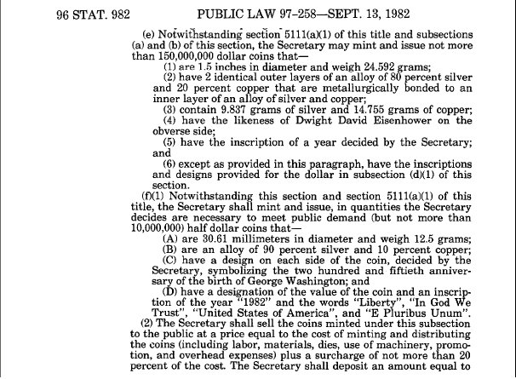
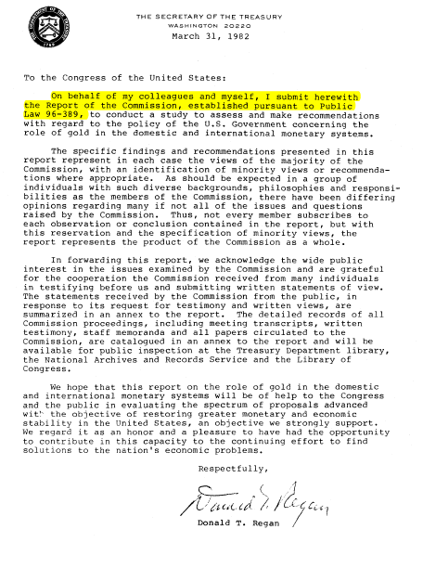
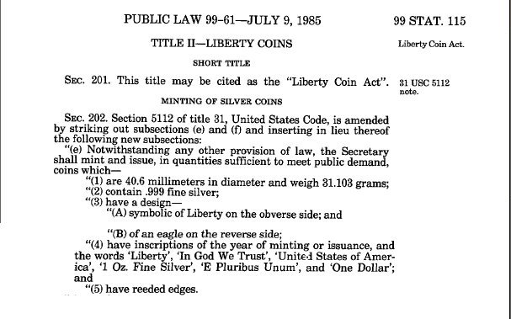
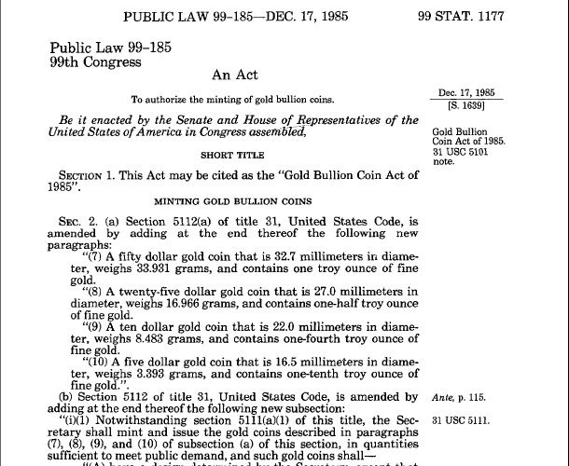
The Legislature Reinstituted Monetary Law
Within 6 Months of the Gold Commission Report, the Legislature reinstitutes lawful Silver Dollar money followed by Gold money in 1985.
Notes:
In less than 6 months after Donald T. Regan delivered the Report from the Commission, Congress enacted its first law, Public Law 97-258 on September 13, 1982 restoring the semblance of constitutionally lawful money. Then in 1985, Congress enacted Public Laws 99-61 and 99-185 that reinstituted constitutionally lawful gold and silver money.

Slide 23


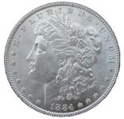
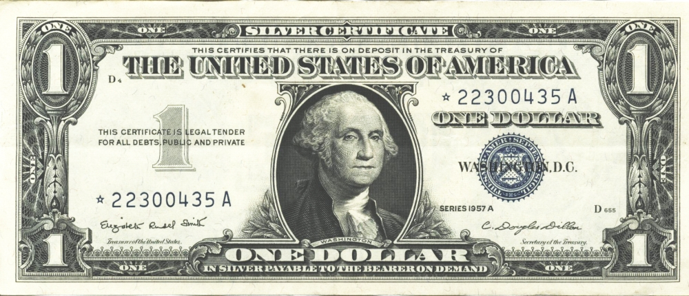

What is the effect of using unconstitutional legal tender?
Property
=
# Egg Cartons
(Brown Eggs)
=
# Lawful Money ($)
# Legal Tender $
1957
=
=
=
U.S. Silver Certificate
1,600 Sq. Ft. Home
~37,700
($)13,500
$13,500
=
No Lawful
Money Available
1982
Fed. Res. Bank Note
1,600 Sq. Ft. Home
~37,700
“$85,400”
2007
=
=
=
Fed. Res. Bank Note
1,600 Sq. Ft. Home
~37,700
($)13,500
“$175,000”
Notes:
So now lets look at the effects of using unconstitutional legal tender Federal Reserve Notes.
Because Federal Reserve Notes have no value in or of themselves and no intrinsic value, they can be inflated in such a manner to make you believe that you made a gain or an accession to wealth, when in fact you had no such gain at all.
Because Federal Reserve Notes have no set fixed value, they can be used to “quietly” steal your wealth with the perception that you had a gain.
Because Federal Reserve Notes have no known or calculable value, they can be used to deceive the citizens into believing they will receive future benefits, such as social security, at today’s purchasing power.

Slide 24
Quiet Theft!
Property
=
# Egg Cartons
(Brown Eggs)
=
# Lawful Money ($)
# Legal Tender $
Buy
1957
=
=
=
U.S. Silver Certificate
1,600 Sq. Ft. Home
~37,700
($)13,500
$13,500
Sell
2007
=
=
=
Fed. Res. Bank Note
1,600 Sq. Ft. Home
~37,700
($)13,500
$175,000
No Cartons of Eggs Gain
No Lawful Money Gain
Federal Reserve Note
“Gain” of $161,500
No Gain No Tax Due
No Gain No Tax Due
Alleged Tax Due
~FRN$55,000
After FRN Tax results in a
Physical Egg Carton Loss of
11,922 Cartons of Eggs
After FRN Tax results in a
Lawful Money Property
Loss of ($)4,269
The purported Federal Reserve Note “Gain” is actually a “quiet theft” in that
it results in a physical property loss with the perception of an actual gain.
Notes:
So now let’s look at an example.
What are the effects of using unconstitutional legal tender notes?
An unrealized loss of capital and property;
A loss of real value;
The loss of the full economic impact of automation.
Brown Egg Data:
EGG ECONOMICS UPDATE reports by Donald Bell, Poultry Specialist (emeritus), University of California , Riverside, CA 92521
http://www.ams.usda.gov/poultry/mncs/ShellEgg/USDAEGGMARKETNEWSREPORT.html
http://www.pathtoinvesting.org/interactive/inflation/simulation_inflation.htm

Slide 25
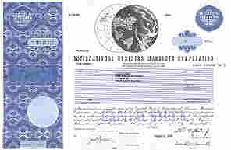
What is the effect of using unconstitutional legal tender?
Stock
=
# Egg Cartons
(Brown Eggs)
=
# Lawful Money $
# Legal Tender $
1962
=
=
=
U.S. Silver Certificate
4 Shares IBM Stock
$1,942.00
$1,942.00
~5,424
=
No Lawful
Money Available
1982
Fed. Res. Bank Note
75 Shares IBM Stock after splits
~4,266
“$4,884”
2007
=
=
=
Fed. Res. Bank Note
300 Shares IBM Stock after splits
~6,571
$2,338.56
“$30,501.00”
IBM Stock Splits: 1964-05-18 [5:4], 1966-05-18 [3:2], 1968-04-23 [2:1], May 29, 1973 [5:4], Jun 1, 1979 [4:1], May 28, 1997 [2:1], May 27, 1999 [2:1]
Notes:
So now lets look at the effects of using unconstitutional legal tender Federal Reserve Notes.
Because Federal Reserve Notes have no value in or of themselves and no intrinsic value, they can be inflated in such a manner to make you believe that you made a gain or an accession to wealth, when in fact you had no such gain at all.
Because Federal Reserve Notes have no set fixed value, they can be used to “quietly” steal your wealth with the perception that you had a gain.
Because Federal Reserve Notes have no known or calculable value, they can be used to deceive the citizens into believing they will receive future benefits, such as social security, at today’s purchasing power.

Slide 26
Quiet Theft!
Stock
=
# Egg Cartons
(Brown Eggs)
=
# Lawful Money $
# Legal Tender $
Buy
1962
=
=
=
U.S. Silver Certificate
IBM Stock
~5,424
$1,942.00
$1,942.00
Sell
2007
=
=
=
Fed. Res. Bank Note
IBM Stock
~6,571
$2,338.56
“$30,501.00”
17% Gain in Eggs Cartons
17% Lawful Money Gain
Federal Reserve Note
“94% Gain” of $28,559
Tax Due ~172 Egg Cartons
Tax Due $59.48
Alleged Tax Due (15%)
~FRN$4283.85
After FRN Tax results in a
Physical Egg Carton Loss of
923 Cartons of Eggs
FRN Inflation results in a
83% tax rate or $328.45 of the
$396.56 of the purported gain
The purported Federal Reserve Note “Gain” is actually a “quiet theft” in that
it results in an 83% tax rate with the perception of 15% tax rate.
Notes:
So now let’s look at an example.
What are the effects of using unconstitutional legal tender notes?
An unrealized loss of capital and property;
A loss of real value;
The loss of the full economic impact of automation.
Brown Egg Data:
EGG ECONOMICS UPDATE reports by Donald Bell, Poultry Specialist (emeritus), University of California , Riverside, CA 92521
http://www.ams.usda.gov/poultry/mncs/ShellEgg/USDAEGGMARKETNEWSREPORT.html
http://www.pathtoinvesting.org/interactive/inflation/simulation_inflation.htm

Slide 27
Thomas Paine
"The laws of a country ought to be the standard of equity and calculated to impress on the minds of the people the moral as well as the legal obligations of political justice. But tender laws, of any kind, operate to destroy morality, and to dissolve by the pretense of law what ought to be the principle of law to support, reciprocal justice between man and man; and the punishment of a member who should move for such a law ought to be DEATH."

Slide 28
We have a Constitutional Crisis
Article I Section 10, Clause 1
No State shall make any Thing but gold and silver Coin a Tender in Payment of Debts
  What does Texas declare is legal tender?
  Does Texas enforce payments of taxes, fines and other debts in anything other than gold in silver coin?
Since the federal constitution has removed all danger of our having a paper tender, our trade advanced fifty percent. Our monied people can trust their cash [throughout the country], and have brought their coin into circulation.
Benjamin Franklin, Publisher and Signer of the Constitution of the United States The Pennsylvania Gazette, December 16, 1789.
Notes:
Quote from Penn Gazette pg 4. middle column, Dec. 16, 1789.

Slide 29
History shows us the solution!
1786 – Paper Money
(Articles of Confederation period)
Blood running in the streets. Mobs of rioters and demonstrators threatening banks and legislators. Looting of shop and home. Credit ruined. Strikes and unemployment. Trade and distribution paralyzed. Shortages of food. Bankruptcies everywhere. Court dockets overloaded. Kidnappings for heavy ransom. Sexual perversion, drunkenness, lawlessness rampant.
America, 1786: George Washington to James Madison
1791 – Coin Money
(Constitutional Law reigns)
Tranquility reigns among the people with that disposition towards the general government which is likely to preserve it. Our public credit [with its foundation on solid money] stands on high ground which three years ago it would have been considered as a species of madness to have foretold.
July 20, 1791, George Washington to David Humphreys
“If anyone had predicted that our economic and social ills could have been solved by simply making nothing but gold and silver coin our money, he would have been call crazy” paraphrase George Washington taken from MOMS 7th Edition pg. 60

Slide 30
What should we do?
Don’t Panic!
  Lawful money (silver and gold) coins exist. Start using them!
  Viable economic transition models exist (i.e. the Euro).
Implement a dual monetary system
  Price goods and services throughout the state in both Federal Reserve note (FRN)$ and Lawful Money $.
  Use the European model to transition all prices, taxes, fines and other debts to Lawful Money $ units over 24 – 36 months.
Implement Lawful Money State Banks
  All deposits and interest are paid in Lawful Money silver or gold coin.
Notes:
This legislative body should give serious consideration to passing legislation that would require all financial transactions within 36 month from the date of enactment to be made in constitutional lawful money of the United States (American Eagle coins) or in sound monetary units of silver, gold, gold and silver coin, or electronic gold currency.
Further, for the period between the 90th day after enactment to the end of the 36th month all financial transactions shall be indicated in both Federal Reserve Note units as well as the chosen sound money unit.
Furthermore all financial transactions between the state and other persons involving certain taxes, fees, and charges on cigarettes and tobacco products be conducted in the chosen sound money unit; requiring the state treasurer to adopt rules for the administration of payment by and receipt by the state and political subdivisions in gold, gold and silver coin, or electronic gold currency.
This can be done and done successfully! Look at Europe; it went from 16 independent currencies to one currency in 36 months by implementing a dual pricing system to facilitate a smooth transition to the new monetary unit over a 36 month period.

Slide 31
What else can be done?
Use specific Lawful Money language in all sales and licensing contracts to avoid the conflicts created by new laws and old opinions.
Pay appropriate taxes in Federal Reserve notes and let the Secretary of Treasury worry about redeeming them at face value.
Press both Federal and State Legislators to pass statutes ensuring the the rights of all persons to receive all forms of United States coin and currency and to exchange some forms thereof for others without discrimination or burden...

Slide 32
Conclusion
Start using lawful money [Gold and Silver Clause] contracts when buying, selling or licensing property.
Minimize tax liabilities by using lawful money as the basis in all transactions
Minimize intrinsic value loss by using Federal Reserve note to pay all taxes, duties and imposts.
Write your State and Federal Representatives and send them copies of the Monetary Unit Protection Act and ask them to enact them.

Slide 33
For more information
Presentations and Other Resources
  http://www.npn.net
Videos
  http://www.youtube.com/watch?v=r0mOTJR_1Lo
  http://www.heritageresearchinstitute.org/PurseSwordPage.htm
Articles
  http://www.EdwinVieira.com/
  http://www.devvy.com/
  http://www.newswithviews.com/
US Law
  http://uscode.house.gov
Organizations:
  http://www.usbor.org
  http://www.andrewjacksonsociety.org
  http://www.gawtp.com/
  http://www.committeesofsafety.org/

Slide 34
Final Thoughts
The current financial crisis is the inevitable result of the current fiat monetary system.
Only a constitutionally sound monetary system can protect the States and its citizens from the devastating effects of a fiat currency.
It’s time for the State legislatures to take action and implement sound money legislation to protect her citizens from the unconscionable effects of the private fiat banking system.

Slide 35
Suggested Reading
"GOLD CLAUSES” AND “SILVER CLAUSES” IN FINANCIAL TRANSACTIONS
A PRACTICAL STUDY CONCERNING THEIR ORIGIN AND USE
http://www.edwinvieira.com/edwin202.htm
Bernanke’s Secret Debt Solution to the Global Financial Crisis
http://withchrist.org/SecretDebtSolution.pdf
Pieces of Eight
http://www.edwinvieira.com/edwin230.htm

Slide 36
The End

Slide 37
Tradition vs. Reality
Tradition: All monetary transactions must be reconciled at Federal Reserve Note face values.
  http://www.treasury.gov/resource-center/faqs/currency/pages/legal-tender.aspx:
  “There is, however, no Federal statute mandating that a private business, a person or an organization must accept currency or coins as for payment for goods and/or services.”
Reality: Only a gold clause contract can be used to demand payment is a particular coin or currency
Title 31 U.S.C §5118(a) states:
    Gold clauses and consent to sue (a) In this section –
        (1) "gold clause" means a provision in or related to an obligation alleging to give the obligee a right to require payment in:
        gold;
        a particular United States coin or currency; or
        United States money measured in gold or a particular United States coin or currency.

