Slide 1
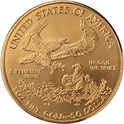
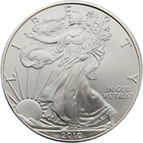
The Lawful Money of The United States

Slide 2
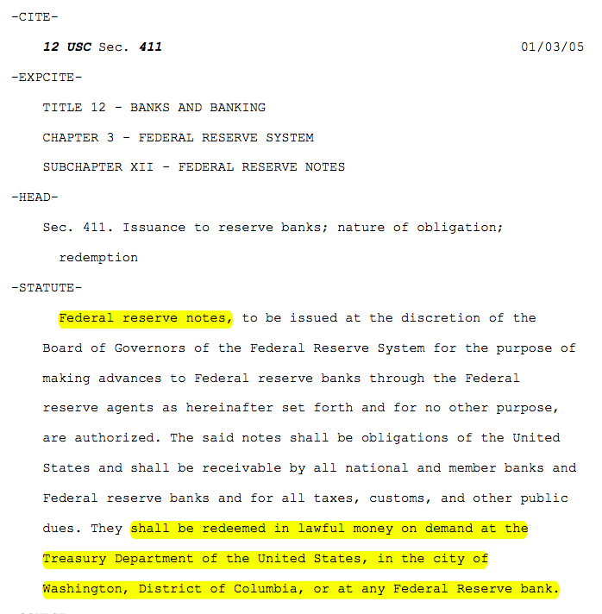
What is lawful money?

Slide 3
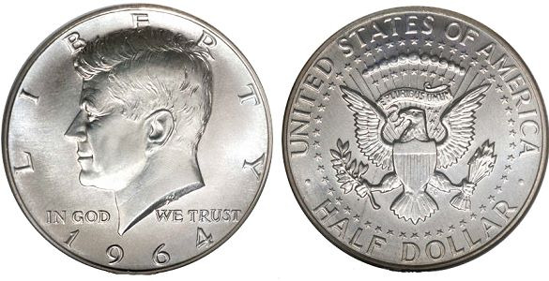
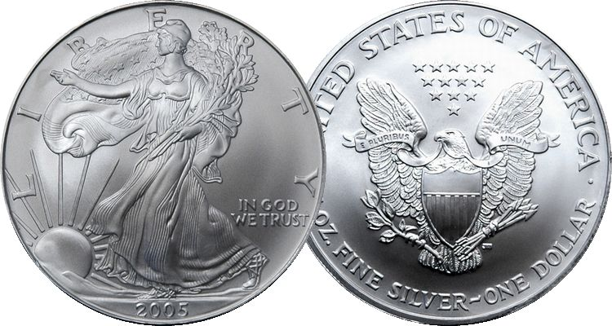

One of these things in not like the others
Congress Declared this to be a Half Dollar of Lawful Money and Legal Tender
Congress Never Declared this to be One Dollar but made it a Legal Tender redeemable for Lawful Money
Congress Declared this to be One Dollar of Lawful Money and Legal Tender
An Examination of the Law will Prove that Federal Reserve Notes are
NOT dollars nor lawful money of the United States

Slide 4

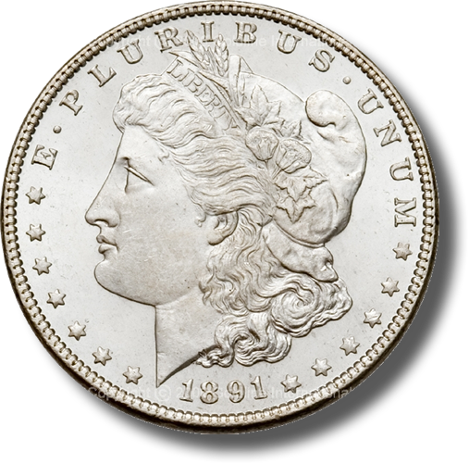

What is One Dollar?
One Dollar is a standard unit of measurement
Money:
371 ¼ grains of Silver minted
= $1.00
Analogous
Time:
24 Hours = 1 Day * 7 = 1 Week
Weight:
16 Ounces = 1 Pound * 2000 = 1 Ton
Length:
1 Inch * 12 = 1 Foot * 3 = 1 Yard
Notes:
The word Dollar is in fact a standard unit of measurement of money; it is analogous to an “hour” for time, an “ounce” for weight, and an “inch” for length.
The Dollar is our Country’s standard unit of measurement for money.
How do you feel when you go to a gas station and pump “15 gallons of gas” into your 12 gallon tank?
Or you went to the lumber yard and purchased an eight foot piece of lumber, and when you got home you discovered that it was actually only 7 ½ feet long?
How would you feel if you went to the grocery store and purchased what you believed were 2 lbs. of bananas, but when you got home you found out that you actually only purchased 1 ¾ of a pound of bananas?
I bet you would feel ripped off.
Now what if I told you that the green Federal Reserve Notes that you have in your pocket, which purports to be of some “dollar” value, are currently worth less than 1/20 the constitutionally guaranteed value in lawful money. I bet you would be really ticked off.
Well folks, be prepared to be very ticked off.

Slide 5
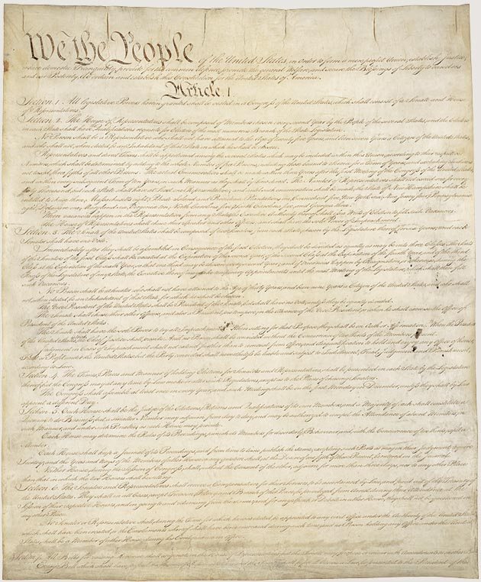
The Dollar of the Constitution
Article I Section 9, Clause 1
  … a Tax or duty may be imposed on such Importation, not exceeding ten dollars for each Person.
Amendment VII
  In Suits at common law, where the value in controversy shall exceed twenty dollars, the right of trial by jury shall be preserved, and no fact tried by a jury, shall be otherwise re-examined in any Court of the United States, than according to the rules of the common law.
Article I Section 8, Clause 5
  [The Congress shall have Power] To coin Money, regulate the Value thereof, and of foreign Coin, and fix the Standard of Weights and Measures;
Article I Section 10, Clause 1
  No State shall … make any Thing but gold and silver coin a Tender in Payments of Debts.
Notes:
It is rather ironic that during the first 124 years of our Republic’s existence (1789 – 1913), it was well understood by the general public that the word “Dollar” means a pure metallic silver coin of a known fixed unit of measurement for money, value and wealth.
Over the next 55 years (1913 – 1968), the definition of the Dollar was slowly removed from public education, dictionaries and our court rooms to the point that in 1968 Congress unconstitutionally eliminated the fundamental and necessary requirement of silver from the “public” definition of the word “Dollar”. Hence our constitutionally guaranteed fixed standard unit of measure of money and wealth was hijacked.
Finally, on 15 August 1971, President Richard Nixon unconstitutionally terminated redemption of Federal Reserve Notes in gold internationally, ending the connection between the Federal Reserve System and any “constitutional” money whatsoever.

Slide 6
Constitutional Units of Measure
Unit of Measure | Times Stated | Existing Definition When Constitution Ratified
Year | 33 | One revolution of the earth around the sun’s axis
Day | 21 | One revolution of the earth around it’s own axis
Hour | 1 | 15 degree rotation of the earth around it’s own axis
Mile | 1 | A unit of linear measure equal to 5,280 feet
Dollar | 2 | A coin containing 371.25 grains of silver
Think about it: Congress can no more declare a year to be ten revolutions of the earth around the sun’s axis (e.g. ~3,650 days per year) as it can to declare a mile to be the circumference of the earth at the equator without a constitutional amendment (an agreement with “We the People”).

Slide 7
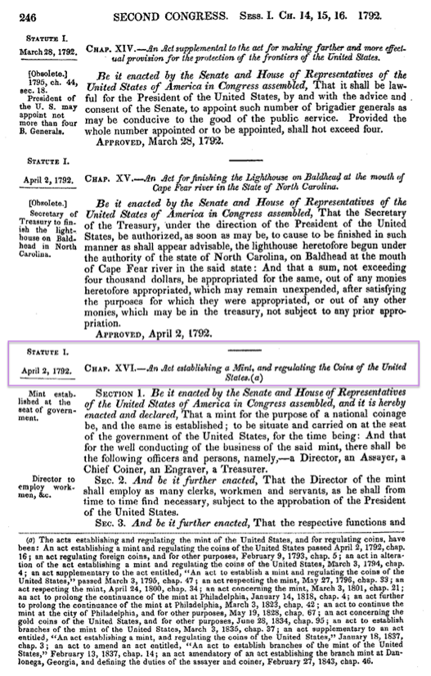
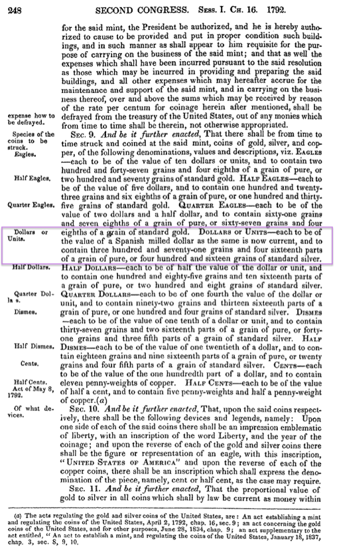


Slide 8
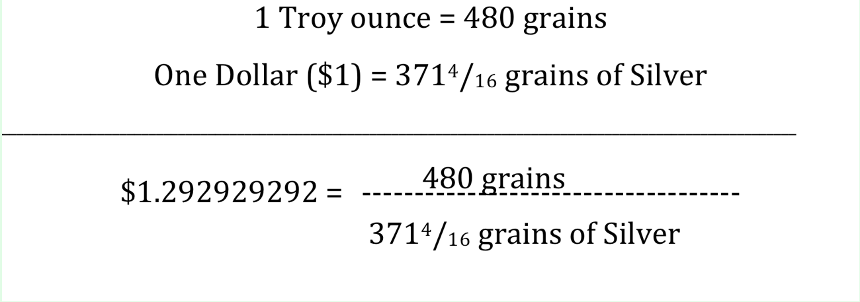
Does the Constitutional Dollar standard exist today?
Yes! How do we know?
The number $1.292929292.
It is derived from the constitutional dollar unit.
Title 31 U.S.C. §5116(b)(2):
The Secretary shall sell silver under conditions the Secretary considers appropriate for at least $1.292929292 a fine troy ounce.
SHORT TITLE OF 2002 AMENDMENT Pub. L. 107-201, Sec. 1, July 23, 2002, 116 Stat. 736, provided that: "This Act [amending section 5116 of this title and enacting provisions set out as notes under sections 5112 and 5116 of this title] may be cited as the 'Support of American Eagle Silver Bullion Program Act'."

Slide 9
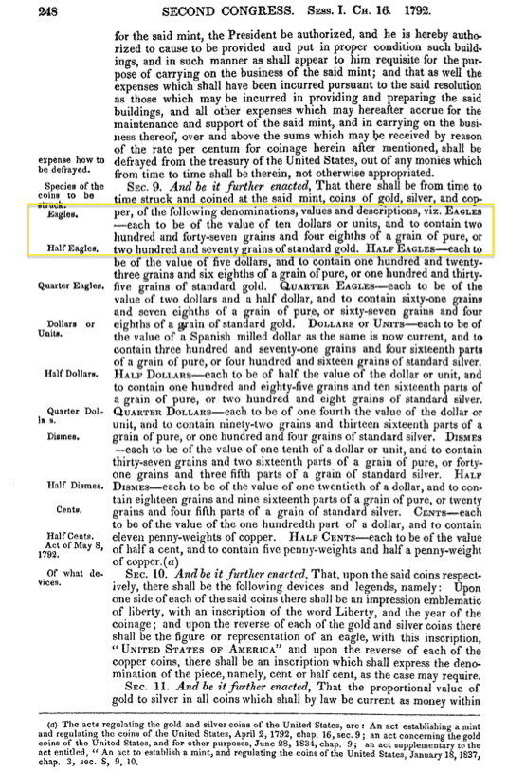
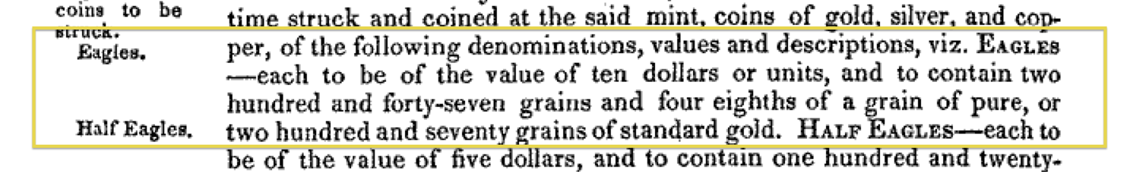
Gold coins are NOT “Dollars”
Gold coins are Eagles whose value
is measured in “dollars” set by Congress under its authority granted at Art. I, Sec.8, Cl. 5 of the U.S. Constitution.

Slide 10
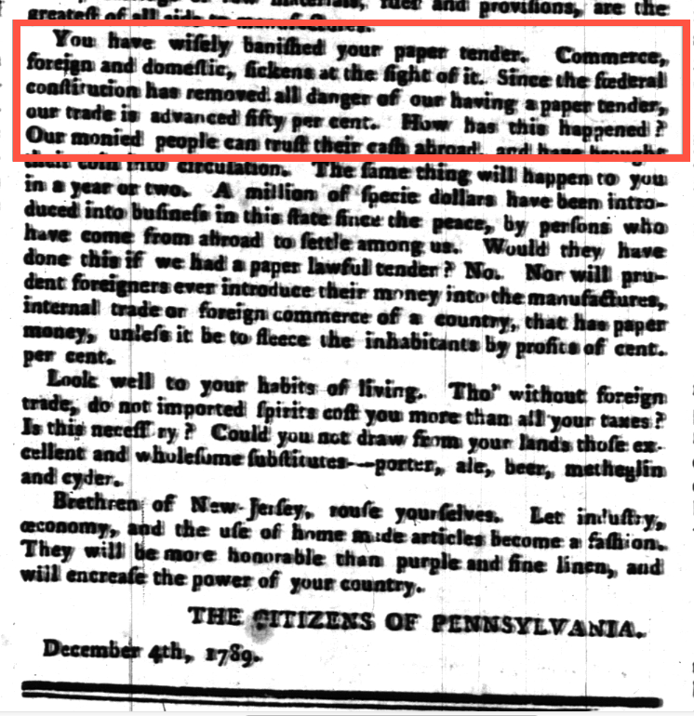
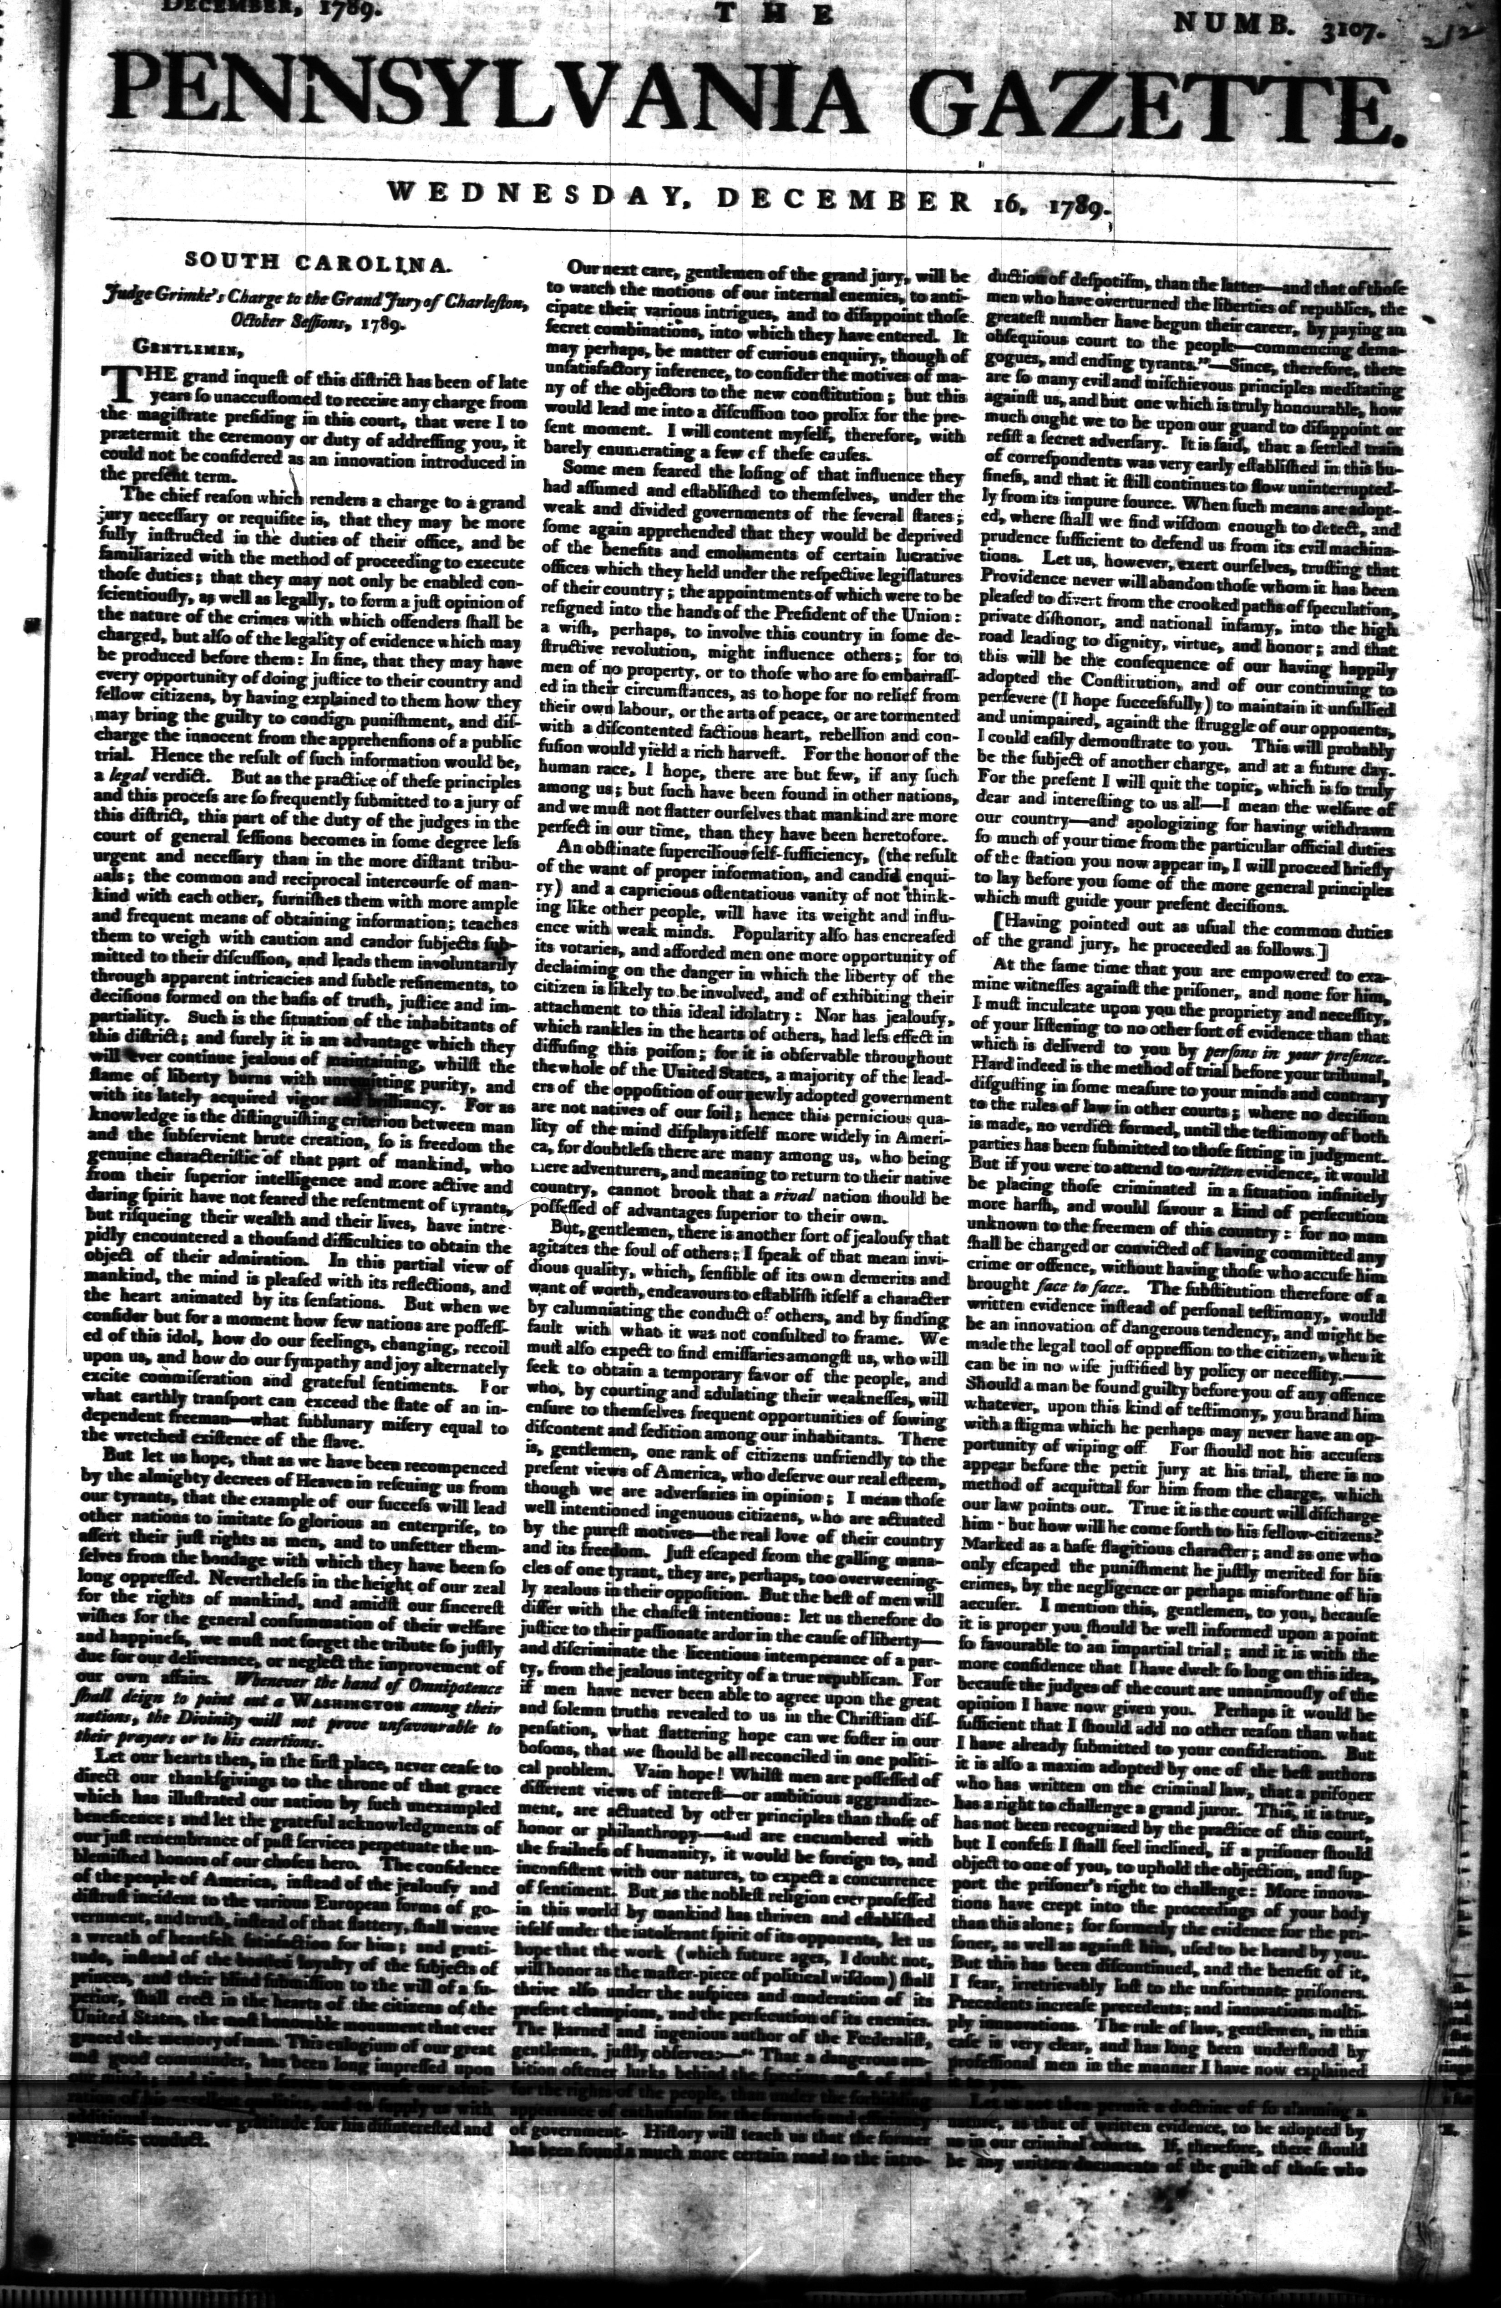
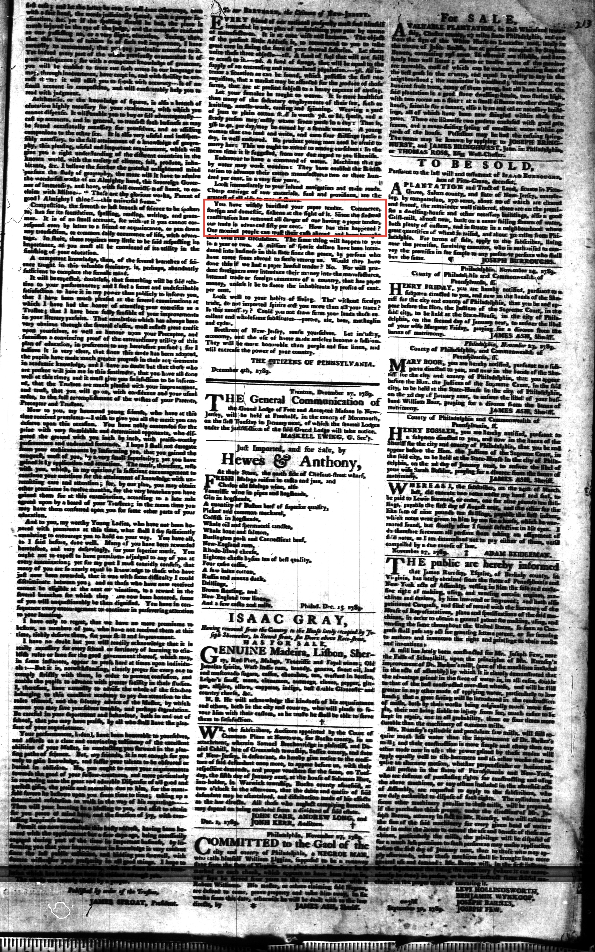
“Since the federal constitution has removed all danger of our having a paper tender …”
You have wisely banished your paper tender. Commerce, foreign and domestic, sickens at the sight of it. Since the federal constitution has removed all danger of our having a paper tender, our trade is advanced fifty per cent. How has this happened? Our monied people can trust their cash abroad and have brought their coin into circulation.

Slide 11
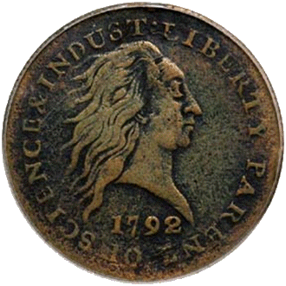
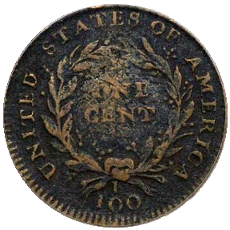
Supreme Court - Coin Money is a Constitutional Requirement
United States v. Marigold, 50 U.S. (9 How.) 560, 567-568 (1850):
  “They [Congress] appertain rather to the execution of an important trust invested by the Constitution, and to the obligation to fulfill that trust on the part of the government, namely, the trust and the duty of creating and maintaining a uniform and pure metallic standard of value throughout the Union. The power of coining money and of regulating its value was delegated to Congress by the Constitution for the very purpose, as assigned by the framers of that instrument, of creating and preserving the uniformity and purity of such standard of value * * *
  "If the medium which the government was authorized to create and establish could immediately be expelled, and substituted by one it had neither created, estimated, nor authorized ­­ one possessing no intrinsic value ­­ then the power conferred by the Constitution would be useless ­­ wholly fruitless of every end it was designed to accomplish. Whatever functions Congress are, by the Constitution, authorized to perform, they are, when the public good requires it, bound to perform; and on this principle, having emitted a circulating medium, a standard of value indispensable for the purposes of the community, and for the action of the government itself, they are accordingly authorized and bound in duty to prevent its debasement and expulsion, and the destruction of the general confidence and convenience …."
Marigold was cited as recently as 2003: International Bancorp Llc v. Societe Des Bains De Mer et Du Cercle Des, 329 F. 3d 359, May 19, 2003 for a slightly different reason but still affirming congressional responsibility to maintain a pure metallic monetary standard;
1792 Penny
Notes:
Let’s take a moment to review the Constitutional lawful money requirements of the United States:
The Supreme Court understood that our Constitution was ratified with the understanding that the legislature was bound in duty to maintain a pure metallic standard of value and to prevent our monetary unit’s debasement and expulsion. Federal Reserve Notes have done just the opposite and have now caused us great harm.
Federal Reserve Notes are UNCONSTITUTIONAL:
They are not a pure metallic standard of value;
They have no intrinsic value;
They are not created by Congress;
They expelled constitutional money from regular use in commerce.
“If the American people ever allow private banks to control the issue of their money, first by inflation and then by deflation, the banks and corporations that will grow up around them will deprive the people of their property until their children will wake up homeless on the continent their fathers conquered.”,
Thomas Jefferson

Slide 12
The U.S. Monetary Laws Today
Title 31 U.S.C. §§ 5112(a)
Title 31 U.S.C. §§ 5112(e)
(7) A fifty dollar gold coin that is 32.7 millimeters in diameter, weighs 33.931 grams, and contains one troy ounce of fine gold.
(8) A twenty-five dollar gold coin that is 27.0 millimeters in diameter, weighs 16.966 grams, and contains one-half troy ounce of fine gold.
(9) A ten dollar gold coin that is 22.0 millimeters in diameter, weighs 8.483 grams, and contains one-fourth troy ounce of fine gold.
(10) A five dollar gold coin that is 16.5 millimeters in diameter, weighs 3.393 grams, and contains one-tenth troy ounce of fine gold.
(e) Notwithstanding any other provision of law, the Secretary shall mint and issue, in quantities sufficient to meet public demand, coins which -
  are 40.6 millimeters in diameter and weigh 31.103 grams;
  contain .999 fine silver;
  have a design -
    symbolic of Liberty on the obverse side; and
    of an eagle on the reverse side;
  have inscriptions of the year of minting or issuance, and the words "Liberty", "In God We Trust", "United States of America", "1 Oz. Fine Silver", "E Pluribus Unum", and "One Dollar"; and
  (5) have reeded edges.

Slide 13
Fact vs. Myth
Fact: All United States Coins and Currency are a legal tender - Title 31 U.S.C §5103 states:
  United States coins and currency (including Federal Reserve notes …) are legal tender for all debts, public charges, taxes, and dues. Foreign gold or silver coins are not legal tender for debts.
Myth: Gold Eagle and Silver Dollar coins have a legal value greater than that shown on their face.
  “A coin dollar is worth no more for the purposes of tender in payment of an ordinary debt than a note dollar. The law has not made the note a standard of value any more than coin. It is true that in the market, as an article of merchandise, one is of greater value than the other; but as money, that is to say, as a medium of exchange, the law knows no difference between them.”
  Thompson v. Butler, 95 U.S. 694, 696 (1878)

Slide 14
Tradition vs. Reality
Tradition: All monetary transactions must be made [or valued] using Federal Reserve Notes.
  http://www.treasury.gov/resource-center/faqs/currency/pages/legal-tender.aspx:
  “There is, however, no Federal statute mandating that a private business, a person or an organization must accept currency or coins as for payment for goods and/or services.”
Reality: Only a gold clause contract can be used to demand payment in a particular coin or currency
Title 31 U.S.C §5118(a) states:
    Gold clauses and consent to sue (a) In this section –
        (1) "gold clause" means a provision in or related to an obligation alleging to give the obligee a right to require payment in:
        gold;
        a particular United States coin or currency; or
        United States money measured in gold or a particular United States coin or currency.

Slide 15
Old Case – New Law
Thompson v. Butler,
95 U.S. 694, 696 (1878)
Title 31 USC §§5119(a) and 5117(b)
A coin dollar is worth no more for the purposes of tender in payment of an ordinary debt than a note dollar. The law has not made the note a standard of value any more than coin. It is true that in the market, as an article of merchandise, one is of greater value than the other; but as money, that is to say, as a medium of exchange, the law knows no difference between them.
§5119 However, the Secretary shall redeem gold certificates owned by the Federal reserve banks at times and in amounts the Secretary decides are necessary to maintain the equal purchasing power of each kind of United States currency
§5117 The Secretary may prescribe the form and denominations of the certificates. The amount of outstanding certificates may be not more than the value (for the purpose of issuing those certificates, of 42 and two-ninths dollars a fine troy ounce) of the gold held against gold certificates.
Thompson v. Butler was recently cited in: Crummey v. Klein Independent School District (Unpublished Opinion, U.S. Ct. App. for the 5th Circuit, No. 08-20133, 2 October 2008). However there was no mention by the Petitioner, Crummey, of the Secretary’s duty to maintain the equal purchasing of each kind of United States Currency. Nor was there any mention of the responsibility of the Secretary to maintain gold bullion at 42 and two-ninths dollars a fine troy ounce, which with minting, assaying and distribution costs is equal to the 50 dollar coin defined at Title 31 U.S.C. §5112(a)(7).
Notes:
31 USC Sec. 5119 (a): Except to the extent authorized in regulations the Secretary of the Treasury prescribes with the approval of the President, the Secretary may not redeem United States currency (including Federal reserve notes and circulating notes of Federal reserve banks and national banks) in gold. However, the Secretary shall redeem gold certificates owned by the Federal reserve banks at times and in amounts the Secretary decides are necessary to maintain the equal purchasing power of each kind of United States currency. …
The Supreme Court in Thompson v. Butler, 95 U.S. 694 (1878) stated:
A coin dollar is worth no more for the purposes of tender in payment of an ordinary debt than a note dollar. The law has not made the note a standard of value any more than coin. It is true that in the market, as an article of merchandise, one is of greater value than the other; but as money, that is to say, as a medium of exchange, the law knows no difference between them.
However, this decision was rendered prior to the creation of the Federal Reserve System and the enactment of 31 USC 5119(a).

Slide 16
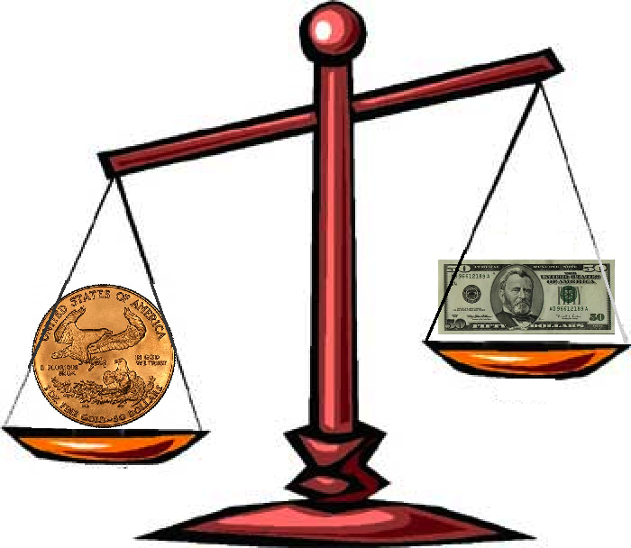
Secretary of Treasury’s has failed in his duty under Title 31 U.S.C. §5119(a)
Title 31 U.S.C §5119(a):
… [T]he Secretary shall redeem gold certificates owned by the Federal reserve banks at times and in amounts the Secretary decides are necessary to maintain the equal purchasing power of each kind of United States currency.
The legal tender $50 dollar gold coin has
significantly more purchasing power than
the $50 Federal Reserve Note.
Notes:
The Secretary of the United States Treasury has broken the law and failed in his duty to maintain the equal purchasing power of each kind of United States currency as required by law pursuant to Title 31 U.S.C. Sec. 5119(a).

Slide 17
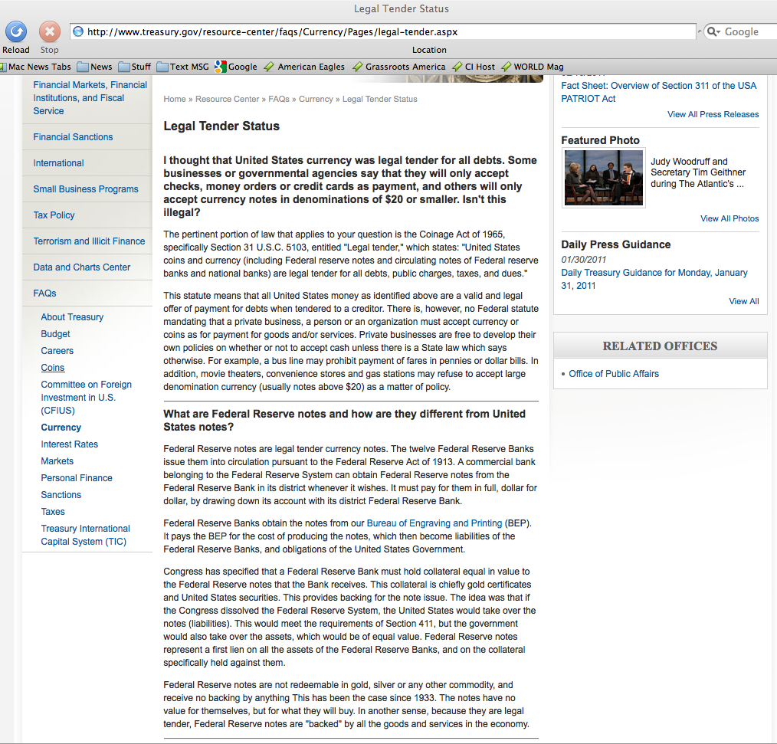
There is, however, no Federal statute mandating that a private business, a person or an organization must accept currency or coins as for payment for goods and/or services. This means you get to choose the currency you use and accept.
Congress has specified that a Federal Reserve Bank must hold collateral equal in value to the Federal Reserve notes that the Bank receives. This collateral is chiefly gold certificates and United States securities. This provides backing for the note issue. The idea was that if the Congress dissolved the Federal Reserve System, the United States would take over the notes (liabilities). This would meet the requirements of Section 411, but the government would also take over the assets, which would be of equal value. Federal Reserve notes represent a first lien on all the assets of the Federal Reserve Banks, and on the collateral specifically held against them.
Notes:
“The Federal Reserve Bank is no more ‘Federal’ than Federal Express”,
G. Edward Griffin (Author)
Federal Reserve Banks are quasi-private banks that are part of the Federal Reserve System. (http://www.stlouisfed.org/news/speeches/2006/03_30_06.htm)
What are Federal Reserve bank notes?
Federal Reserve bank notes are promissory notes issued by the Federal Reserve Banks.
The Federal Reserve bank notes, by law – Title 12 U.S.C. 411, are [supposed to be] redeemable for lawful money on demand, which Constitutionally speaking are minted coins containing 371 ¼ grains of pure silver or its gold equivalent as regulated by Congress pursuant to Article I Section 8, Clause 5.
The United States Supreme Court stated – United States v. Marigold – a still valid opinion:
“[Congress has the] obligation to fulfill that trust on the part of the government, namely, the trust and the duty of creating and maintaining a uniform and pure metallic standard of value throughout the Union. The power of coining money and of regulating its value was delegated to Congress by the Constitution for the very purpose, as assigned by the framers of that instrument, of creating and preserving the uniformity and purity of such standard of value … If the medium which the government was authorized to create and establish could immediately be expelled, and substituted by one it had neither created, estimated, nor authorized ­­ one possessing no intrinsic value ­­ then the power conferred by the Constitution would be useless ­­ wholly fruitless of every end it was designed to accomplish. …” United States v. Marigold, 50 U.S. (9 How.) 560, 567-68 (1850)
Federal Reserve Notes are UNCONSTITUTIONAL:
They are not a pure metallic standard of value;
They have no intrinsic value;
They are not created by Congress;
They expelled constitutional money from regular use in commerce.

Slide 18
Right to use Gold or Silver Coin
The Constitution guarantees Citizens the right to use Gold and Silver as
  Money,
  Repayment of debts and
  Security in Gold Clause Contracts
It wasn’t until Oct. 27, 1977 that Americans were statutorily allowed, once again to engage in Gold clause contracts (see Title 31 USC 5118(d)(2)) since Roosevelt and Congress banned them first by Exec Order 6102 signed April 5, 1933 and then by Statute, under the Gold Reserve Act of January 30, 1934.
This right to use Gold is Silver Coin is why the Sec. of Treasury had to admit on his web site that a private business, a person or an organization can use any U.S. currency or coins as for payment for goods and/or services.
31 U.S.C Sec. 5118
Gold clauses and consent to sue
  (a) In this section –
    (1) "gold clause" means a provision in or related to an obligation alleging to give the obligee a right to require payment in:
    gold;
    a particular United States coin or currency; or
    United States money measured in gold or a particular United States coin or currency.
(d) (1) In this subsection, "obligation" means any obligation (except United States currency) payable in United States money.
(2) An obligation issued containing a gold clause or governed by a gold clause is discharged on payment (dollar for dollar) in United States coin or currency that is legal tender at the time of payment. This paragraph does not apply to an obligation issued after October 27, 1977.

Slide 19
What we’ve learned thus far?
Lawful Money
  Constitutionally authorized gold and silver coin
  Currently minted coins are authorized at Title 31 U.S.C §5112
Legal Tender
  a medium of payment allowed by law to be valid for meeting a financial obligation.
  See Title 31 U.S.C §5103
One ($1) Dollar
  A minted silver coin containing at least 371¼ gains of fine (pure) silver. (Note 1 troy ounce = 480 grains)
Gold or Silver Clause Contract
  A contract for payment in gold or silver coin.
  Authorized by law at Title 31 U.S.C §5118
ETF - Exchange Traded Fund
  a mutual fund that is traded on an exchange having as its principle a particular commodity (such as gold or silver) or shares of stock.
ETN - Exchange Traded Note
  is a senior, unsecured, unsubordinated debt security issued by an underwriting bank
  are designed to provide investors access to the returns of various market benchmarks

Slide 20
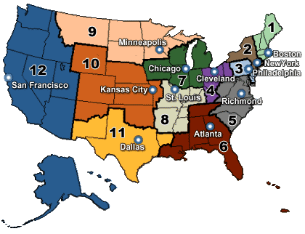
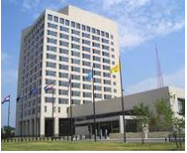
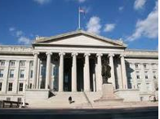


How the acquisition of American Eagle & Liberty coins should work
Title 12 USC Sec. 411
Federal reserve notes, to be issued at the discretion of the Board of Governors of the Federal Reserve System for the purpose of making advances to Federal reserve banks through the Federal reserve agents as hereinafter set forth and for no other purpose, are authorized. The said notes shall be obligations of the United States and shall be receivable by all national and member banks and Federal reserve banks and for all taxes, customs, and other public dues. They shall be redeemed in lawful money on demand at the Treasury Department of the United States, in the city of Washington, District of Columbia, or at any Federal Reserve bank.
FRB Kansas City
Federal Reserve Bank
Districts Map
US Treasury
Washington D.C.
FRB Dallas
We the People
FRB Philadelphia

Slide 21

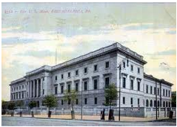

How the acquisition of American Eagle & Liberty coins does work
American Century
4500 Main Street, 4th Floor
Kansas City, MO 64111
1-888-345-2071
www.americancentury.com
US Mint
Dillon Gage, Inc.
15301 Dallas Parkway
Suite 200
Addison, TX 75001
1-800-375-4653
www.dillongage.com
FideliTrade
3601 N. Market Street
Wilmington, DE 19802
1-800-223-1080
www.fidelitrade.com
Retail Gold Dealer
We the People
Authorized National Dealers
(Market Makers)

Slide 22
Uses of Gold and Silver
Money
  In the United States gold & silver coins are the only lawful constitutional money
Investments
  Gold & silver can be used as a hedge against inflation created by fiat currencies
Industrial
  Gold & silver are used throughout the electronics, medical and photographic industries
Article I Section 8, Clause 5
  [The Congress shall have Power] To coin Money, regulate the Value thereof, and of foreign Coin, and fix the Standard of Weights and Measures;
Article I Section 10, Clause 1
  No State shall … make any Thing but gold and silver coin a Tender in Payments of Debts.

Slide 23
How to use American Eagle & Liberty coins as money
Use a Gold and Silver
Clause Contract
The contract specifies that the coins are the exclusive legal tender medium of payment so there is no confusion about their legal value
The contract removes the ambiguity in the disparate purchasing power between Federal Reserve Bank notes and Lawful Money Coin
The contract reduces the risk of the IRS making frivolous claim that you received something other than the the face value of the gold or silver coin

Slide 24
Elements of a Gold Contract
Preamble
  Lists the parties and date of the contract
Authorization and Construction
  Cites the laws and supreme court decisions
Valuation of Payment
  Sets out the weight and face-values of the coins tendered as payment
Delivery and Satisfaction of Payment
  Specifies that the delivery of coins as the exclusive form of payment
Receipt of Full Payment
  Acknowledges full payment has been made

Slide 25
Preamble Element
This Medical Services Payment Clause, “Agreement”, made effective this 15th day of September, 2012, by and between Dr. Seuss, “Doctor” and John Doe, “Patient”.

Slide 26
Authorization and Construction
(a) Authorization and Construction. This Agreement is authorized by, relies upon, and must be construed and implemented according to:
(i) Section 4(c) of the Act of 28 October 1977, Public Law 95-147, 91 Statutes at Large 1227, 1229, now codified in 31 United States Code, Section 5118(d)(2);
(ii) Section 2(a)(7) of the Act of 17 December 1985, Public Law 99-185, 99Statutes at Large 1177, 1177,now codified in Title 31, United State Code, Section 5112(a)(7);
(iii) Title II, Section 202(h) of the Act of 9 July 1985, Public Law 99-61, 99 Statutes at Large 113, 116, now codified in Title 31, United States Code, Section 5112(h);
(iv) the decisions of the Supreme Court of the United States in New York ex rel. Bunk of New York v. Board of Supervisors, 74 U.S. (7 Wallace) 26 (1869); Bronson v. Rodes, 74 U.S. (7 Wallace) 229 (1869); Butler v. Horowitz, 74 U.S. (7 Wallace) 258 (1869); and Thompson v. Butler, 95 U.S. 694 (1878); and
(v) such other authorities as the Doctor, the Patient, or both may invoke in the event of any challenge, by any third party and for any reason, to the propriety, sufficiency, or effect of any part of this Agreement.

Slide 27
Valuation of Payment
b) Valuation of Payment. Payment for the sale and purchase of medical and surgical services shall be valued at Fifty ($50.00) "dollars" of coined gold, each such "dollar" to consist of two one-hundredths (0.02) of a Troy ounce of fine gold in the form of the coins hereinafter specified in Section (c) of this Agreement, as authorized pursuant to:
(i) the valuation of "fifty dollar [s]" in gold coin as "contain[ing] one (1) troy ounce of fine gold", established and implemented by the Congress of the United States in Section 2(a)(7) of the Act of 17 December 1985, Public Law 99-185, 99 Statutes at Large 1177, 1177, now codified in Title 31, United State Code, Section 5112 (a)(7), enacted under Congress's exclusive power " [t]o coin Money, [and] regulate the Value thereof' in Article I, Section 8, Clause 5 of the Constitution of the United States; and
(ii) the rule set down by the Supreme Court of the United States in Thompson v. Butler, 95 U.S. 694,696 (1878). that:
[o]ne owing a debt may pay it in gold coin or legal-tender notes of the United States, as he chooses, unless there is something to the contrary in the obligation out of which the debt arises. A coin dollar is worth no more for the purposes of tender in payment of an ordinary debt than a note dollar. The law has not made the note a standard of value any more than coin. It is true that in the market, as an article of merchandise, one is of greater value than the other; but as money, that is to say, as a medium of exchange, the law knows no difference between them.

Slide 28
Delivery and Satisfaction of Payment
Delivery and Satisfaction of Payment. Payment for the sale and purchase of medical and surgical services shall consist only, and be executed exclusively through physical delivery by the Patient (or his authorized agent) to the Doctor (or his authorized agent), of one (1) American Eagle "fifty dollar gold coin[s]” –
(i) each of which "contains one (1) troy ounce of fine gold, pursuant to Section 2(a)(7) of the Act of 17 December 1985, Public Law 99-185, 99 Statutes at Large 1177, 1177, now codified in Title 31, United States Code, Section 5112(a)(7);
(ii) each of which has been designated "legal tender" by Congress under Title II, Section 202(h) of the Act of 9 July 1985, Public Law 99-61, 99 Statutes at Large 113, 116, now codified in Title 31, United States Code, Sections 5112 (h) and 5103; and
(iii) which collectively shall constitute the sole and exclusive medium of exchange, money, currency, and legal tender for the purposes of this Agreement.

Slide 29
Receipt of Full Payment
Receipt of Full Payment. The Doctor hereby acknowledges that the Patient has tendered and the Doctor has accepted and received the full payment specified in Section (c) of this Agreement.
Initialed as acknowledgement of receipt of full payment ________________

Slide 30
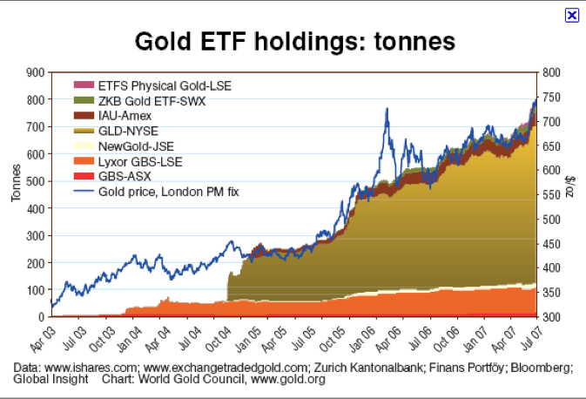

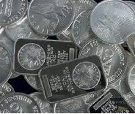
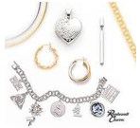
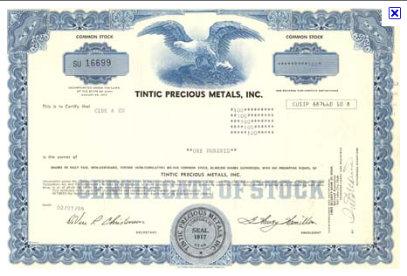
Gold & Silver as Investments
Three Types of Gold & Silver Investments
  Physical Ownership
    Bars, Coins and Jewelry
      These physical items can be held in IRA accounts
  Exchange Traded Fund (ETF) or ETN
  Common stock ownership in Mining or other types of precious metal related companies
    Note: many mining companies do not own the gold they are mining and receive a percentage of revenue from the gold or silver they mine

Slide 31
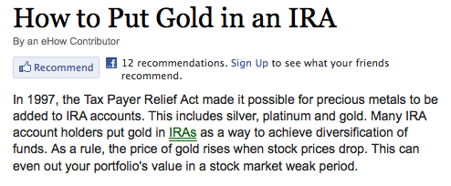
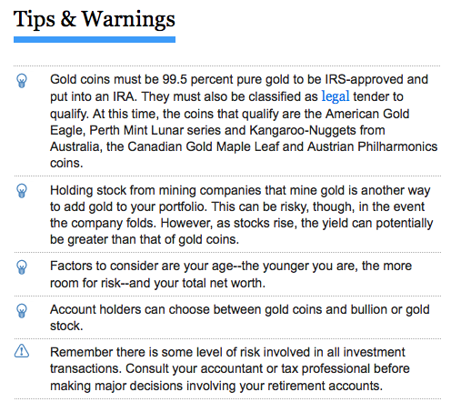
Holding Gold and Silver Coins in Individual Retirement Accounts
You are allowed to acquire and hold gold and silver in your IRA accounts – this includes coins, bullion and stock
Holding American Eagles and Liberty Coins has tax advantages
  Pursuant to IRC §408(m)(3)(A) the coins shall not be treated as "collectible[s]” at the time of distribution.
  The coins are to be distributed at their face-value.

Slide 32
Six Types of Gold ETFs
Gold ETFs That Contain Gold Products
Gold ETFs That Contain Gold Futures
Gold Industry ETFs
Gold ETNs
More Than Gold ETFs
Short Gold ETFs

Slide 33
Suggested Reading
"GOLD CLAUSES” AND “SILVER CLAUSES” IN FINANCIAL TRANSACTIONS
A PRACTICAL STUDY CONCERNING THEIR ORIGIN AND USE
http://www.edwinvieira.com/edwin202.htm
Bernanke’s Secret Debt Solution to the Global Financial Crisis
http://withchrist.org/SecretDebtSolution.pdf
Pieces of Eight
http://www.edwinvieira.com/edwin230.htm

Slide 34
The End

Slide 35
Tradition vs. Reality
Tradition: All monetary transactions must be reconciled at Federal Reserve Note face values.
  http://www.treasury.gov/resource-center/faqs/currency/pages/legal-tender.aspx:
  “There is, however, no Federal statute mandating that a private business, a person or an organization must accept currency or coins as for payment for goods and/or services.”
Reality: Only a gold clause contract can be used to demand payment is a particular coin or currency
Title 31 U.S.C §5118(a) states:
    Gold clauses and consent to sue (a) In this section –
        (1) "gold clause" means a provision in or related to an obligation alleging to give the obligee a right to require payment in:
        gold;
        a particular United States coin or currency; or
        United States money measured in gold or a particular United States coin or currency.

