Slide 1

Great Nations
have passed
and now lay in
ruins
Assyrian
Babylon
Persia
Greece
Rome
Ottoman
Is
America
exempt?

Slide 2
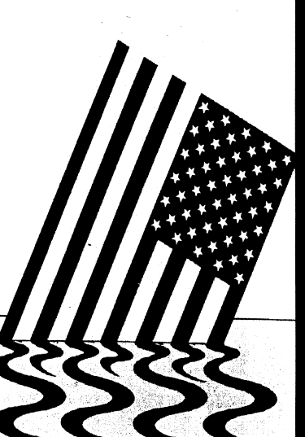
Why do nations fall?
According to Edward Gibbon
Rome Fell because:
Rapid increase of divorce; undermining of the sanctity of home
Higher & higher taxes; welfare system
Decay of religion
Mad craze for pleasure; sports becoming focus and progressively more brutal
Armament build-up; ignoring internal decadence
Notes:
Edward Gibbon, The Decline and Fall of the Roman Empire (1776-1788)
http://www.historyguide.org/intellect/gibbon_decline.html

Slide 3
Why will America fall?
A Nation in Trouble: Rom. 1
Truth suppressed
Rejection of God
Idolatry
Sexual immorality
Violent behavior
We who know better, sit silently and do nothing about it

Slide 4
Luther Martin, a delegate of Federal Constitution
Convention, 1788:
  “It was said, it ought to be considered, that national crimes can only be, and frequently are, punished in this world by national punishments.”
George Mason, the “father of Bill of Rights”, 1788:
  “As nations cannot be rewarded or punished in the next world, so they must be in this by inevitable chain of causes and effects, Providence punishes national sins by national calamities
Samual Adams, s. of Declaration of Independence:
  “Revelation assures us that ‘Righteousness exalteth a nation. Communities are dealt with in this world by the wise and just Ruler of the Universe. He rewards or punishes them according to their general character.”

Slide 5
Thomas Jefferson, 1794
“I likewise tremble for my country when I reflect that God is just, that His justice cannot sleep forever:
Daniel Webster, 1903
“If we and our posterity reject religious instruction and authority, violate the rules of eternal justice trifle with the injunctions of morality, and recklessly destroy the political constitution which holds us together, no man can tell how sudden a catastrophe may overwhelm us that shall bury all our glory in profound obscurity.”

Slide 6
What Truths Have Been Suppressed?
God Governs the affairs of men
  Ben Franklin (Congressional Congress, 1787)
    "I have lived, Sir, a long time, and the longer I live, the more convincing proofs I see of this truth--that God Governs the affairs of men. And if a sparrow cannot fall to the ground without His notice, is it probable that an empire can rise without His aid?
We the People Control the Power of the Purse & Sword
  Necessity Lawful Money the Power to Restrain and Redress
  Necessity of State Militias to secure the Rights of Free States and the People
Silence of the Constitution is Authoritative
  9th & 10th Amendments

Slide 7
Power of the Purse
Take-away-points
The U.S. monetary system (Federal Reserve System) is unconstitutional and violates the Rule of Law.
The U.S. monetary system is dishonest.
The U.S. monetary system will blow up.
Notes:
According to the report made pursuant to Public Law 96-389 the present monetary arrangements [i.e. the Federal Reserve Banking System] of the United States are unconstitutional --even anti-constitutional-- from top to bottom.
“If what is used as a medium of exchange is fluctuating in its value, it is no better than unjust weights and measures…which are condemned by the Laws of God and man …” Since bank notes, such as the Federal Reserve Notes that we carry around in our pockets, can be inflated or deflated at will they are dishonest.
The amount of Federal Reserve Notes in circulation are past the historical point of recovery and thus will ultimately lead to a massive hyperinflation that will “blow-up” the current U.S. monetary system resulting in massive social and economic dislocation.

Slide 8
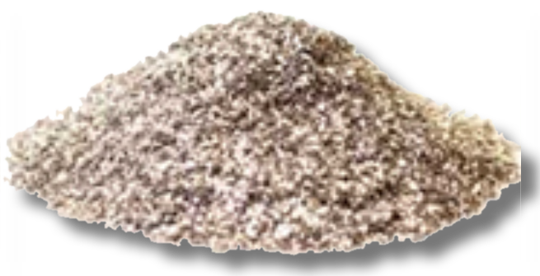
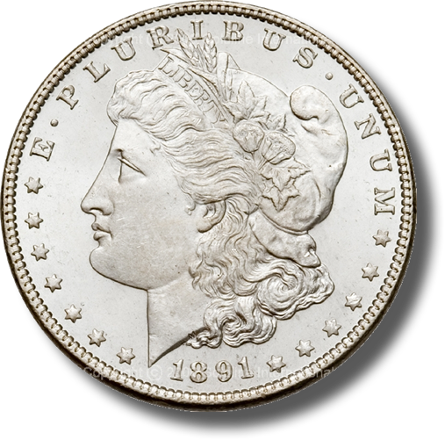

What is One Dollar?
One Dollar is a standard unit of measurement
Money:
371 ¼ grains of Silver minted
= $1.00
Analogous
Time:
24 Hours = 1 Day * 7 = 1 Week
Weight:
16 Ounces = 1 Pound * 2000 = 1 Ton
Length:
1 Inch * 12 = 1 Foot * 3 = 1 Yard
Notes:
The word Dollar is in fact a standard unit of measurement of money; it is analogous to an “hour” for time, an “ounce” for weight, and an “inch” for length.
The Dollar is our Country’s standard unit of measurement for money.
How do you feel when you go to a gas station and pump “15 gallons of gas” into your 12 gallon tank?
Or you went to the lumber yard and purchased an eight foot piece of lumber, and when you got home you discovered that it was actually only 7 ½ feet long?
How would you feel if you went to the grocery store and purchased what you believed were 2 lbs. of bananas, but when you got home you found out that you actually only purchased 1 ¾ of a pound of bananas?
I bet you would feel ripped off.
Now what if I told you that the green Federal Reserve Notes that you have in your pocket, which purports to be of some “dollar” value, are currently worth less than 1/20 the constitutionally guaranteed value in lawful money. I bet you would be really ticked off.
Well folks, be prepared to be very ticked off.

Slide 9
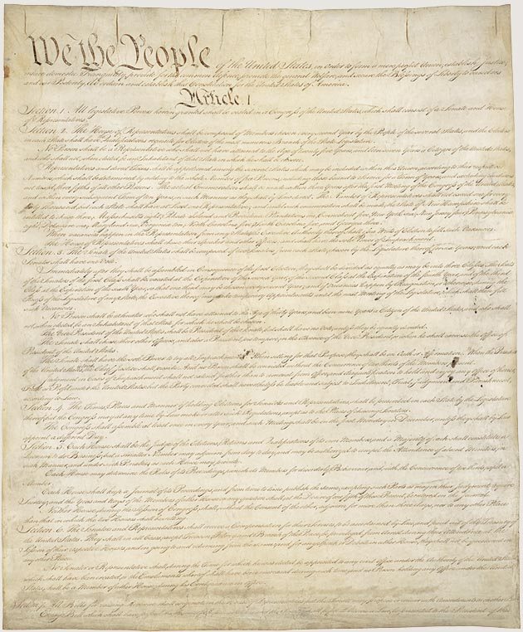
The Dollar of the Constitution
Article I Section 8, Clause 5
  [The Congress shall have Power] To coin Money, regulate the Value thereof, and of foreign Coin, and fix the Standard of Weights and Measures;
Article I Section 9, Clause 1
  … a Tax or duty may be imposed on such Importation, not exceeding ten dollars for each Person.
Article I Section 10, Clause 1
  No State shall … make any Thing but gold and silver coin a Tender in Payments of Debts.
Amendment VII
  In Suits at common law, where the value in controversy shall exceed twenty dollars, the right of trial by jury shall be preserved, and no fact tried by a jury, shall be otherwise re-examined in any Court of the United States, than according to the rules of the common law.
Notes:
It is rather ironic that during the first 124 years of our Republic’s existence (1789 – 1913), it was well understood by the general public that the word “Dollar” means a pure metallic silver coin of a known fixed unit of measurement for money, value and wealth.
Over the next 55 years (1913 – 1968), the definition of the Dollar was slowly removed from public education, dictionaries and our court rooms to the point that in 1968 Congress unconstitutionally eliminated the fundamental and necessary requirement of silver from the “public” definition of the word “Dollar”. Hence our constitutionally guaranteed fixed standard unit of measure of money and wealth was hijacked.
Finally, on 15 August 1971, President Richard Nixon unconstitutionally terminated redemption of Federal Reserve Notes in gold internationally, ending the connection between the Federal Reserve System and any “constitutional” money whatsoever.

Slide 10
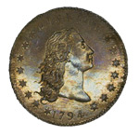
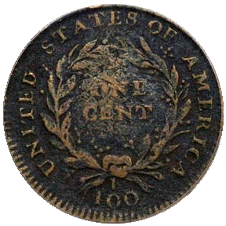
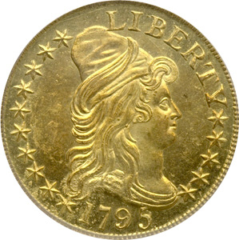
Congress’ Responsibility to Regulate the Value of Coin
Key:
1 troy oz = 480 grains
1 troy oz = 31.1034 grams
1 troy oz = 1.09714 oz
X 100 =
(4,630 grains
of Copper)
1 Cent
(46.3 grains
of Copper)
1 Dollar
(371.25 grains Silver)
X 10 =
(3,712.5 grains
of Silver)
1 Dollar
(371.25 grains Silver)
10 Dollar
(247.5 grains Gold)
Congress has the responsibility to regulate the value of all minted coins to the fixed pure metal Dollar standard
Notes:
By empowering Congress “To coin Money, [and] regulate the Value thereof”, Article I, Section 8, Clause 5 of the Constitution of the United States, guarantees a national system of coinage with uniform intrinsic value. By explicitly referring to “dollars”, in Article I, Section 9, Clause 1 and the Seventh Amendment of the Constitution of the United States, fixed the silver minted dollar coin as the monetary-unit by which Congress must “regulate the Value” of all other coinage too.
On their face, the monetary powers and disabilities set out in the Constitution are eminently suitable for these goals:
By denying the States any power to “emit Bills of Credit” or “coin Money”, Article I, Section 10, Clause 1 eradicates the “fallacious Medium” of regional paper currencies and eliminates multiple systems of coinage throughout the country.
The Clause also limits the States’ legal-tender power to “gold and silver Coin”, thereby establishing specie as the sole constitutional medium for governmentally enforced “Payment of Debts”.
By empowering Congress “To coin Money, [and] regulate the Value thereof”, Article I, Section 8, Clause 5 creates a national system of coinage with uniform intrinsic value.
By explicitly referring to “dollars”, Article I, Section 9, Clause 1 and the Seventh Amendment fix the silver Spanish milled dollar as the money-unit by which Congress should “regulate the Value” of all other coinage.
By not including the language “emit bills” that the Articles of Confederation contained, Article I, Section 8, Clause 2 disables Congress from issuing any paper currency. And by limiting Congress’s power to punish counterfeiting to “Securities” and “current Coin”, Article I, Section 8, Clause 6 confirms that Congress may “coin Money” itself, or raise “Money” by “borrow[ing]”, but not “emit”, “issue”, “create”, “make”, or “declare what shall be” “Money” in any other way.
Thus, the word “dollar[s]” by its use in the Constitution of the United States has a fixed meaning that can only be changed by Constitutional Amendment. And that meaning is a minted coin containing at least 371 ¼ grains of .99 fine silver. Congress’s responsibility is to regulate the value of coins made of other metals, such as a penny made with copper or a nickel made of nickel, relative to the weight of the one-dollar silver coin.

Slide 11
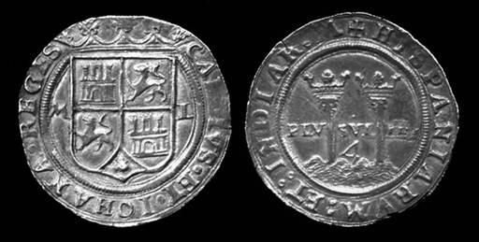
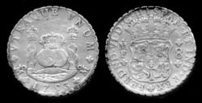
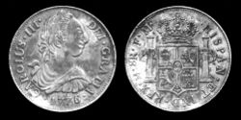
A Bit of History
The “Dollar” is a fixed standard unit of measurement that was established in 1497 by King Ferdinand and Queen Isabella of Spain. It is a minted coin containing at least 371⁴/₁₆ grains of fine (pure) Silver.
Silver eight real coin of Carlos and Johanna of Spain, dated ca. 1544, depicting the Pillars of Hercules on the reverse.
Silver eight real coin of King Ferdinand VI of Spain, dated 1753.
Silver eight real coin of King Carlos III of Spain, dated 1776.
Notes:
The definition of a Dollar goes back to 1497, it was the “royal money” of King Ferdinand and Queen Isabella of Spain, See, e.g., J. Earl Massey, America’s Money: the Story of Our Coins and Currency (1968), at 33-36; T. Schwarz, A History of United States Coinage (1980), at 29.
By 1518 the Dollar monetary unit standard became so well accepted that coins were also being minted in the valley of St. Joachim, in Bohemia (now in the Czech Republic)
As a matter of fact:
Webster's 1958 New Collegiate Dictionary defined the Dollar as:
Any of three U.S. Coins: First issued in 1794 and since 1837 weighing 412.5 grains of silver .900 fine [412.5 * .9 = 371.25 fine (pure) silver];
A silver coin of 420 grains called a trade dollar containing 378 grains of pure metal and 42 grains of alloy;
A gold coin of 25.8 grains .900 fine;
Webster’s 1913 dictionary defined the Dollar as:
A silver coin of the United States containing 371 ¼ grains of silver and 41.25 grains of alloy, that is, having a total weight of 412.5 grains.
A gold coin of the United States containing 23.22 grains of gold and 2.58 grains of alloy, that is, having a total weight of 25.8 grains, nine-tenths fine. It is no longer coined.
NOTE: Previous to 1837 the silver dollar had a larger amount of alloy, but only the same amount of silver as now, the total weight being 416 grains. The gold dollar as a distinct coin was first made in 1849. The eagles, half eagles, and quarter eagles coined before 1834 contained 24.75 grains of gold and 2.25 grains of alloy for each dollar.
(http://machaut.uchicago.edu/?resource=Webster%27s&word=Dollar&use1913=on&use1828=on)
Today’s dictionary definition of the word “Dollar” is:
A Dollar bill. A paper note printed by the Treasury, or by the Federal Reserve Banks under authority of the treasury, having the purported value of one dollar. Prior to 1964 such notes could be redeemed for the equivalent dollar value of silver coins, but in that year the backing of the currency with silver was discontinued. Such notes not convertible into precious metals at a fixed rate are called "fiat money", receiving their value solely from the good faith of the issuing government or bank.
(http://machaut.uchicago.edu/?resource=Webster%27s&word=Dollar&use1913=on&use1828=on at item 3)

Slide 12
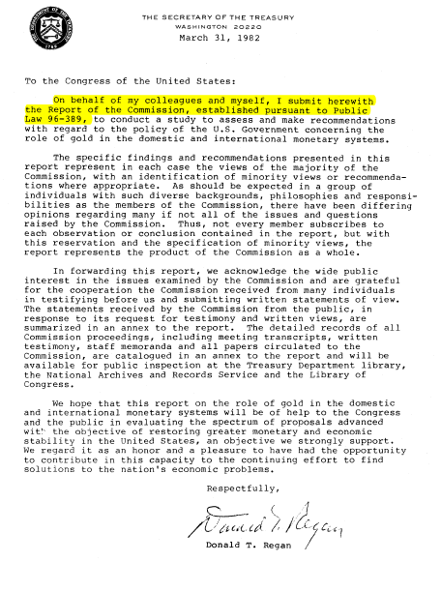
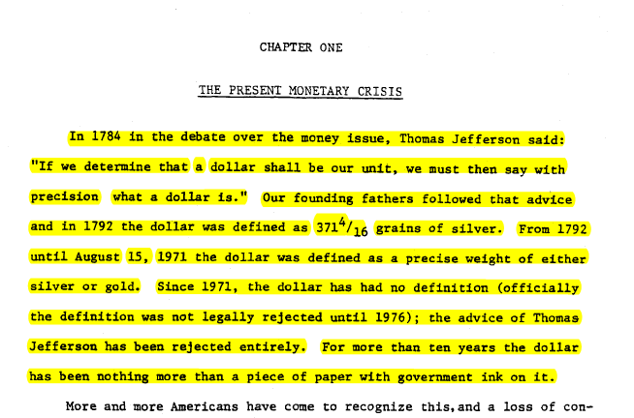
The Dollar of the Constitution: A coin containing 371¼ grains of Silver
In 1784 …Thomas Jefferson said:
  “If we determine that a dollar shall be our unit, we must then say with precision what a dollar is." Our founding fathers followed that advice and in 1792 the dollar was defined as 371 ¼ grains of silver. From 1792 until August 15, 1971 the dollar was defined as a precise weight of either silver or gold.”
Notes:
During the period from 1775 through 1779, Congress authorized numerous emissions of Continental Currency and other bills of credit, ostensibly redeemable in silver Spanish milled dollars (or their equivalent in silver or gold), with the Colonies on “the faith of the United States” pledged for their eventual redemption. In total, Congress emitted some 241,500,000 in Continental Currency—a production elephantine in comparison to the 10,000,000 in silver and gold estimated to have comprised the money supply in early 1775.
By the time 1784 came around, the phrase “Worthless as a Continental” was so popular that Thomas Jefferson said: “If we determine that a dollar shall be our unit, we must then say with precision what a dollar is."
By the time the Constitution of the United States of America was formally adopted in 1789, the Dollar standard unit, a minted coin containing 371 ¼ grains of silver, was adopted as the fixed standard monetary unit of the United States with the following constitutional requirements: “No State shall … make any Thing but gold and silver Coin a Tender in Payment of Debts” (Article 1, Section 10, clause 1 of the Constitution of the United States of America)

Slide 13
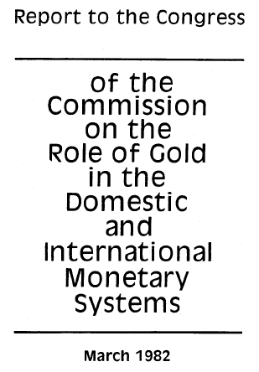
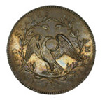
The Dollar (Silver) coin guarantees citizens a fixed measure of value
Deut 25:13-14
13 Thou shalt not have in thy bag divers weights, a great and a small.
14 Thou shalt not have in thine house divers measures, a great and a small.
15 But thou shalt have a perfect and just weight, a perfect and just measure shalt thou have: that thy days may be lengthened in the land which the LORD thy God giveth thee.
The constitutional Dollar – a minted Coin containing 371 ¼ grains of silver – guarantees value:
  “It is significant that this power of coining money is mentioned in the same sentence in the Constitution as the power to "fix the standards of weights and measures,“ for the framers regarded money as a weight of metal and a measure of value. Roger Sherman, a delegate to the Constitutional Convention, wrote that “If what is used as a medium of exchange is fluctuating in its value, it is no better than unjust weights and measures…which are condemned by the Laws of God and man …".
Prov 20:10
10 Divers weights, and divers measures, both of them are alike abomination to the LORD.
1794 Silver Dollar America's First Silver Dollar Struck
Notes:
Roger Sherman (http://www.constitutionfacts.com/constitution/Signers.htm), the Connecticut delegate to the Constitutional Convention, believed so strongly in the necessity of coined metallic money that he said “If what is used as a medium of exchange is fluctuating in its value, it is no better than unjust weights and measures…which are condemned by the Laws of God and man …” and he and the majority of other delegate only gave their vote for the ratification of the Constitution after the dollar (a minted coin containing at least 371 ¼ grains of silver) was agreed to be the official unit of currency and money for the United States of America.
As Madison’s notes record:
Mr READ, thought the words: “and emit bills on the credit of the United States", if not struck out or forbade from practice as specifically required by the ratified constitution, would be as alarming as the mark of the Beast in Revelations.
Hence Article 1, Section 10 of the Constitution of the United States of America states:
“No State shall enter into any Treaty, Alliance, or Confederation; grant Letters of Marque and Reprisal; coin Money; emit Bills of Credit; make any Thing but gold and silver Coin a Tender in Payment of Debts; pass any Bill of Attainder, ex post facto Law, or Law impairing the Obligation of Contracts, or grant any Title of Nobility”

Slide 14
The Federal Reserve System
Created in 1913 under the Owen- Glass Act
Consists of: 12 private banks and 1 quasi-gvmt board
Monetizes debt out of thin air
It’s setup to Privatize Gains and Socialize Losses
It’s organizational structure and power have been deemed unconstitutional
(see: A.L.A. Schechter Poultry Corp. v. U.S., 295 U.S. 495)
It’s dependant on the income tax system
  It uses income tax to control inflation
  It uses income tax revenue to pay interest on the “public” debt
  It uses income tax revenue to create more debt in order to collect more interest
100% of what is collected is absorbed solely by interest on the Federal debt and by Federal Government contributions to transfer payments. In other words, all individual income tax revenues are gone before one nickel is spent on the services which taxpayers expect from their Government.

Slide 15

What is a Federal Reserve Note?
It is a Private Bank Note
  (It is a promise from the bank to pay real lawful money)
It is Redeemable for Lawful Money on Demand
  (Pursuant to Title 12 U.S.C. § 411)
It is NOT Constitutionally Authorized Money
  (Constitution only authorizes gold or silver Coin as Tender in Payment of Debts within the 50 states of the Union, see Article I Section 10, Clause 1)
Notes:
“The Federal Reserve Bank is no more ‘Federal’ than Federal Express”,
G. Edward Griffin (Author)
Federal Reserve Banks are quasi-private banks that are part of the Federal Reserve System. (http://www.stlouisfed.org/news/speeches/2006/03_30_06.htm)
What are Federal Reserve bank notes?
Federal Reserve bank notes are promissory notes issued by the Federal Reserve Banks.
The Federal Reserve bank notes, by law – Title 12 U.S.C. 411, are [supposed to be] redeemable for lawful money on demand, which Constitutionally speaking are minted coins containing 371 ¼ grains of pure silver or its gold equivalent as regulated by Congress pursuant to Article I Section 8, Clause 5.
The United States Supreme Court stated – United States v. Marigold – a still valid opinion:
“[Congress has the] obligation to fulfill that trust on the part of the government, namely, the trust and the duty of creating and maintaining a uniform and pure metallic standard of value throughout the Union. The power of coining money and of regulating its value was delegated to Congress by the Constitution for the very purpose, as assigned by the framers of that instrument, of creating and preserving the uniformity and purity of such standard of value … If the medium which the government was authorized to create and establish could immediately be expelled, and substituted by one it had neither created, estimated, nor authorized ­­ one possessing no intrinsic value ­­ then the power conferred by the Constitution would be useless ­­ wholly fruitless of every end it was designed to accomplish. …” United States v. Marigold, 50 U.S. (9 How.) 560, 567-68 (1850)
Federal Reserve Notes are UNCONSTITUTIONAL:
They are not a pure metallic standard of value;
They have no intrinsic value;
They are not created by Congress;
They expelled constitutional money from regular use in commerce.

Slide 16

Federal Reserve Notes are
NOT Dollar$ or Lawful Money
-CITE-
12 USC Sec. 411 01/03/05
-EXPCITE-
TITLE 12 - BANKS AND BANKING
CHAPTER 3 - FEDERAL RESERVE SYSTEM
SUBCHAPTER XII - FEDERAL RESERVE NOTES
-HEAD-
Sec. 411. Issuance to reserve banks; nature of obligation; redemption
-STATUTE-
Federal reserve notes, to be issued at the discretion of the Board of Governors of the Federal Reserve System for the purpose of making advances to Federal reserve banks through the Federal reserve agents as hereinafter set forth and for no other purpose, are authorized. The said notes shall be obligations of the United States and shall be receivable by all national and member banks and Federal reserve banks and for all taxes, customs, and other public dues. They shall be redeemed in lawful money on demand at the Treasury Department of the United States, in the city of Washington, District of Columbia, or at any Federal Reserve bank.
=
Federal reserve notes shall be redeemed in lawful money on demand.
Notes:
As we have discussed, there is a specific constitutional prohibition to emit paper money; hence why Federal Reserve Notes cannot be nor have ever been lawful money of the United States. They are simply a form of fiat currency forced upon the citizens of the United States of America in their ignorance.
However, Title 12 sec. 411 of the United States Code gives us a remedy to demand constitutionally lawful money from the Federal Reserve Bank and we need to start making our demand.

Slide 17
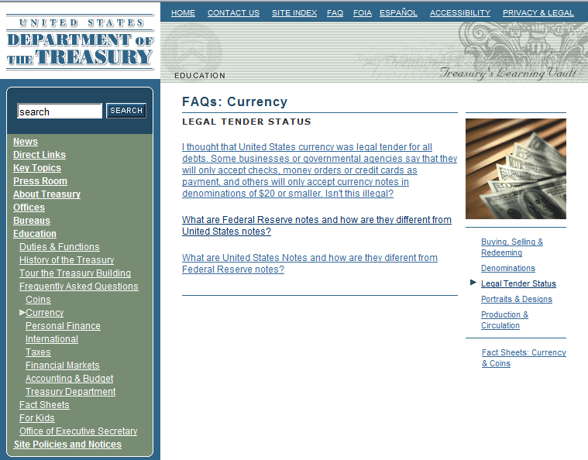
A Federal Reserve Note is not a Dollar - they have no value
U.S. Dept of Treasury web site states:
  Federal Reserve notes are not redeemable in gold, silver or any other commodity, and receive no backing by anything. This has been the case since 1933. The notes have no value for themselves …
http://www.ustreas.gov/education/faq/currency/legal-tender.shtml#q2
No [Determinable] Value
Notes:
The Department of Treasury web-site under it’s frequently asked questions (FAQ) section states that:
“[Federal Reserve notes] are not redeemable in gold, silver or any other commodity, and receive no backing by anything. This has been the case since 1933. The notes have no value for themselves …”
Hence, Federal Reserve notes are unconstitutional, and therefore unlawful. They have no value and as a result, they have been used by Federal Reserve Banks, in cooperation with the government, to perpetrate a “quiet theft” on the citizens of this great country, which we will discuss in more detail shortly.

Slide 18
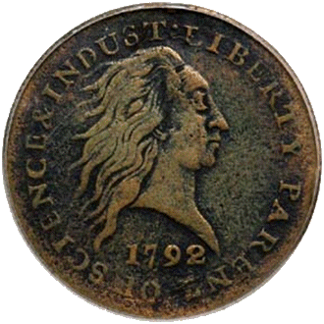
Supreme Court - Coin Money is a Constitutional Requirement
United States v. Marigold, 50 U.S. (9 How.) 560, 567-568 (1850):
  “They [Congress] appertain rather to the execution of an important trust invested by the Constitution, and to the obligation to fulfill that trust on the part of the government, namely, the trust and the duty of creating and maintaining a uniform and pure metallic standard of value throughout the Union. The power of coining money and of regulating its value was delegated to Congress by the Constitution for the very purpose, as assigned by the framers of that instrument, of creating and preserving the uniformity and purity of such standard of value * * *
  "If the medium which the government was authorized to create and establish could immediately be expelled, and substituted by one it had neither created, estimated, nor authorized ­­ one possessing no intrinsic value ­­ then the power conferred by the Constitution would be useless ­­ wholly fruitless of every end it was designed to accomplish. Whatever functions Congress are, by the Constitution, authorized to perform, they are, when the public good requires it, bound to perform; and on this principle, having emitted a circulating medium, a standard of value indispensable for the purposes of the community, and for the action of the government itself, they are accordingly authorized and bound in duty to prevent its debasement and expulsion, and the destruction of the general confidence and convenience …."
1792 Penny
Notes:
Let’s take a moment to review the Constitutional lawful money requirements of the United States:
The Supreme Court understood that our Constitution was ratified with the understanding that the legislature was bound in duty to maintain a pure metallic standard of value and to prevent our monetary unit’s debasement and expulsion. Federal Reserve Notes have done just the opposite and have now caused us great harm.
Federal Reserve Notes are UNCONSTITUTIONAL:
They are not a pure metallic standard of value;
They have no intrinsic value;
They are not created by Congress;
They expelled constitutional money from regular use in commerce.
“If the American people ever allow private banks to control the issue of their money, first by inflation and then by deflation, the banks and corporations that will grow up around them will deprive the people of their property until their children will wake up homeless on the continent their fathers conquered.”,
Thomas Jefferson

Slide 19
The Legislature Knows The Truth
From the Report of the Commission, established pursuant to Public Law 96-389
  “In addition to the compelling economic case for the gold standard, a case buttressed by both historical and theoretical arguments, there is a compelling argument based upon the Constitution. The present monetary arrangements of the United States are unconstitutional --even anti-constitutional-- from top to bottom.” (vol II, pg. 243)
Notes:
On March 31, 1982, Donald T. Regan, the then Secretary of Treasury, delivered the Report from the Commission established pursuant to Public Law 96-389 to the Legislature informing them that the present monetary arrangements [i.e. the Federal Reserve Banking System] of the United States are unconstitutional --even anti-constitutional-- from top to bottom.

Slide 20
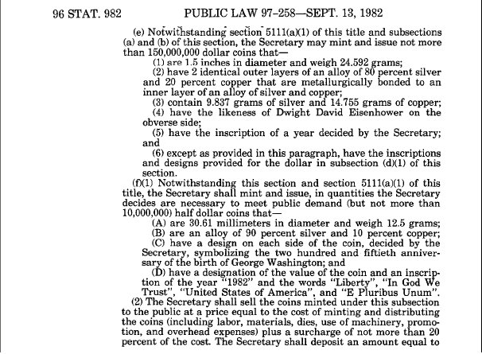
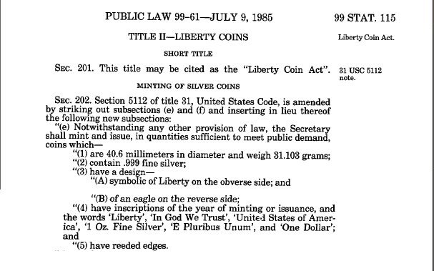
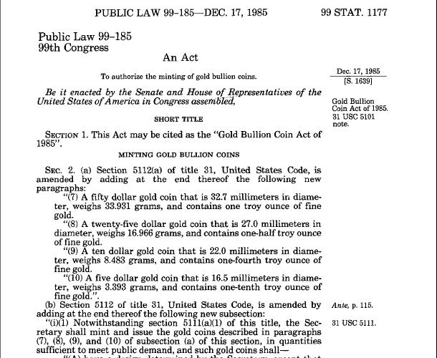
The Legislature Reinstituted Monetary Law
Within 6 Months of the Gold Commission Report, the Legislature reinstitutes lawful Silver Dollar money followed by Gold money in 1985.
Notes:
In less than 6 months after Donald T. Regan delivered the Report from the Commission, Congress enacted its first law, Public Law 97-258 on September 13, 1982 restoring the semblance of constitutionally lawful money. Then in 1985, Congress enacted Public Laws 99-61 and 99-185 that reinstituted constitutionally lawful gold and silver money.

Slide 21
Power of the Purse
Take-away-points
The U.S. monetary system (Federal Reserve System) is unconstitutional and violates the Rule of Law.
The U.S. monetary system is dishonest.
The U.S. monetary system will blow up.

Slide 22

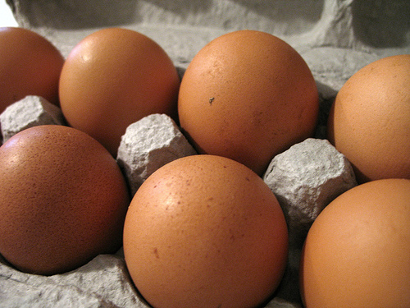
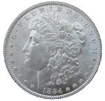
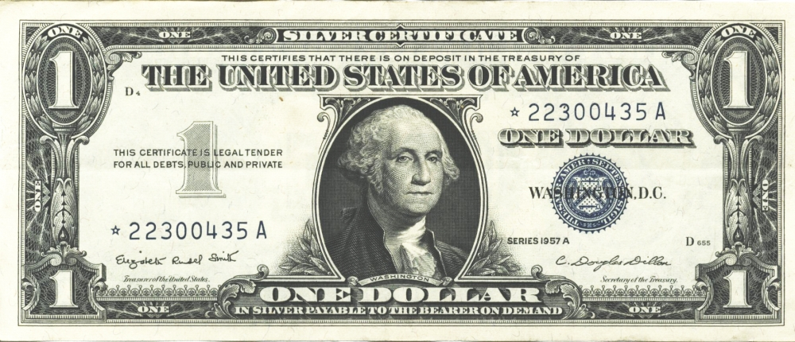
What is the effect of using unconstitutional legal tender?
Property
=
# Egg Cartons
(Brown Eggs)
=
# Lawful Money ($)
# Legal Tender $
1957
=
=
=
U.S. Silver Certificate
1,600 Sq. Ft. Home
~37,700
($)13,500
$13,500
=
No Lawful
Money Available
1982
Fed. Res. Bank Note
1,600 Sq. Ft. Home
~37,700
“$85,400”
2007
=
=
=
Fed. Res. Bank Note
1,600 Sq. Ft. Home
~37,700
($)13,500
“$175,000”
Notes:
So now lets look at the effects of using unconstitutional legal tender Federal Reserve Notes.
Because Federal Reserve Notes have no value in or of themselves and no intrinsic value, they can be inflated in such a manner to make you believe that you made a gain or an accession to wealth, when in fact you had no such gain at all.
Because Federal Reserve Notes have no set fixed value, they can be used to “quietly” steal your wealth with the perception that you had a gain.
Because Federal Reserve Notes have no known or calculable value, they can be used to deceive the citizens into believing they will receive future benefits, such as social security, at today’s purchasing power.

Slide 23
Quiet Theft!
Property
=
# Egg Cartons
(Brown Eggs)
=
# Lawful Money ($)
# Legal Tender $
Buy
1957
=
=
=
U.S. Silver Certificate
1,600 Sq. Ft. Home
~37,700
($)13,500
$13,500
Sell
2007
=
=
=
Fed. Res. Bank Note
1,600 Sq. Ft. Home
~37,700
($)13,500
$175,000
No Cartons of Eggs Gain
No Lawful Money Gain
Federal Reserve Note
“Gain” of $161,500
No Gain No Tax Due
No Gain No Tax Due
Alleged Tax Due
~FRN$55,000
After FRN Tax results in a
Physical Egg Carton Loss of
11,922 Cartons of Eggs
After FRN Tax results in a
Lawful Money Property
Loss of ($)4,269
The purported Federal Reserve Note “Gain” is actually a “quiet theft” in that
it results in a physical property loss with the perception of an actual gain.
Notes:
So now let’s look at an example.
What are the effects of using unconstitutional legal tender notes?
An unrealized loss of capital and property;
A loss of real value;
The loss of the full economic impact of automation.
Brown Egg Data:
EGG ECONOMICS UPDATE reports by Donald Bell, Poultry Specialist (emeritus), University of California , Riverside, CA 92521
http://www.ams.usda.gov/poultry/mncs/ShellEgg/USDAEGGMARKETNEWSREPORT.html
http://www.pathtoinvesting.org/interactive/inflation/simulation_inflation.htm

Slide 24
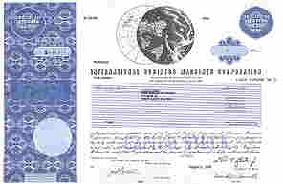
What is the effect of using unconstitutional legal tender?
Stock
=
# Egg Cartons
(Brown Eggs)
=
# Lawful Money $
# Legal Tender $
1962
=
=
=
U.S. Silver Certificate
4 Share IBM Stock
$1,942.00
$1,942.00
~5,424
=
No Lawful
Money Available
1982
Fed. Res. Bank Note
75 Shares IBM Stock after splits
~4,266
“$4,884”
2007
=
=
=
Fed. Res. Bank Note
300 Shares IBM Stock after splits
~6,571
$2,338.56
“$30,501.00”
IBM Stock Splits: 1964-05-18 [5:4], 1966-05-18 [3:2], 1968-04-23 [2:1], May 29, 1973 [5:4], Jun 1, 1979 [4:1], May 28, 1997 [2:1], May 27, 1999 [2:1]
Notes:
So now lets look at the effects of using unconstitutional legal tender Federal Reserve Notes.
Because Federal Reserve Notes have no value in or of themselves and no intrinsic value, they can be inflated in such a manner to make you believe that you made a gain or an accession to wealth, when in fact you had no such gain at all.
Because Federal Reserve Notes have no set fixed value, they can be used to “quietly” steal your wealth with the perception that you had a gain.
Because Federal Reserve Notes have no known or calculable value, they can be used to deceive the citizens into believing they will receive future benefits, such as social security, at today’s purchasing power.

Slide 25
Quiet Theft!
Stock
=
# Egg Cartons
(Brown Eggs)
=
# Lawful Money $
# Legal Tender $
Buy
1962
=
=
=
U.S. Silver Certificate
IBM Stock
~5,424
$1,942.00
$1,942.00
Sell
2007
=
=
=
Fed. Res. Bank Note
IBM Stock
~6,570
$2,338.56
“$30,501.00”
17% Gain in Eggs Cartons
17% Lawful Money Gain
Federal Reserve Note
“94% Gain” of $28,559
Tax Due ~172 Egg Cartons
Tax Due $59.48
Alleged Tax Due (15%)
~FRN$4283.85
After FRN Tax results in a
Physical Egg Carton Loss of
923 Cartons of Eggs
FRN Inflation results in a
83% tax rate or $328.45 of the
$396.56 of the purported gain
The purported Federal Reserve Note “Gain” is actually a “quiet theft” in that
it results in an 83% tax rate with the perception of 15% tax rate.
Notes:
So now let’s look at an example.
What are the effects of using unconstitutional legal tender notes?
An unrealized loss of capital and property;
A loss of real value;
The loss of the full economic impact of automation.
Brown Egg Data:
EGG ECONOMICS UPDATE reports by Donald Bell, Poultry Specialist (emeritus), University of California , Riverside, CA 92521
http://www.ams.usda.gov/poultry/mncs/ShellEgg/USDAEGGMARKETNEWSREPORT.html
http://www.pathtoinvesting.org/interactive/inflation/simulation_inflation.htm

Slide 26
Relevant Law & Cases
31 USC 5119(a)
  “the Secretary shall … maintain the equal purchasing power of each kind of United States currency”
12 USC 411
  “Federal reserve notes … shall be redeemed in lawful money on demand at the Treasury Department of the United States, in the city of Washington, District of Columbia, or at any Federal Reserve bank.”
31 USC 5112(a)(7)-(10), (e)
  These sections define the size weight and pure metal content of each lawful money coin.
Thompson v. Butler,
95 U.S. 694 (1878)
  A dollar is a dollar
  See 5th Cir. Opinion
  Crummy v. Klein ISD,
  No. 08-20133, Oct. 2, 2008
Eisner v. Macomber
252 U.S. 189, 206 (1920)
  Congress cannot by legislation alter the Constitution, from which alone it derives its power to legislate, and within whose limitations alone that power can be lawfully exercised.
United States v. Marigold,
50 U.S. (9 How.) 560 (1850)
  Constitutionally coined money is a pure metallic standard of value; a coin with known intrinsic value.
Notes:
31 USC Sec. 5119 (a): Except to the extent authorized in regulations the Secretary of the Treasury prescribes with the approval of the President, the Secretary may not redeem United States currency (including Federal reserve notes and circulating notes of Federal reserve banks and national banks) in gold. However, the Secretary shall redeem gold certificates owned by the Federal reserve banks at times and in amounts the Secretary decides are necessary to maintain the equal purchasing power of each kind of United States currency. …
The Supreme Court in Thompson v. Butler, 95 U.S. 694 (1878) stated:
A coin dollar is worth no more for the purposes of tender in payment of an ordinary debt than a note dollar. The law has not made the note a standard of value any more than coin. It is true that in the market, as an article of merchandise, one is of greater value than the other; but as money, that is to say, as a medium of exchange, the law knows no difference between them.
However, this decision was rendered prior to the creation of the Federal Reserve System and the enactment of 31 USC 5119(a).

Slide 27
Power of the Purse
Take-away-points
The U.S. monetary system (Federal Reserve System) is unconstitutional and violates the Rule of Law.
The U.S. monetary system is dishonest.
The U.S. monetary system will blow up.

Slide 28
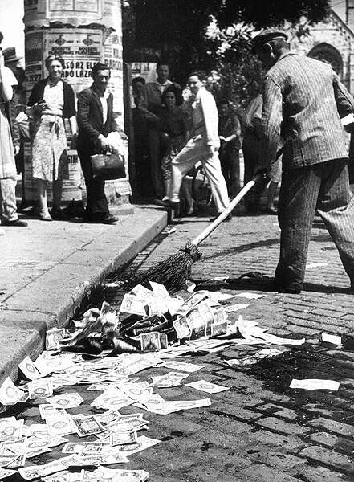
Where we are headed:
Without exceptions, the history of irredeemable legal tender paper & electronic money is that its purchasing power always approaches its cost of production: ZERO
A lifetime’s worth of savings – literally down the sewer!

Slide 29
“The process by which banks create money is so simple that the mind is repelled.”
Money: Whence it came, where it went
John Kenneth Galbraith

Slide 30

How banks create money out of nothing

Slide 31
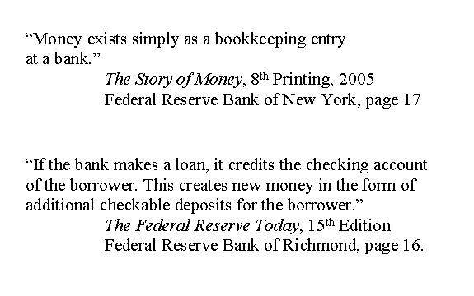

Slide 32
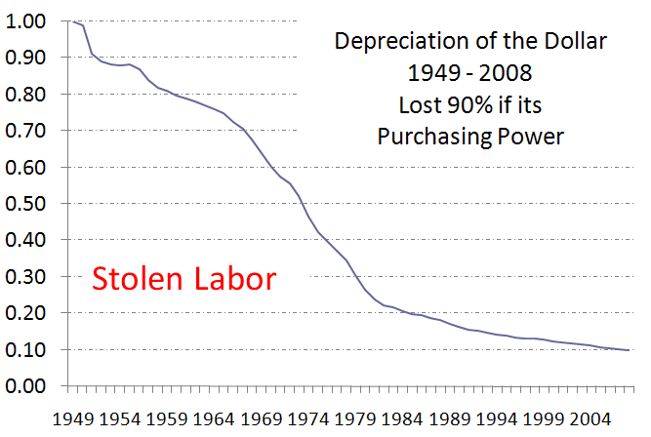

Slide 33
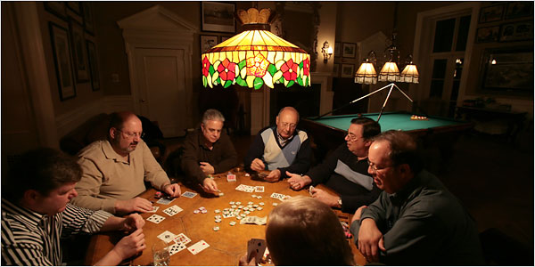
Bankers are gambling with your savings and promises of future payment

Slide 34
Hyper-Inflation History
Country | Year(s) | Highest inflation per month % |  | Country | Year(s) | Highest inflation per month %
Argentina | 1989/90 | 196.60 |  | Hungary | 1923/24 | 82.18
Armenia | 1993/94 | 438.04 |  | Kazakhstan | 1994 | 57.00
Austria | 1921/22 | 124.27 |  | Kyrgyzstan | 1992 | 157.00
Azerbaijan | 1991/94 | 118.09 |  | Nicaragua | 1986/89 | 126.62
Belarus | 1994 | 53.40 |  | Peru | 1988/90 | 114.12
Bolivia | 1984/86 | 120.39 |  | Poland | 1921/24 | 187.54
Brazil | 1989/93 | 84.32 |  | Poland | 1989/90 | 77.33
Bulgaria | 1997 | 242.70 |  | Serbia | 1992/94 | 309,000,000
China | 1947/49 | 4,208.73 |  | Soviet Union | 1922/24 | 278.72
Congo(Zaire) | 1991/94 | 225.00 |  | Taiwan | 1945/49 | 398.73
France | 1789/96 | 143.26 |  | Tajikistan | 1995 | 78.10
Georgia | 1993/94 | 196.72 |  | Turkmenistan | 1993/96 | 62.50
Germany | 1920/23 | 29,525.71 |  | Ukraine | 1992/94 | 249.00
Greece | 1942/45 | 11,288.00 |  | Yugolasvia | 1990 | 58.82
Hungary | 1945/46 | 1.295E+16 |  | Zimbabwe | 2007/09 | 231,000,000
Source: Monetary Regimes and Inflation, by Peter Bernholz

Slide 35
Thomas Paine
"The laws of a country ought to be the standard of equity and calculated to impress on the minds of the people the moral as well as the legal obligations of political justice. But tender laws, of any kind, operate to destroy morality, and to dissolve by the pretense of law what ought to be the principle of law to support, reciprocal justice between man and man; and the punishment of a member who should move for such a law ought to be DEATH."

Slide 36
We have a Constitutional Crisis
Article I Section 10, Clause 1
No State shall make any Thing but gold and silver Coin a Tender in Payment of Debts
  What does Texas declare is legal tender?
  Does Texas enforce payments of taxes, fines and other debts in anything other than gold in silver coin?
Since the federal constitution has removed all danger of our having a paper tender, our trade advanced fifty percent. Our monied people can trust their cash [throughout the country], and have brought their coin into circulation.
Benjamin Franklin, Publisher and Signer of the Constitution of the United States The Pennsylvania Gazette, December 16, 1789.
Notes:
Quote from Penn Gazette pg 4. middle column, Dec. 16, 1789.

Slide 37
History shows us the solution!
1786 – Paper Money
(Articles of Confederation period)
Blood running in the streets. Mobs of rioters and demonstrators threatening banks and legislators. Looting of shop and liotne. Credit ruined. Strikes and unemployment. Trade and distribution paralyzed. Shortages of food. Bankruptcies everywhere. Court dockets overloaded. Kidnappings for heavy ransom. Sexual perversion, drunkenness, lawlessness rampant.
America, 1786: George Washington to James Madison
1791 – Coin Money
(Constitutional Law reigns)
Tranquility reigns among the people with that disposition towards the general government which is likely to preserve it. Our public credit [with its foundation on solid money] stands on high ground which three years ago it would have been considered as a species of madness to have foretold.
July 20, 1791, George Washington to David Humphreys
“If anyone had predicted that our economic and social ills could have been solved by simply making nothing but gold and silver coin our money, he would have been call crazy” paraphrase George Washington taken from MOMS 7th Edition pg. 60

Slide 38
Power of the Sword
Take-away-points
Peoples have a Right to defend their Power & Liberty
  Rights and Freedom Retained by the People
    Amendment 9: The enumeration in the Constitution, of certain rights, shall not be construed to deny or disparage others retained by the people.
  Powers of the State and People
    Amendment 10: The powers not delegated to the United States by the Constitution, nor prohibited by it to the States, are reserved to the States respectively, or to the people.
Constitution provides 3 methods for the People to retain their Power & Liberty
  Redress (Power of the Purse)
  Militias (Power of the Sword)
  The Ballot

Slide 39
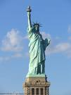
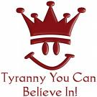
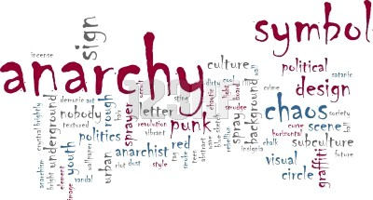
The Balance of Individual Freedom
Tyranny
Anarchy
Jer 10:23 O LORD, I know that the way of man is not in himself: it is not in man that walks to direct his steps.

Slide 40
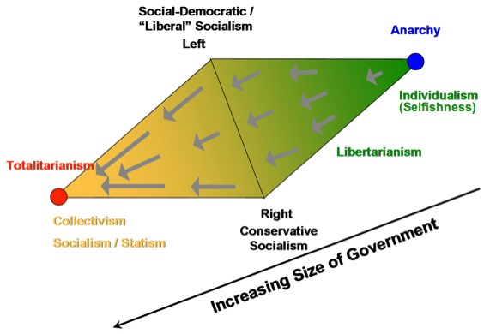
The Two-Dimensional (Diamond) Political Paradigm
Source: http://www.truthandliberty.com/Politics.html

Slide 41
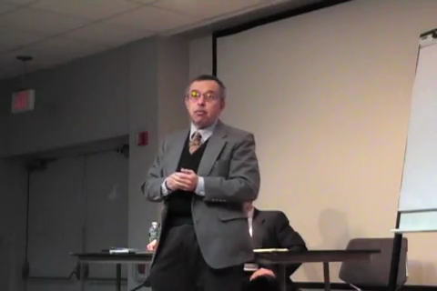
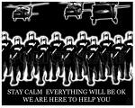

A Free State or Police State
Police State Free State

Slide 42
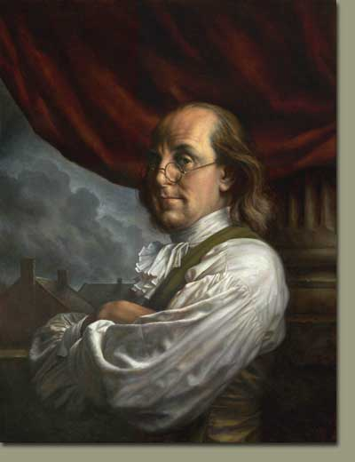
What form of Government?
Unlike prior forms of government, the Founding Fathers’ created a Republic form of government that the People themselves correct; without having to abolish that form of government to which they are accustomed. Hence the Founders provided a means within the Constitution whereby We the People could repel enemies be they foreign or domestic, terrorists or tyrants, or usurpers of Constitutional authority.
A Republic if you can keep it.
We the People, via the Constitution, have been given both the Power of the Sword and Purse to repel all enemies – foreign or domestic, terrorists or tyrants, or usurpers – by and through the Militia of the Several States, the use and control of lawful money and the redress provisions of the Constitution and the Bill of Rights.
“,,, if you can keep it.” Not if the government can keep it or our representatives can keep it, but if you (We the People of these United States) can keep it for ourselves and by ourselves.
  We the People are personally responsible for maintaining and protecting the Constitution and seeing to its enforcement against all foes, be they foreign or domestic.
Ben Franklin 1787

Slide 43
Citizens’ Power of the Sword Militia of the Several States
U.S. Constitution Article 1 § 8 clause 15
  To provide for calling forth the Militia to execute the Laws of the Union, suppress Insurrections and repel Invasions;
U.S. Constitution Article 1 § 8 clause 16
  To provide for organizing, arming, and disciplining, the Militia, and for governing such Part of them as may be employed in the Service of the United States, reserving to the States respectively, the Appointment of the Officers, and the Authority of training the Militia according to the discipline prescribed by Congress;
Amendment II (2) to the U.S. Constitution
  A well regulated Militia, being necessary to the security of a free State, the right of the people to keep and bear Arms, shall not be infringed.

Slide 44
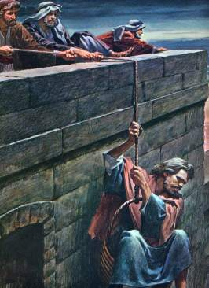
Paul exercised his Rights against Tyrants and Usurpers
In like manner, We the People have the right and responsibility to exercise our rights against Tyrants and Usurpers.
  Luke 22:36 And Jesus said to them, But now, he who has a purse, let him take it , and likewise his wallet. And he who has no sword, let him sell his garment and buy one.
"Without doubt one is allowed to resist against the unjust aggressor to one’s life, one’s goods or one’s physical integrity; sometimes, even 'til the aggressor’s death... In fact, this act is aimed at preserving one’s life or one’s goods and to make the aggressor powerless.”
Acts 16:37
“But Paul said to the officers: "They beat us publicly without a trial, even though we are Roman citizens, and threw us into prison. And now do they want to get rid of us quietly? No! Let them come themselves and escort us out."
2 Cor 11:32-33
In Damascus the governor,
under King Aretas had the city guarded in
order to arrest
me.
33 But I was lowered in a
basket from a
window in the wall and slipped through his hands.
Notes:
Quote from Thomas Aquinas as published at: http://www.lewrockwell.com/orig2/stagnaro4.html

Slide 45
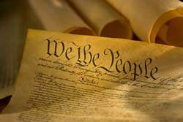
We the People of the
United States, in Order
to form a more perfect
Union, establish Justice
insure domestic
Tranquility, provide for
the common defense,
promote the general
Welfare, and secure the
Blessings of Liberty to
ourselves and our
Posterity, do ordain and
Establish this Constitution
For the United States of America.

Slide 46
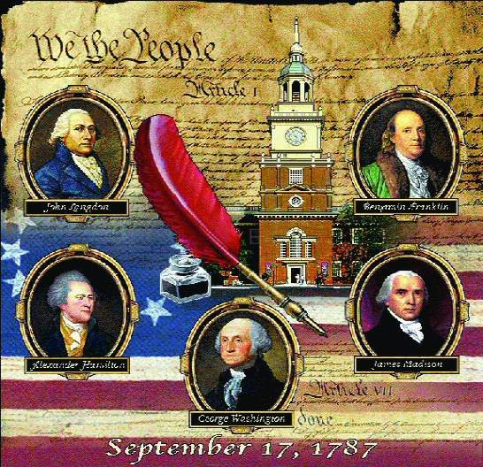
In 1867 the North American Review summed up the Founding Fathers’ accomplishment:
“The American government and the Constitution is the most precious possession which the world holds, or which the future can inherit. This is true—true because the American system of government is the political expression of Christian ideas.”

Slide 47
Matt 6:31-34
31 "Do not be anxious then, saying, 'What shall we eat?' or 'What shall we drink?' or 'With what shall we clothe ourselves?' 32 "For all these things the Gentiles eagerly seek; for your heavenly Father knows that you need all these things.
33 "But seek first His kingdom and His righteousness; and all these things shall be added to you.
34 "Therefore do not be anxious for tomorrow; for tomorrow will care for itself. Each day has enough trouble of its own.
Luke 22:36-37
He said to them, "But now if you have a purse, take it, and also a bag; and if you don't have a sword, sell your cloak and buy one.
1 Tim 6:6-7
6 but godliness with contentment is great gain.
7 For we brought nothing into the world, and we can take nothing out of it.
8 But if we have food and clothing, we will be content with that.

Slide 48
Current and past Presidents have signed several unconstitutional executive orders giving his office sole authority to impose martial law, and suspend habeas corpus. Hence the President has dictatorial Powers over the people with no checks and balances.
Executive order #11921 Provide that the President can declare a state of emergency that is not defined, and congress cannot review the action for six months.
Executive ORDER # 10990 allows the government to take over all modes of transportation.
Executive ORDER # 10995 the government to seize and control the communication media
Executive ORDER # 10997 allows the government to take over all electrical Power, gas, petroleum, fuels and minerals.

Slide 49
EXECUTIVE ORDER # 10998 allows the government to take over all food resources and farms.
EXECUTIVE ORDER #11000 allows the government to mobilize civilians into work brigades under government supervision.
EXECUTIVE ORDER #11001 allows the government to take over all health, education and welfare functions.
EXECUTIVE ORDER #11002 designates the Postmaster
General to operate a national registration of all persons.
EXCUTIVE ORDER # 11004 allows the Housing and Finance Authority to relocate communities, build new housing with public funds, designate areas to be abandoned and establish new locations for populations.

Slide 50
Those who do not know their history are doomed to repeat it.
Ecclesiastes 1:9
  That which has been is that which shall be; and that which has been done is that which shall be done; and there is nothing new under the sun.
Supreme Court final decision on “Emergency”
  Emergency does not create power. Emergency does not increase power or remove or diminish the restrictions upon power granted or reserved. The Constitution was adopted in a period of grave emergency. Its grants of power to the Federal Government and its limitations of the power of the States were determined in the light of emergency and they are not altered by emergency. Home Building & Loan Assoc. v. Blaisdell 290 U.S. 395, 425 (1934)

Slide 51
What Can We Do?
Pray
  1 Tim 2:1-3
    I urge, then, first of all, that requests, prayers, intercession and thanksgiving be made for everyone-- for kings and all those in authority, that we may live peaceful and quiet lives in all godliness and holiness. This is good, and pleases God our Savior,
Study Our Constitution and Laws
  Hosea 4:6
    My people are destroyed for lack of knowledge. Because you have rejected knowledge, I will also reject you from being priest to Me. Since you have forgotten the law of your God, I will also forget your sons, even I.
Elect Honorable Men to Public Office

