Slide 1


The Dollar
The Constitutional Guarantee of the Value of our Money & Wealth
=
Notes:
“If the American people ever allow private banks to control the issue of their money, first by inflation and then by deflation, the banks and corporations that will grow up around them will deprive the people of their property until their children will wake up homeless on the continent their fathers conquered.”, Thomas Jefferson
Have you ever pondered the question “What is money?”
Have you ever thought about what money represents?
Have you ever asked yourself whether money is a unit of measure of wealth, value or some combination thereof?
Have you ever asked yourself whether money represents a fixed unit of measurement or a variable unit of measurement? And if a variable unit of measurement than who gets to decide its value at any moment in time?
Have you ever studied our Constitution to see what it says about money?
Well today, I hope to be able to definitively answer all of these questions and more.

Slide 2
Do you know the answers to these questions?
What is a Dollar?
What is a Federal Reserve Note?
What is significant about the word “Dollar” appearing in the Constitution of the United States of America?
What is Lawful Money?
Does the Constitution allow the United States to issue or print paper money?
Notes:
Please answer the following 5 questions:
What is a Dollar? _______________________________________________
What is a Federal Reserve Note? __________________________________
What is significant about the word “Dollar” appearing in the Constitution of the United States of America?
______________________________________________________________
What is Lawful Money? ___________________________________________
Does the Constitution allow the United States to issue or print paper money?
______________________________________________________________

Slide 3
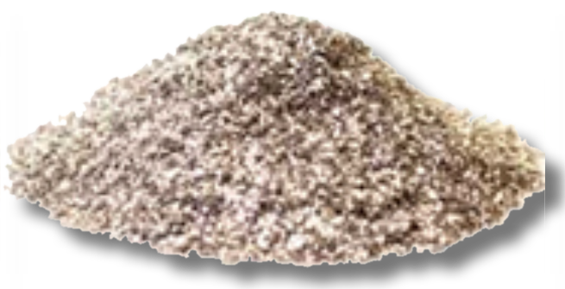
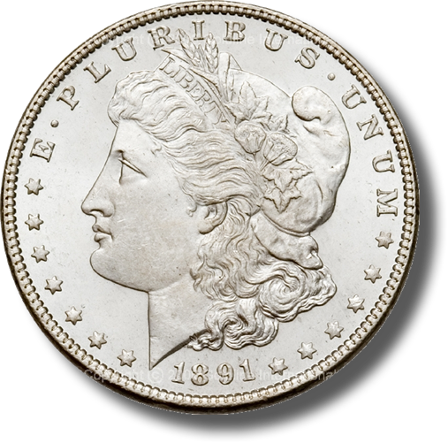
What is a Dollar?
A Dollar is a standard unit of measurement of
Money:
371 ¼ grains of Silver minted
= $1.00
Analogous
Time:
24 Hours = 1 Day * 7 = 1 Week
Weight:
16 Ounces = 1 Pound * 2000 = 1 Ton
Length:
1 Inch * 12 = 1 Foot * 3 = 1 Yard
Notes:
The word Dollar is in fact a standard unit of measurement of money; it is analogous to an “hour” for time, an “ounce” for weight, and an “inch” for length.
The Dollar is our Country’s standard unit of measurement for money.
How do you feel when you go to a gas station and pump “25 gallons of gas” into your 12 gallon tank?
Or you went to the lumber yard and purchased an eight foot piece of lumber, and when you got home you discovered that it was actually only 6 ½ feet long?
How would you feel if you went to the grocery store and purchased what you believed were 2 lbs. of bananas, but when you got home you found out that you actually only purchased ¾ of a pound of bananas?
I bet you would feel ripped off.
Now what if I told you that the green Federal Reserve Notes that you have in your pocket, which purports to be of some “dollar” value, are currently worth less than 1/16 the constitutionally guaranteed value in lawful money. I bet you would be really ticked off.
Well folks, be prepared to be very ticked off.

Slide 4
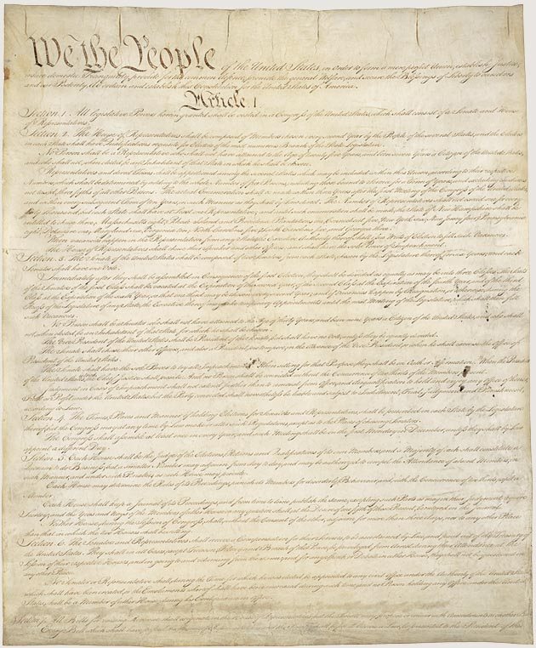
The Dollar of the Constitution
Article I Section 8, Clause 5
[The Congress shall have Power] To coin Money, regulate the Value thereof, and of foreign Coin, and fix the Standard of Weights and Measures;
Article I Section 9, Clause 1
… a Tax or duty may be imposed on such Importation, not exceeding ten dollars for each Person.
Article I Section 10, Clause 1
No State shall … make any Thing but gold and silver coin a Tender in Payments of Debts.
Amendment VII
In Suits at common law, where the value in controversy shall exceed twenty dollars, the right of trial by jury shall be preserved, and no fact tried by a jury, shall be otherwise re-examined in any Court of the United States, than according to the rules of the common law.
Notes:
Remember what was written in The Pennsylvania Gazette, December 16, 1789: “Since the federal constitution has removed all danger of our having a paper tender, our trade advanced fifty percent. Our monied people can trust their cash [throughout the country], and have brought their coin into circulation.”
It is rather ironic that during the first 124 years of our Republic’s existence (1789 – 1913), it was well understood by the general public that the word “Dollar” means a pure metallic silver coin of a known fixed unit of measurement for money, value and wealth.
Over the next 55 years (1913 – 1968), the definition of the Dollar was slowly removed from public education, dictionaries and our court rooms to the point that in 1968 Congress unconstitutionally eliminated the fundamental and necessary requirement of silver from the “public” definition of the word “Dollar”. Hence our constitutionally guaranteed fixed standard unit of measure of money and wealth was hijacked.
Finally, on 15 August 1971, President Richard Nixon unconstitutionally terminated redemption of Federal Reserve Notes in gold internationally, ending the connection between the Federal Reserve System and any “constitutional” money whatsoever.

Slide 5
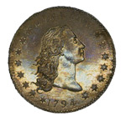
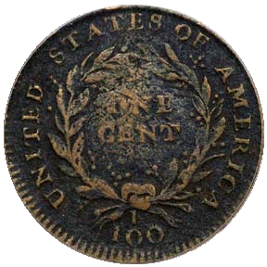
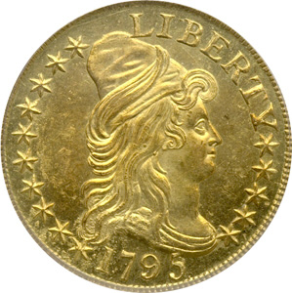
Congress’ Responsibility to Regulate the Value of Coin
Key:
1 troy oz = 480 grains 1 troy oz = 31.1034 grams 1 troy oz = 1.09714 oz
X 100 = (4,630 grains of Copper)
1 Cent (46.3 grains of Copper)
1 Dollar (371.25 grains Silver)
X 10 = (3,712.5 grains of Silver)
1 Dollar (371.25 grains Silver)
10 Dollar (247.5 grains Gold)
Congress has the responsibility to regulate the value of all minted coins to the fixed pure metal Dollar standard
Notes:
By empowering Congress “To coin Money, [and] regulate the Value thereof”, Article I, Section 8, Clause 5 of the Constitution of the United States, guarantees a national system of coinage with uniform intrinsic value. By explicitly referring to “dollars”, in Article I, Section 9, Clause 1 and the Seventh Amendment of the Constitution of the United States, fixed the silver minted dollar coin as the monetary-unit by which Congress must “regulate the Value” of all other coinage too.
On their face, the monetary powers and disabilities set out in the Constitution are eminently suitable for these goals:
By denying the States any power to “emit Bills of Credit” or “coin Money”, Article I, Section 10, Clause 1 eradicates the “fallacious Medium” of regional paper currencies and eliminates multiple systems of coinage throughout the country.
The Clause also limits the States’ legal-tender power to “gold and silver Coin”, thereby establishing specie as the sole constitutional medium for governmentally enforced “Payment of Debts”.
By empowering Congress “To coin Money, [and] regulate the Value thereof”, Article I, Section 8, Clause 5 creates a national system of coinage with uniform intrinsic value.
By explicitly referring to “dollars”, Article I, Section 9, Clause 1 and the Seventh Amendment fix the silver Spanish milled dollar as the money-unit by which Congress should “regulate the Value” of all other coinage.
By not including the language “emit bills” that the Articles of Confederation contained, Article I, Section 8, Clause 2 disables Congress from issuing any paper currency. And by limiting Congress’s power to punish counterfeiting to “Securities” and “current Coin”, Article I, Section 8, Clause 6 confirms that Congress may “coin Money” itself, or raise “Money” by “borrow[ing]”, but not “emit”, “issue”, “create”, “make”, or “declare what shall be” “Money” in any other way.
Thus, the word “dollar[s]” by its use in the Constitution of the United States has a fixed meaning that can only be changed by Constitutional Amendment. And that meaning is a minted coin containing at least 371 ¼ grains of .99 fine silver. Congress’s responsibility is to regulate the value of coins made of other metals, such as a penny made with copper or a nickel made of nickel, relative to the weight of the one-dollar silver coin.

Slide 6
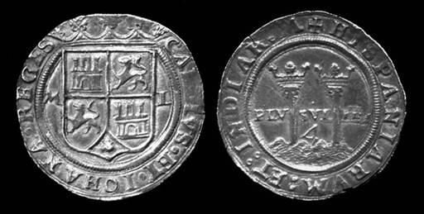
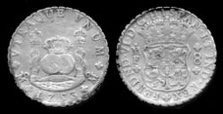
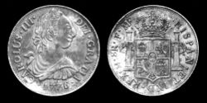
A Bit of History
The “Dollar” is a fixed standard unit of measurement that was established in 1497 by King Ferdinand and Queen Isabella of Spain. It is a minted coin containing at least 371⁴/₁₆ grains of fine (pure) Silver.
Silver eight real coin of Carlos and Johanna of Spain, dated ca. 1544, depicting the Pillars of Hercules on the reverse.
Silver eight real coin of King Ferdinand VI of Spain, dated 1753.
Silver eight real coin of King Carlos III of Spain, dated 1776.
Notes:
The definition of a Dollar goes back to 1497, it was the “royal money” of King Ferdinand and Queen Isabella of Spain, See, e.g., J. Earl Massey, America’s Money: the Story of Our Coins and Currency (1968), at 33-36; T. Schwarz, A History of United States Coinage (1980), at 29.
By 1518 the Dollar monetary unit standard became so well accepted that coins were also being minted in the valley of St. Joachim, in Bohemia (middle thirds of the Czech Republic)
As a matter of fact:
Webster's 1958 New Collegiate Dictionary defined the Dollar as:
Any of three U.S. Coins: First issued in 1794 and since 1837 weighing 412.5 grains of silver .900 fine [412.5 * .9 = 371.25 fine (pure) silver];
A silver coin of 420 grains called a trade dollar containing 378 grains of pure metal and 42 grains of alloy;
A gold coin of 25.8 grains .900 fine;
Webster’s 1913 dictionary defined the Dollar as:
A silver coin of the United States containing 371 ¼ grains of silver and 41.25 grains of alloy, that is, having a total weight of 412.5 grains.
A gold coin of the United States containing 23.22 grains of gold and 2.58 grains of alloy, that is, having a total weight of 25.8 grains, nine-tenths fine. It is no longer coined.
NOTE: Previous to 1837 the silver dollar had a larger amount of alloy, but only the same amount of silver as now, the total weight being 416 grains. The gold dollar as a distinct coin was first made in 1849. The eagles, half eagles, and quarter eagles coined before 1834 contained 24.75 grains of gold and 2.25 grains of alloy for each dollar.
(http://machaut.uchicago.edu/?resource=Webster%27s&word=Dollar&use1913=on&use1828=on)
Today’s dictionary definition of the word “Dollar” is:
A Dollar bill. A paper note printed by the Treasury, or by the Federal Reserve Banks under authority of the treasury, having the purported value of one dollar. Prior to 1964 such notes could be redeemed for the equivalent dollar value of silver coins, but in that year the backing of the currency with silver was discontinued. Such notes not convertible into precious metals at a fixed rate are called "fiat money", receiving their value solely from the good faith of the issuing government or bank.
(http://machaut.uchicago.edu/?resource=Webster%27s&word=Dollar&use1913=on&use1828=on at item 3)

Slide 7
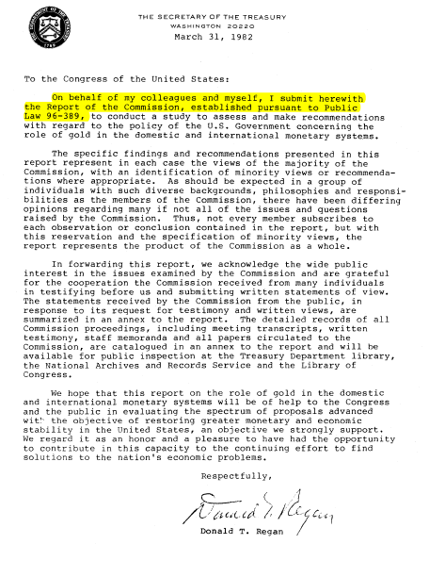
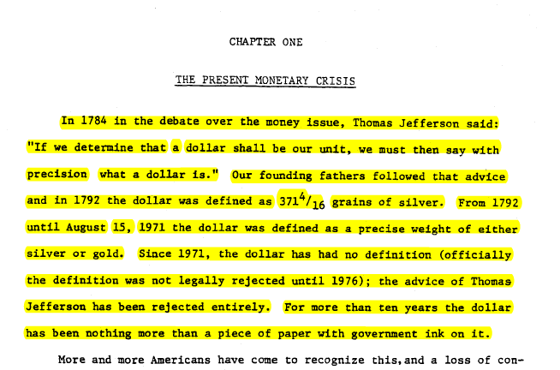
The Dollar of the Constitution: A coin containing 371¼ grains of Silver
In 1784 …Thomas Jefferson said:
“If we determine that a dollar shall be our unit, we must then say with precision what a dollar is." Our founding fathers followed that advice and in 1792 the dollar was defined as 371 ¼ grains of silver. From 1792 until August 15, 1971 the dollar was defined as a precise weight of either silver or gold.”
Notes:
During the period from 1775 through 1779, Congress authorized numerous emissions of Continental Currency and other bills of credit, ostensibly redeemable in silver Spanish milled dollars (or their equivalent in silver or gold), with the Colonies on “the faith of the United States” pledged for their eventual redemption. In total, Congress emitted some 241,500,000 in Continental Currency—a production elephantine in comparison to the 10,000,000 in silver and gold estimated to have comprised the money supply in early 1775.
By the time 1784 came around, the phrase “Worthless as a Continental” was so popular that Thomas Jefferson said: “If we determine that a dollar shall be our unit, we must then say with precision what a dollar is."
By the time the Constitution of the United States of America was formally adopted in 1789, the Dollar standard unit, a minted coin containing 371 ¼ grains of silver, was adopted as the fixed standard monetary unit of the United States with the following constitutional requirements: “No State shall … make any Thing but gold and silver Coin a Tender in Payment of Debts” (Article 1, Section 10, clause 1 of the Constitution of the United States of America)

Slide 8
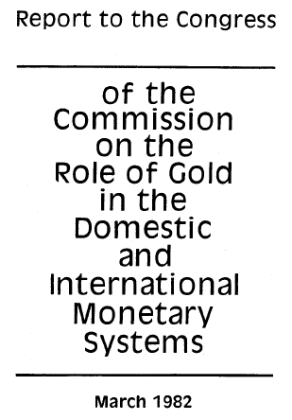
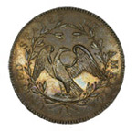
The Dollar (Silver) coin guarantees citizens a fixed measure of value
The constitutional Dollar – a minted Coin containing 371 ¼ grains of silver – guarantees value:
“It is significant that this power of coining money is mentioned in the same sentence in the Constitution as the power to "fix the standards of weights and measures,“ for the framers regarded money as a weight of metal and a measure of value. Roger Sherman, a delegate to the Constitutional Convention, wrote that “If what is used as a medium of exchange is fluctuating in its value, it is no better than unjust weights and measures…which are condemned by the Laws of God and man …".
1794 Silver Dollar America's First Silver Dollar Struck
Notes:
Roger Sherman (http://www.constitutionfacts.com/constitution/Signers.htm), the Connecticut delegate to the Constitutional Convention, believed so strongly in the necessity of coined metallic money that he said “If what is used as a medium of exchange is fluctuating in its value, it is no better than unjust weights and measures…which are condemned by the Laws of God and man …” and he and the majority of other delegate only gave their vote for the ratification of the Constitution after the dollar (a minted coin containing at least 371 ¼ grains of silver) was agreed to be the official unit of currency and money for the United States of America.
As Madison’s notes record:
Mr READ, thought the words: “and emit bills on the credit of the United States", if not struck out or forbade from practice as specifically required by the ratified constitution, would be as alarming as the mark of the Beast in Revelations.
Hence Article 1, Section 10 of the Constitution of the United States of America states:
“No State shall enter into any Treaty, Alliance, or Confederation; grant Letters of Marque and Reprisal; coin Money; emit Bills of Credit; make any Thing but gold and silver Coin a Tender in Payment of Debts; pass any Bill of Attainder, ex post facto Law, or Law impairing the Obligation of Contracts, or grant any Title of Nobility”
The report is available at the Library of Congress

Slide 9
What is a Federal Reserve Note?
It is a Private Bank Note
(It is a promise from the bank to pay real lawful money)
It is Redeemable for Lawful Money on Demand
(Pursuant to Title 12 U.S.C. § 411)
It is NOT Constitutionally Authorized Money
(Constitution only authorizes gold or silver Coin as Tender in Payment of Debts within the 50 states of the Union, see Article I Section 10, Clause 1)
Notes:
“The Federal Reserve Bank is no more ‘Federal’ than Federal Express”, G. Edward Griffin (Author)
Federal Reserve Banks are quasi-private banks that are part of the Federal Reserve System. (http://www.stlouisfed.org/news/speeches/2006/03_30_06.htm)
What are Federal Reserve bank notes?
Federal Reserve bank notes are promissory notes issued by the Federal Reserve Banks.
The Federal Reserve bank notes, by law – Title 12 U.S.C. 411, are [supposed to be] redeemable for lawful money on demand, which Constitutionally speaking are minted coins containing 371 ¼ grains of pure silver or its gold equivalent as regulated by Congress pursuant to Article I Section 8, Clause 5.
“[Congress has the] obligation to fulfill that trust on the part of the government, namely, the trust and the duty of creating and maintaining a uniform and pure metallic standard of value throughout the Union. The power of coining money and of regulating its value was delegated to Congress by the Constitution for the very purpose, as assigned by the framers of that instrument, of creating and preserving the uniformity and purity of such standard of value … If the medium which the government was authorized to create and establish could immediately be expelled, and substituted by one it had neither created, estimated, nor authorized ­­ one possessing no intrinsic value ­­ then the power conferred by the Constitution would be useless ­­ wholly fruitless of every end it was designed to accomplish. …” United States v. Marigold, 50 U.S. (9 How.) 560, 567-68 (1850)
Federal Reserve Notes are UNCONSTITUTIONAL:
They are not a pure metallic standard of value;
They have no intrinsic value;
They are not created by Congress;
They expelled constitutional money from regular use in commerce.

Slide 10
Federal Reserve Notes are NOT Dollar$ or Lawful Money
-CITE-
12 USC Sec. 411 01/03/05
-EXPCITE-
TITLE 12 - BANKS AND BANKING
CHAPTER 3 - FEDERAL RESERVE SYSTEM
SUBCHAPTER XII - FEDERAL RESERVE NOTES
-HEAD-
Sec. 411. Issuance to reserve banks; nature of obligation; redemption
-STATUTE-
Federal reserve notes, to be issued at the discretion of the Board of Governors of the Federal Reserve System for the purpose of making advances to Federal reserve banks through the Federal reserve agents as hereinafter set forth and for no other purpose, are authorized. The said notes shall be obligations of the United States and shall be receivable by all national and member banks and Federal reserve banks and for all taxes, customs, and other public dues. They shall be redeemed in lawful money on demand at the Treasury Department of the United States, in the city of Washington, District of Columbia, or at any Federal Reserve bank.
=
Federal reserve notes shall be redeemed in lawful money on demand.
Notes:
As we have now seen, there is a specific constitutional prohibition to emit paper money; hence why Federal Reserve Notes cannot be nor have ever been lawful money of the United States. They are simply a form of fiat currency forced upon the citizens of the United States of America in their ignorance.
However, Title 12 United States Code section 411 gives us a remedy to demand constitutionally lawful money from the Federal Reserve Bank and we need to start making our demand.

Slide 11
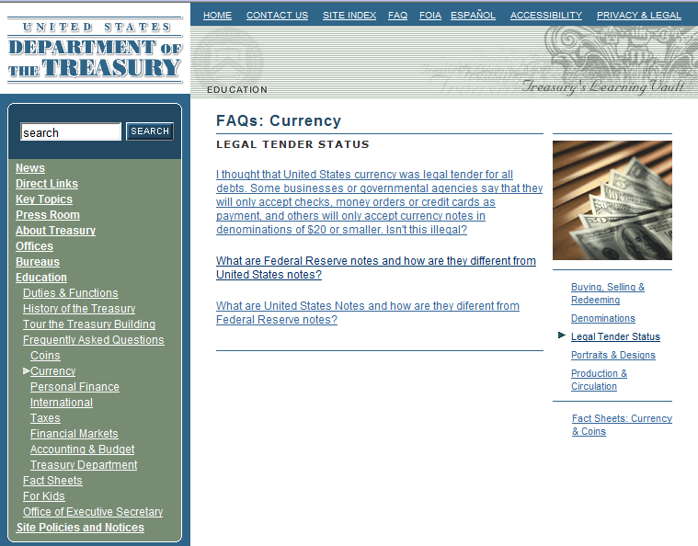
A Federal Reserve Note is not a Dollar - they have no value
U.S. Dept of Treasury web site states:
Federal Reserve notes are not redeemable in gold, silver or any other commodity, and receive no backing by anything. This has been the case since 1933. The notes have no value for themselves …
http://www.ustreas.gov/education/faq/currency/legal-tender.shtml#q2
No [Determinable] Value
Notes:
The Department of Treasury web-site under it’s frequently asked questions (FAQ) section states that:
“[Federal Reserve notes] are not redeemable in gold, silver or any other commodity, and receive no backing by anything. This has been the case since 1933. The notes have no value for themselves …”
http://www.ustreas.gov/education/faq/currency/legal-tender.shtml#q2
Hence, Federal Reserve notes are unconstitutional, and therefore unlawful. They have no value and as a result, they have been used by Federal Reserve Banks, in cooperation with the government, to perpetrate a “quiet theft” on the citizens of this great country, which we will discuss in more detail shortly.

Slide 12
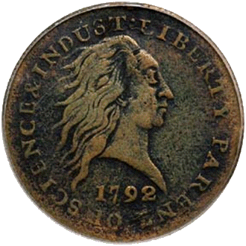
Supreme Court - Coin Money is a Constitutional Requirement
United States v. Marigold, 50 U.S. (9 How.) 560, 567-68 (1850):
“They [Congress] appertain rather to the execution of an important trust invested by the Constitution, and to the obligation to fulfill that trust on the part of the government, namely, the trust and the duty of creating and maintaining a uniform and pure metallic standard of value throughout the Union. The power of coining money and of regulating its value was delegated to Congress by the Constitution for the very purpose, as assigned by the framers of that instrument, of creating and preserving the uniformity and purity of such standard of value * * *
"If the medium which the government was authorized to create and establish could immediately be expelled, and substituted by one it had neither created, estimated, nor authorized ­­ one possessing no intrinsic value ­­ then the power conferred by the Constitution would be useless ­­ wholly fruitless of every end it was designed to accomplish. Whatever functions Congress are, by the Constitution, authorized to perform, they are, when the public good requires it, bound to perform; and on this principle, having emitted a circulating medium, a standard of value indispensable for the purposes of the community, and for the action of the government itself, they are accordingly authorized and bound in duty to prevent its debasement and expulsion, and the destruction of the general confidence and convenience …."
1792 Penny
Notes:
The Supreme Court understood that our Constitution was ratified with the understanding that the legislature was bound in duty to maintain a pure metallic standard of value and to prevent our monetary unit’s debasement and expulsion, which the Federal Reserve Note has done.
Federal Reserve Notes are UNCONSTITUTIONAL:
They are not a pure metallic standard of value;
They have no intrinsic value;
They are not created by Congress;
They expelled constitutional money from regular use in commerce.
“If the American people ever allow private banks to control the issue of their money, first by inflation and then by deflation, the banks and corporations that will grow up around them will deprive the people of their property until their children will wake up homeless on the continent their fathers conquered.”, Thomas Jefferson

Slide 13
The Legislature Knows The Truth
From the Report of the Commission, established pursuant to Public Law 96-389
“In addition to the compelling economic case for the gold standard, a case buttressed by both historical and theoretical arguments, there is a compelling argument based upon the Constitution. The present monetary arrangements of the United States are unconstitutional --even anti-constitutional-- from top to bottom.” (vol II, pg. 243)
Notes:
On March 31, 1982, Donald T. Regan, the then Secretary of Treasury, delivered the Report from the Commission established pursuant to Public Law 96-389 to the Legislature informing them that the present monetary arrangements [i.e. the Federal Reserve Banking System] of the United States are unconstitutional --even anti-constitutional-- from top to bottom.

Slide 14
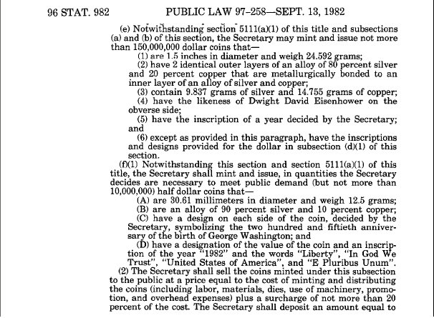
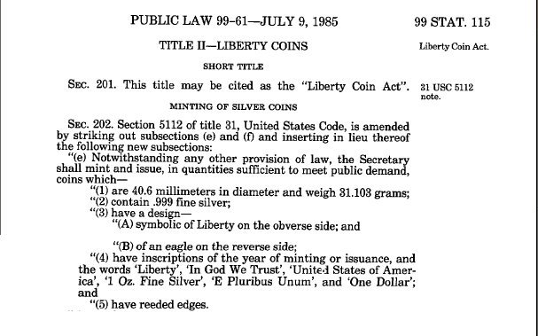
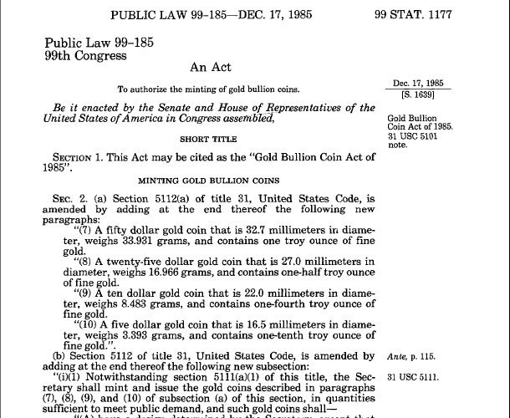
The Legislature Reinstituted Monetary Law
Within 6 Months of the Gold Commission Report, the Legislature reinstitutes lawful Silver Dollar money followed by Gold money in 1985.
Notes:
In less than 6 months after Donald T. Regan delivered the Report from the Commission, Congress enacted its first law, Public Law 97-258 on September 13, 1982 restoring the semblance of constitutionally lawful money. Then in 1985, Congress enacted Public Laws 99-61 and 99-185 that reinstituted constitutionally lawful gold and silver money.

Slide 15
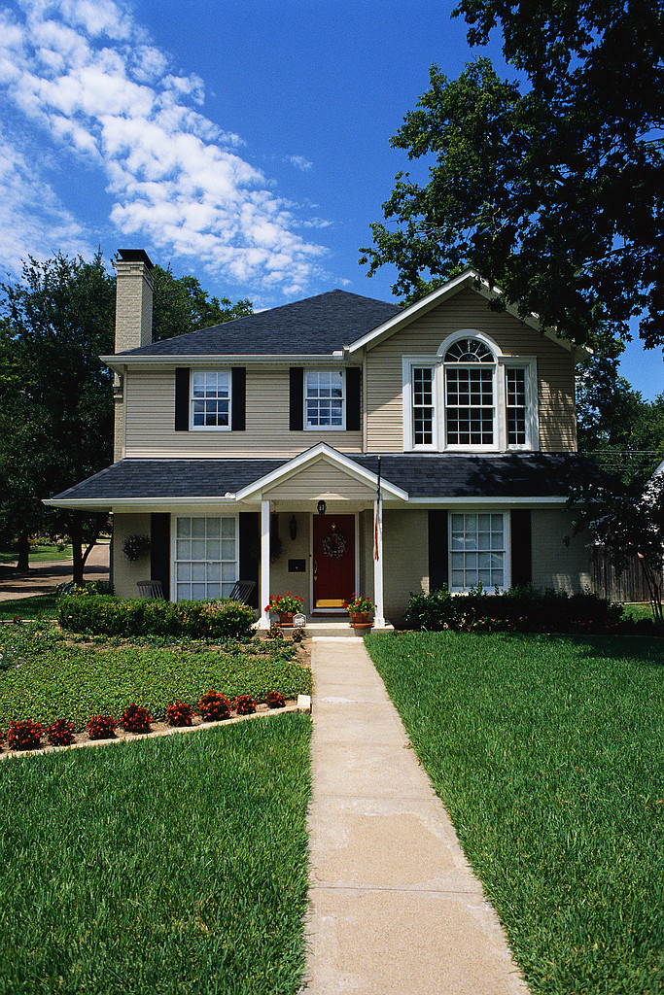
What is the effect of using unconstitutional legal tender?
Property
1957
1,600 Sq. Ft. Home
Notes:
So now lets look at the effects of using unconstitutional legal tender Federal Reserve Notes.
Because Federal Reserve Notes have no value in or of themselves and no intrinsic value, they can be inflated in such a manner to make you believe that you made a gain or an accession to wealth, when in fact you had no such gain at all.
Because Federal Reserve Notes have no set fixed value, they can be used to “quietly” steal your wealth with the perception that you had a gain.
Because Federal Reserve Notes have no known or calculable value, they can be used to deceive the citizens into believing they will receive future benefits, such as social security, at today’s purchasing power.

Slide 16
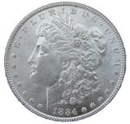
What is the effect of using unconstitutional legal tender?
Property
=
# Lawful Money ($)
1957
=
1,600 Sq. Ft. Home
($)13,500
Notes:
So now lets look at the effects of using unconstitutional legal tender Federal Reserve Notes.
Because Federal Reserve Notes have no value in or of themselves and no intrinsic value, they can be inflated in such a manner to make you believe that you made a gain or an accession to wealth, when in fact you had no such gain at all.
Because Federal Reserve Notes have no set fixed value, they can be used to “quietly” steal your wealth with the perception that you had a gain.
Because Federal Reserve Notes have no known or calculable value, they can be used to deceive the citizens into believing they will receive future benefits, such as social security, at today’s purchasing power.

Slide 17
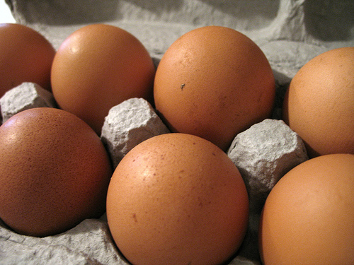
What is the effect of using unconstitutional legal tender?
Property
=
# Egg Cartons (Brown Eggs)
=
# Lawful Money ($)
1957
=
=
1,600 Sq. Ft. Home
~37,700
($)13,500
Notes:
So now lets look at the effects of using unconstitutional legal tender Federal Reserve Notes.
Because Federal Reserve Notes have no value in or of themselves and no intrinsic value, they can be inflated in such a manner to make you believe that you made a gain or an accession to wealth, when in fact you had no such gain at all.
Because Federal Reserve Notes have no set fixed value, they can be used to “quietly” steal your wealth with the perception that you had a gain.
Because Federal Reserve Notes have no known or calculable value, they can be used to deceive the citizens into believing they will receive future benefits, such as social security, at today’s purchasing power.

Slide 18
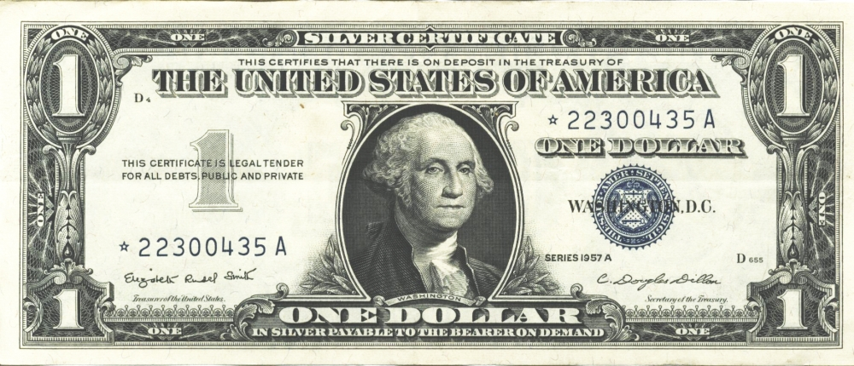
What is the effect of using unconstitutional legal tender?
Property
=
# Egg Cartons (Brown Eggs)
=
# Lawful Money ($)
# Legal Tender $
1957
=
=
=
U.S. Silver Certificate
1,600 Sq. Ft. Home
~37,700
($)13,500
$13,500
Notes:
So now lets look at the effects of using unconstitutional legal tender Federal Reserve Notes.
Because Federal Reserve Notes have no value in or of themselves and no intrinsic value, they can be inflated in such a manner to make you believe that you made a gain or an accession to wealth, when in fact you had no such gain at all.
Because Federal Reserve Notes have no set fixed value, they can be used to “quietly” steal your wealth with the perception that you had a gain.
Because Federal Reserve Notes have no known or calculable value, they can be used to deceive the citizens into believing they will receive future benefits, such as social security, at today’s purchasing power.

Slide 19
What is the effect of using unconstitutional legal tender?
Property
=
# Egg Cartons (Brown Eggs)
=
# Lawful Money ($)
# Legal Tender $
1957
=
=
=
U.S. Silver Certificate
1,600 Sq. Ft. Home
~37,700
($)13,500
$13,500
No Lawful
Money Available
1982
1,600 Sq. Ft. Home
Notes:
So now lets look at the effects of using unconstitutional legal tender Federal Reserve Notes.
Because Federal Reserve Notes have no value in or of themselves and no intrinsic value, they can be inflated in such a manner to make you believe that you made a gain or an accession to wealth, when in fact you had no such gain at all.
Because Federal Reserve Notes have no set fixed value, they can be used to “quietly” steal your wealth with the perception that you had a gain.
Because Federal Reserve Notes have no known or calculable value, they can be used to deceive the citizens into believing they will receive future benefits, such as social security, at today’s purchasing power.

Slide 20
What is the effect of using unconstitutional legal tender?
Property
=
# Egg Cartons (Brown Eggs)
=
# Lawful Money ($)
# Legal Tender $
1957
=
=
=
U.S. Silver Certificate
1,600 Sq. Ft. Home
~37,700
($)13,500
$13,500
=
No Lawful
Money Available
1982
1,600 Sq. Ft. Home
~37,700
Notes:
So now lets look at the effects of using unconstitutional legal tender Federal Reserve Notes.
Because Federal Reserve Notes have no value in or of themselves and no intrinsic value, they can be inflated in such a manner to make you believe that you made a gain or an accession to wealth, when in fact you had no such gain at all.
Because Federal Reserve Notes have no set fixed value, they can be used to “quietly” steal your wealth with the perception that you had a gain.
Because Federal Reserve Notes have no known or calculable value, they can be used to deceive the citizens into believing they will receive future benefits, such as social security, at today’s purchasing power.

Slide 21
What is the effect of using unconstitutional legal tender?
Property
=
# Egg Cartons (Brown Eggs)
=
# Lawful Money ($)
# Legal Tender $
1957
=
=
=
U.S. Silver Certificate
1,600 Sq. Ft. Home
~37,700
($)13,500
$13,500
=
No Lawful
Money Available
1982
Fed. Res. Bank Note
1,600 Sq. Ft. Home
~37,700
“$85,400”
Notes:
So now lets look at the effects of using unconstitutional legal tender Federal Reserve Notes.
Because Federal Reserve Notes have no value in or of themselves and no intrinsic value, they can be inflated in such a manner to make you believe that you made a gain or an accession to wealth, when in fact you had no such gain at all.
Because Federal Reserve Notes have no set fixed value, they can be used to “quietly” steal your wealth with the perception that you had a gain.
Because Federal Reserve Notes have no known or calculable value, they can be used to deceive the citizens into believing they will receive future benefits, such as social security, at today’s purchasing power.

Slide 22
What is the effect of using unconstitutional legal tender?
Property
=
# Egg Cartons (Brown Eggs)
=
# Lawful Money ($)
# Legal Tender $
1957
=
=
=
U.S. Silver Certificate
1,600 Sq. Ft. Home
~37,700
($)13,500
$13,500
=
No Lawful
Money Available
1982
Fed. Res. Bank Note
1,600 Sq. Ft. Home
~37,700
“$85,400”
2007
1,600 Sq. Ft. Home
Notes:
So now lets look at the effects of using unconstitutional legal tender Federal Reserve Notes.
Because Federal Reserve Notes have no value in or of themselves and no intrinsic value, they can be inflated in such a manner to make you believe that you made a gain or an accession to wealth, when in fact you had no such gain at all.
Because Federal Reserve Notes have no set fixed value, they can be used to “quietly” steal your wealth with the perception that you had a gain.
Because Federal Reserve Notes have no known or calculable value, they can be used to deceive the citizens into believing they will receive future benefits, such as social security, at today’s purchasing power.

Slide 23
What is the effect of using unconstitutional legal tender?
Property
=
# Egg Cartons (Brown Eggs)
=
# Lawful Money ($)
# Legal Tender $
1957
=
=
=
U.S. Silver Certificate
1,600 Sq. Ft. Home
~37,700
($)13,500
$13,500
=
No Lawful
Money Available
1982
Fed. Res. Bank Note
1,600 Sq. Ft. Home
~37,700
“$85,400”
2007
=
1,600 Sq. Ft. Home
~37.700
Notes:
So now lets look at the effects of using unconstitutional legal tender Federal Reserve Notes.
Because Federal Reserve Notes have no value in or of themselves and no intrinsic value, they can be inflated in such a manner to make you believe that you made a gain or an accession to wealth, when in fact you had no such gain at all.
Because Federal Reserve Notes have no set fixed value, they can be used to “quietly” steal your wealth with the perception that you had a gain.
Because Federal Reserve Notes have no known or calculable value, they can be used to deceive the citizens into believing they will receive future benefits, such as social security, at today’s purchasing power.

Slide 24
What is the effect of using unconstitutional legal tender?
Property
=
# Egg Cartons (Brown Eggs)
=
# Lawful Money ($)
# Legal Tender $
1957
=
=
=
U.S. Silver Certificate
1,600 Sq. Ft. Home
~37,700
($)13,500
$13,500
=
No Lawful
Money Available
1982
Fed. Res. Bank Note
1,600 Sq. Ft. Home
~37,700
“$85,400”
2007
=
=
1,600 Sq. Ft. Home
~37.700
($)13,500
Notes:
So now lets look at the effects of using unconstitutional legal tender Federal Reserve Notes.
Because Federal Reserve Notes have no value in or of themselves and no intrinsic value, they can be inflated in such a manner to make you believe that you made a gain or an accession to wealth, when in fact you had no such gain at all.
Because Federal Reserve Notes have no set fixed value, they can be used to “quietly” steal your wealth with the perception that you had a gain.
Because Federal Reserve Notes have no known or calculable value, they can be used to deceive the citizens into believing they will receive future benefits, such as social security, at today’s purchasing power.

Slide 25
What is the effect of using unconstitutional legal tender?
Property
=
# Egg Cartons (Brown Eggs)
=
# Lawful Money ($)
# Legal Tender $
1957
=
=
=
U.S. Silver Certificate
1,600 Sq. Ft. Home
~37,700
($)13,500
$13,500
=
No Lawful
Money Available
1982
Fed. Res. Bank Note
1,600 Sq. Ft. Home
~37,700
“$85,400”
2007
=
=
=
Fed. Res. Bank Note
1,600 Sq. Ft. Home
~37.700
($)13,500
“$175,000”
Notes:
So now lets look at the effects of using unconstitutional legal tender Federal Reserve Notes.
Because Federal Reserve Notes have no value in or of themselves and no intrinsic value, they can be inflated in such a manner to make you believe that you made a gain or an accession to wealth, when in fact you had no such gain at all.
Because Federal Reserve Notes have no set fixed value, they can be used to “quietly” steal your wealth with the perception that you had a gain.
Because Federal Reserve Notes have no known or calculable value, they can be used to deceive the citizens into believing they will receive future benefits, such as social security, at today’s purchasing power.

Slide 26
Watch Carefully
Property
Buy
1957
1,600 Sq. Ft. Home
Sell
2007
1,600 Sq. Ft. Home
Notes:
So now let’s look at an example.
What are the effects of using unconstitutional legal tender notes?
An unrealized loss of capital and property;
A loss of real value;
The loss of the full economic impact of automation.
Brown Egg Data:
EGG ECONOMICS UPDATE reports by Donald Bell, Poultry Specialist (emeritus), University of California , Riverside, CA 92521
http://www.ams.usda.gov/poultry/mncs/ShellEgg/USDAEGGMARKETNEWSREPORT.html
http://www.pathtoinvesting.org/interactive/inflation/simulation_inflation.htm

Slide 27
Was a gain made in this transaction?
Property
=
# Egg Cartons
(Brown Eggs)
Buy
1957
=
1,600 Sq. Ft. Home
~37,700
Sell
2007
=
1,600 Sq. Ft. Home
~37,700
Notes:
So now let’s look at an example.
What are the effects of using unconstitutional legal tender notes?
An unrealized loss of capital and property;
A loss of real value;
The loss of the full economic impact of automation.
Brown Egg Data:
EGG ECONOMICS UPDATE reports by Donald Bell, Poultry Specialist (emeritus), University of California , Riverside, CA 92521
http://www.ams.usda.gov/poultry/mncs/ShellEgg/USDAEGGMARKETNEWSREPORT.html
http://www.pathtoinvesting.org/interactive/inflation/simulation_inflation.htm

Slide 28
No Gain!
Property
=
# Egg Cartons
(Brown Eggs)
Buy
1957
=
1,600 Sq. Ft. Home
~37,700
Sell
2007
=
1,600 Sq. Ft. Home
~37,700
No Cartons of Eggs Gain
No Gain No Tax Due
Notes:
So now let’s look at an example.
What are the effects of using unconstitutional legal tender notes?
An unrealized loss of capital and property;
A loss of real value;
The loss of the full economic impact of automation.
Brown Egg Data:
EGG ECONOMICS UPDATE reports by Donald Bell, Poultry Specialist (emeritus), University of California , Riverside, CA 92521
http://www.ams.usda.gov/poultry/mncs/ShellEgg/USDAEGGMARKETNEWSREPORT.html
http://www.pathtoinvesting.org/interactive/inflation/simulation_inflation.htm

Slide 29
Was a gain made in this transaction?
Property
=
# Egg Cartons
(Brown Eggs)
=
# Lawful Money ($)
Buy
1957
=
=
1,600 Sq. Ft. Home
~37,700
($)13,500
Sell
2007
=
=
1,600 Sq. Ft. Home
~37,700
($)13,500
No Cartons of Eggs Gain
No Gain No Tax Due
Notes:
So now let’s look at an example.
What are the effects of using unconstitutional legal tender notes?
An unrealized loss of capital and property;
A loss of real value;
The loss of the full economic impact of automation.
Brown Egg Data:
EGG ECONOMICS UPDATE reports by Donald Bell, Poultry Specialist (emeritus), University of California , Riverside, CA 92521
http://www.ams.usda.gov/poultry/mncs/ShellEgg/USDAEGGMARKETNEWSREPORT.html
http://www.pathtoinvesting.org/interactive/inflation/simulation_inflation.htm

Slide 30
No Gain was made in either of these transactions
Property
=
# Egg Cartons
(Brown Eggs)
=
# Lawful Money ($)
Buy
1957
=
=
1,600 Sq. Ft. Home
~37,700
($)13,500
Sell
2007
=
=
1,600 Sq. Ft. Home
~37,700
($)13,500
No Cartons of Eggs Gain
No Lawful Money Gain
No Gain No Tax Due
No Gain No Tax Due
Notes:
So now let’s look at an example.
What are the effects of using unconstitutional legal tender notes?
An unrealized loss of capital and property;
A loss of real value;
The loss of the full economic impact of automation.
Brown Egg Data:
EGG ECONOMICS UPDATE reports by Donald Bell, Poultry Specialist (emeritus), University of California , Riverside, CA 92521
http://www.ams.usda.gov/poultry/mncs/ShellEgg/USDAEGGMARKETNEWSREPORT.html
http://www.pathtoinvesting.org/interactive/inflation/simulation_inflation.htm

Slide 31
What happens when notes with no intrinsic value are used?
Property
=
# Egg Cartons
(Brown Eggs)
=
# Lawful Money ($)
# Legal Tender $
Buy
1957
=
=
=
U.S. Silver Certificate
1,600 Sq. Ft. Home
~37,700
($)13,500
$13,500
Sell
2007
=
=
=
Fed. Res. Bank Note
1,600 Sq. Ft. Home
~37,700
($)13,500
$175,000
No Cartons of Eggs Gain
No Lawful Money Gain
No Gain No Tax Due
No Gain No Tax Due
Notes:
So now let’s look at an example.
What are the effects of using unconstitutional legal tender notes?
An unrealized loss of capital and property;
A loss of real value;
The loss of the full economic impact of automation.
Brown Egg Data:
EGG ECONOMICS UPDATE reports by Donald Bell, Poultry Specialist (emeritus), University of California , Riverside, CA 92521
http://www.ams.usda.gov/poultry/mncs/ShellEgg/USDAEGGMARKETNEWSREPORT.html
http://www.pathtoinvesting.org/interactive/inflation/simulation_inflation.htm

Slide 32
A Quiet Theft Occurs!
Property
=
# Egg Cartons
(Brown Eggs)
=
# Lawful Money ($)
# Legal Tender $
Buy
1957
=
=
=
U.S. Silver Certificate
1,600 Sq. Ft. Home
~37,700
($)13,500
$13,500
Sell
2007
=
=
=
Fed. Res. Bank Note
1,600 Sq. Ft. Home
~37,700
($)13,500
$175,000
No Cartons of Eggs Gain
No Lawful Money Gain
Federal Reserve Note
“Gain” of $161,500
No Gain No Tax Due
No Gain No Tax Due
Alleged Tax Due
~FRN$55,000
Notes:
So now let’s look at an example.
What are the effects of using unconstitutional legal tender notes?
An unrealized loss of capital and property;
A loss of real value;
The loss of the full economic impact of automation.
Brown Egg Data:
EGG ECONOMICS UPDATE reports by Donald Bell, Poultry Specialist (emeritus), University of California , Riverside, CA 92521
http://www.ams.usda.gov/poultry/mncs/ShellEgg/USDAEGGMARKETNEWSREPORT.html
http://www.pathtoinvesting.org/interactive/inflation/simulation_inflation.htm

Slide 33
How Does the Quiet Theft Occur?
Property
=
# Egg Cartons
(Brown Eggs)
=
# Lawful Money ($)
# Legal Tender $
Buy
1957
=
=
=
U.S. Silver Certificate
1,600 Sq. Ft. Home
~37,700
($)13,500
$13,500
Sell
2007
=
=
=
Fed. Res. Bank Note
1,600 Sq. Ft. Home
~37,700
($)13,500
$175,000
No Cartons of Eggs Gain
No Lawful Money Gain
Federal Reserve Note
“Gain” of $161,500
No Gain No Tax Due
No Gain No Tax Due
Alleged Tax Due
~FRN$55,000
After FRN Tax results in a
Physical Egg Carton Loss of
11,922 Cartons of Eggs
After FRN Tax results in a
Lawful Money Property Loss of ($)4,269
Notes:
So now let’s look at an example.
What are the effects of using unconstitutional legal tender notes?
An unrealized loss of capital and property;
A loss of real value;
The loss of the full economic impact of automation.
Brown Egg Data:
EGG ECONOMICS UPDATE reports by Donald Bell, Poultry Specialist (emeritus), University of California , Riverside, CA 92521
http://www.ams.usda.gov/poultry/mncs/ShellEgg/USDAEGGMARKETNEWSREPORT.html
http://www.pathtoinvesting.org/interactive/inflation/simulation_inflation.htm

Slide 34
Quiet Theft!
Property
=
# Egg Cartons
(Brown Eggs)
=
# Lawful Money ($)
# Legal Tender $
Buy
1957
=
=
=
U.S. Silver Certificate
1,600 Sq. Ft. Home
~37,700
($)13,500
$13,500
Sell
2007
=
=
=
Fed. Res. Bank Note
1,600 Sq. Ft. Home
~37,700
($)13,500
$175,000
No Cartons of Eggs Gain
No Lawful Money Gain
Federal Reserve Note
“Gain” of $161,500
No Gain No Tax Due
No Gain No Tax Due
Alleged Tax Due
~FRN$55,000
After FRN Tax results in a
Physical Egg Carton Loss of
11,922 Cartons of Eggs
After FRN Tax results in a
Lawful Money Property Loss of ($)4,269
The purported Federal Reserve Note “Gain” is actually a “quiet theft” in that
it results in a physical property loss with the perception of an actual gain.
Notes:
So now let’s look at an example.
What are the effects of using unconstitutional legal tender notes?
An unrealized loss of capital and property;
A loss of real value;
The loss of the full economic impact of automation.
Brown Egg Data:
EGG ECONOMICS UPDATE reports by Donald Bell, Poultry Specialist (emeritus), University of California , Riverside, CA 92521
http://www.ams.usda.gov/poultry/mncs/ShellEgg/USDAEGGMARKETNEWSREPORT.html
http://www.pathtoinvesting.org/interactive/inflation/simulation_inflation.htm

Slide 35
Relevant Law & Cases
31 USC 5119(a)
“the Secretary shall … maintain the equal purchasing power of each kind of United States currency”
12 USC 411
“Federal reserve notes … shall be redeemed in lawful money on demand at the Treasury Department of the United States, in the city of Washington, District of Columbia, or at any Federal Reserve bank.”
31 USC 5112(a)(7)-(10), (e)
These sections define the size weight and pure metal content of each lawful money coin.
Thompson v. Butler, 95 U.S. 694 (1878)
A dollar is a dollar
See 5th Cir. Opinion Crummy v. Klein ISD, No. 08-20133, Oct. 2, 2008
Juilliard v. Greenman, 110 U.S. 421 (1884)
Congress has the right to issue redeemable legal tender paper currency.
United States v. Marigold, 50 U.S. (9 How.) 560 (1850)
Constitutionally coined money is a pure metallic standard of value; a coin with known intrinsic value.
Notes:
31 USC Sec. 5119 (a): Except to the extent authorized in regulations the Secretary of the Treasury prescribes with the approval of the President, the Secretary may not redeem United States currency (including Federal reserve notes and circulating notes of Federal reserve banks and national banks) in gold. However, the Secretary shall redeem gold certificates owned by the Federal reserve banks at times and in amounts the Secretary decides are necessary to maintain the equal purchasing power of each kind of United States currency. …
The Supreme Court in Thompson v. Butler, 95 U.S. 694 (1878) stated:
A coin dollar is worth no more for the purposes of tender in payment of an ordinary debt than a note dollar. The law has not made the note a standard of value any more than coin. It is true that in the market, as an article of merchandise, one is of greater value than the other; but as money, that is to say, as a medium of exchange, the law knows no difference between them.
However, this decision was rendered prior to the creation of the Federal Reserve System and the enactment of 31 USC 5119(a).
Citations
US Code:
31 USC 5119(a)
12 USC 411
31 USC 5112(a)(7)-(10), (e)
U.S. SUPREME COURT Opinions
Thompson v. Butler, 95 U.S. 694
Juilliard v. Greenman, 110 U.S. 421
United States v. Marigold, 50 U.S. (9 How.) 560

Slide 36
Issues Created by New Laws and Old Opinions
The “dollar is a dollar” [Thompson v. Butler, 95 U.S. 694 (1878)] concept is still true today. However, the constitutional dollar is confounded with the FRN “dollar”, despite the fact that they lack the requisite equality of purchasing power as required by law [see: 31 U.S.C 5119(a)].
United States Notes [see: Juilliard v. Greenman, 110 U.S. 421 (1884)], when they were available, were always redeemable at their full face value; unlike their Federal Reserve note counter-part.

Slide 37
What can be done?
Use specific Lawful Money language in all sales and licensing contracts to avoid the conflicts created by new laws and old opinions.
Pay appropriate taxes in Federal Reserve notes and let the Secretary of Treasury worry about redeeming them at face value.

Slide 38
What else can be done?
Write your local US Attorney, Congressman and State Legislator and inform them that the Secretary of Treasury as of April 26, 2009 is in violation of three laws:
The Secretary is in violation of Title 31 USC 5119(a) for failing to maintain the equal purchasing power of all United States Currency.
The Secretary is in violation of Title 12 USC 411 for failing to redeem Federal Reserve Notes at their face value for lawful money on demand.
The Secretary is in violation of Title 31 USC 5112(i)(1) for failing to maintain a sufficient supply of constitutional lawful money coins to meet public demand.
Notes:
Click here to find your local US Attorney, Congressman and State Representative.

Slide 39
Conclusion
Always use lawful money contracts when buying, selling or licensing property;
Minimize tax liabilities by using lawful money as the basis in all transactions;
Minimize intrinsic value loss by using Federal Reserve notes to pay all taxes, duties and imposts;
Inform all government authorities of the Secretary of Treasury Derelictions of duty; and
Contact your favorite radio show host and inform them about Constitutional Lawful Money.

