Slide 1
Constitutional Homeland Security
A study of how the Well Regulated Militias of the Several States are necessary for the physical and fiscal security of these United States
Notes:
“If the American people ever allow private banks to control the issue of their money, first by inflation and then by deflation, the banks and corporations that will grow up around them will deprive the people of their property until their children will wake up homeless on the continent their fathers conquered.”, Thomas Jefferson
Have you ever pondered the question “What is money?”
Have you ever thought about what money represents?
Have you ever asked yourself whether money is a unit of measure of wealth, value or some combination thereof?
Have you ever studied our Constitution to see what it says about money?
Today, I hope to be able to definitively answer all of these questions and more.

Slide 2
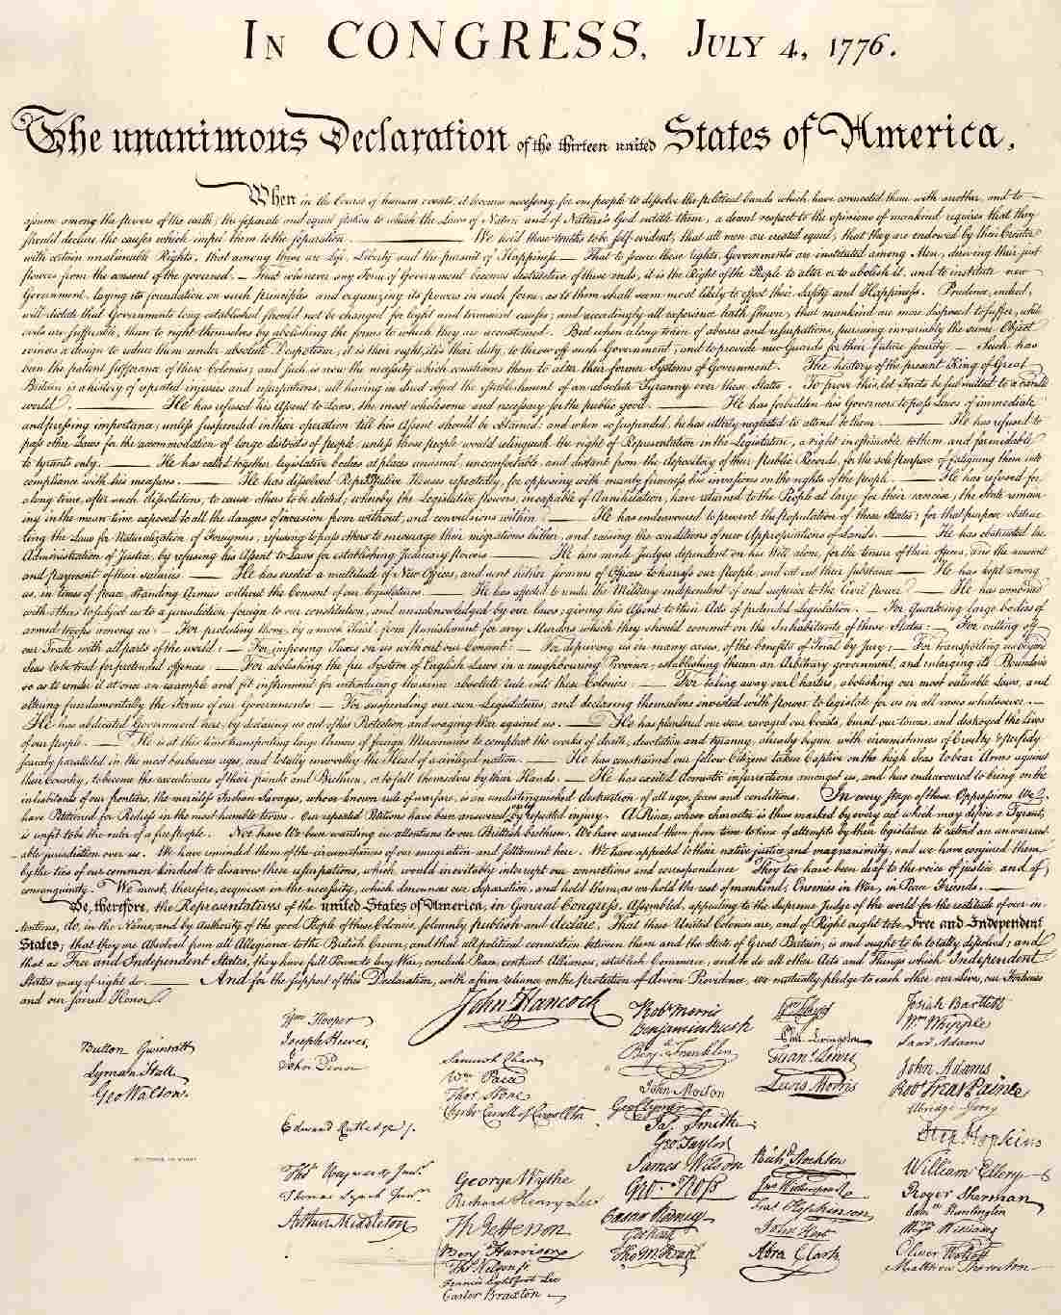
Organized Rebellion to Tyranny is a Duty!
But when a long train of abuses and usurpations, pursuing invariably the same Object evinces a design to reduce them under absolute Despotism, it is their right, it is their duty, to throw off such Government, and to provide new Guards for their future security. -- Such has been the patient sufferance of these Colonies; and such is now the necessity which constrains them to alter their former Systems of Government. The history of the present King of Great Britain is a history of repeated injuries and usurpations, all having in direct object the establishment of an absolute Tyranny over these States. To prove this, let Facts be submitted to a candid world.

Slide 3
“The Laws of Nature and of Nature’s God”
“Consent of the People” and
“Do Ordain and Establish”
constitute an on-going process
“When in the Course of human events it becomes necessary for one people *** to assume among the powers of the earth, the separate and equal station to which the Laws of Nature and of Nature's God entitle them ***
That to secure these rights, Governments are instituted among Men, deriving their just powers from the consent of the governed, ***.
We the People
Constitution
Declaration of Independence
Preamble
We the People Do Ordain and Establish this Constitution
“That whenever any Form of Government becomes destructive of these ends, it is the Right of the People to alter or to abolish it, and to institute new Government, laying its foundation on such principles and organizing its powers in such form, as to them shall seem most likely to effect their Safety and Happiness.”
Second Amendment
“A well regulated militia, being necessary to the security of a free state, the right of the people to keep and bear arms, shall not be infringed.”
The Power of the Purse
The Power of the Sword
But when a long train of abuses and usurpations, pursuing invariably the same Object evinces a design to reduce them under absolute Despotism, it is their right, it is their duty, to throw off such Government, and to provide new Guards for their future security. -- Such has been the patient sufferance of these Colonies; and such is now the necessity which constrains them to alter their former Systems of Government. The history of the present King of Great Britain is a history of repeated injuries and usurpations, all having in direct object the establishment of an absolute Tyranny over these States. To prove this, let Facts be submitted to a candid world.
Congress
We the People
“in direct control and voters at elections
Congress
Tax Spend Borrow Money
Army
Navy
“The Militia of the Several States”
State
State
The Free Market
The President
“when in the actual service of the United States
“Execute the Laws of the Union”
“Suppress insurrections”
“Repel Invasions”
Willingness To Loan
Demand for U.S. Coinage
(“free coinage”)
Use of Alternative Moneys
by the States
by the People Individually
by both, through the Militia
We the People
Direct and Personal participation throughout the country in small local organizations
“Take care that the Laws be faithfully executed”
State
“*** reserving to the states respectively, the appointment of the officers, ***”
First Amendment
Congress shall make no law *** abridging *** the right of the people peaceably to assemble, and to petition the government for a redress of grievances.
We the People
Influence at all times
Factions
(The Federalist No. 10)
Ultimate break on the power of factions
(The Federalist No. 46)

Slide 4
The Sovereign Powers of the General Government of the United States U. S. Constitution, Art I, Sec 8, Clauses 1-18
The Congress shall have Power To lay and collect Taxes, Duties, Imposts and Excises, to pay the Debts and provide for the common Defense and general Welfare of the United States; but all Duties, Imposts and Excises shall be uniform throughout the United States;
To borrow Money on the credit of the United States;
To regulate Commerce with foreign Nations, and among the several States, and with the Indian Tribes;
To establish an uniform Rule of Naturalization, and uniform Laws on the subject of Bankruptcies throughout the United States;
To coin Money, regulate the Value thereof, and of foreign Coin, and fix the Standard of Weights and Measures;
To provide for the Punishment of counterfeiting the Securities and current Coin of the United States;
To establish Post Offices and post Roads;
To promote the Progress of Science and useful Arts, by securing for limited Times to Authors and Inventors the exclusive Right to their respective Writings and Discoveries;
To constitute Tribunals inferior to the supreme Court;
To define and punish Piracies and Felonies committed on the high Seas, and Offences against the Law of Nations;
To declare War, grant Letters of Marque and Reprisal, and make Rules concerning Captures on Land and Water;
To raise and support Armies, but no Appropriation of Money to that Use shall be for a longer Term than two Years;
To provide and maintain a Navy;
To make Rules for the Government and Regulation of the land and naval Forces;
To provide for calling forth the Militia to execute the Laws of the Union, suppress Insurrections and repel Invasions;
To provide for organizing, arming, and disciplining, the Militia, and for governing such Part of them as may be employed in the Service of the United States, reserving to the States respectively, the Appointment of the Officers, and the Authority of training the Militia according to the discipline prescribed by Congress;
To exercise exclusive Legislation in all Cases whatsoever, over such District (not exceeding ten Miles square) as may, by Cession of particular States, and the Acceptance of Congress, become the Seat of the Government of the United States, and to exercise like Authority over all Places purchased by the Consent of the Legislature of the State in which the Same shall be, for the Erection of Forts, Magazines, Arsenals, dock-Yards, and other needful Buildings;--And
To make all Laws which shall be necessary and proper for carrying into Execution the foregoing Powers, and all other Powers vested by this Constitution in the Government of the United States, or in any Department or Officer thereof.

Slide 5
Silence of the Constitution is Authoritative
Amendment IX
The enumeration in the Constitution, of certain rights, shall not be construed to deny or disparage others retained by the people.
Amendment X
The powers not delegated to the United States by the Constitution, nor prohibited by it to the States, are reserved to the States respectively, or to the people.

Slide 6
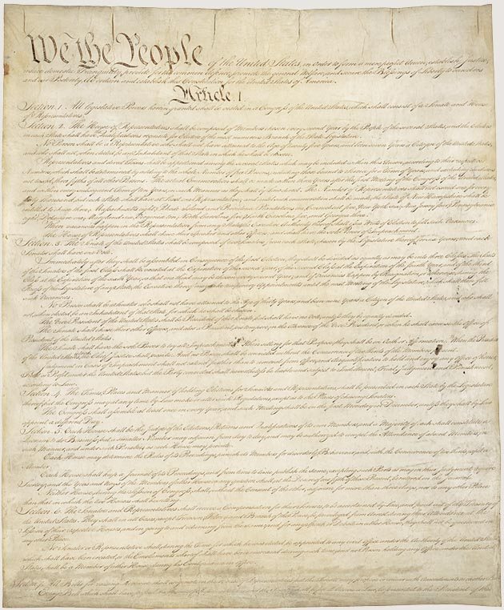
Constitutional Homeland Security
Article I Section 8, Clauses 15 & 16
[The Congress shall have Power] To provide for calling forth the Militia to execute the Laws of the Union, suppress Insurrections;
To provide for organizing, arming, and disciplining, the Militia, and for governing such Part of them as may be employed in the Service of the United States, reserving to the States respectively, the Appointment of the Officers, and the Authority of training the Militia according to the discipline prescribed by Congress;
2nd Amendment
A well regulated Militia, being necessary to the security of a free State, the right of the people to keep and bear Arms, shall not be infringed.
Notes:
It is rather ironic that during the first 124 years of our Republic’s existence (1789 – 1913), it was well understood by the general public that the word “Dollar” means a pure metallic silver coin of a known fixed unit of measurement for money, value and wealth.
Over the next 55 years (1913 – 1968), the definition of the Dollar was slowly removed from public education, dictionaries and our court rooms to the point that in 1968 Congress unconstitutionally eliminated the fundamental and necessary requirement of silver from the “public” definition of the word “Dollar”. Hence our constitutionally guaranteed fixed standard unit of measure of money and wealth was hijacked.
Finally, on 15 August 1971, President Richard Nixon unconstitutionally terminated redemption of Federal Reserve Notes in gold internationally, ending the connection between the Federal Reserve System and any “constitutional” money whatsoever.

Slide 7
Basic Constitutional Powers Granted to the Militias of the Several States
Execute (enforce) the laws of the United States,
Deter domestic violence,
Suppress insurrections,
Repel invasions in whatever form,
Secure “a free State” and guarantee “a Republican Form of Government in each State and otherwise
Maintain the continuity of representative constitutional government in the face of whatever may threaten it

Slide 8
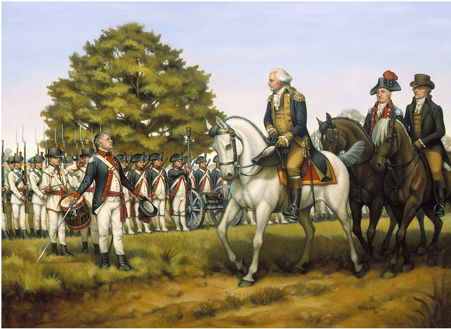
...To Execute the Laws of the Union The Whiskey Rebellion. Harrisburg, Pennsylvania -- October 3, 1794
In September 1791 the western counties of Pennsylvania broke out in rebellion against a federal excise tax on the distillation of whiskey. After local and federal officials were attacked, President Washington and his advisors decided to send troops to pacify the region. It was further decided that militia troops, rather than regulars, would be sent. On August 14, 1792, under the provisions of the newly-enacted militia law, Secretary of War, Henry Knox called upon the governors of Virginia, Maryland, New Jersey, and Pennsylvania for 12,950 troops as a test of the President's power to enforce the law. Numerous problems, both political and logistical, had to be overcome and by October, 1794 the militiamen were on the march. The New Jersey units marched from Trenton to Harrisburg, Pennsylvania. There they were reviewed by their Commander-in-Chief, President George Washington, accompanied by Secretary of the Treasury and Revolutionary war veteran Alexander Hamilton. By the time the troops reached Pittsburgh, the rebellion had subsided, and western Pennsylvania was quickly pacified. This first use of the Militia Law of 1792 set a precedence for the use of the militia to "execute the laws of the union, (and) suppress insurrections".

Slide 9
Functions and Responsibilities of the Militias of the Several States
To serve in declared wars
Stop terrorist attacks
Stop Insurrections & conspiracies
Stop dissemination of chemical, biological and radioactive hazards
Control epidemics
Assist in natural disasters
Assist in human created disasters
Stop economic crisis
Stop social crisis
Stop illegal aliens
Stop domestic & international criminal commerce
Stop government corruption
Stop oppression of citizens
Stop “Usurpation”
Stop “Tyranny”
Stop all combinations thereof

Slide 10
Components of the Militia Structure
Committees of Inquiry (Intelligence gathering)
Committees of Safety (Emergency preparedness)
Officers (Appointed by the State)
Services Units (Transportation, Food Service, armorer, and Supply)
Committees of Correspondence (Communications)
Militia Units (Trained and Armed homeland security)

Slide 11
Organizational Functions
Officers
Services Units
Lead
Lead units and committees when local or national need arises
Organize
Community units and committees based upon skill, needs, desires
Mobilize
Mobilize units and committees to execute laws, to suppress insurrections, repel invasions, manage disasters, etc.
Train
Train the Militia according to the discipline prescribed by Congress
Transportation
Provide and coordinate transportation services for officers, units and committees
Food Services
Provide and coordinate food services for officers, units and committees
Armorer
Provide/repair weapons & armor
Audit militia unit training, weapon and ammunition compliance
General Supplies

Slide 12
Organizational Functions
Committee of Inquiry
Committees of Safety
Intelligence Gathering
Attend gvmt meetings
Make FOIA requests
Walk gvmt halls
Use inside sources
Intelligence Training
How to make FOIA requests
How to use archives
How to access to “closed mtgs”
How to access “closed records”
Establishing sources
Emergency Preparedness
First Responders
Medical response teams
Hostage negotiations
Emergency Food supply mgmt
Emergency Training
CPR, First aid, Water safety
Medical Services
HASMAT
Fire Rescue
Transport
Hostage negotiations
Food Safety

Slide 13
Organizational Functions
Committees of Correspondence
Militia Units
Inter-militia communications
Communication Services
Communications network installation and support
Data transport (internet, LAN and WAN networks)
Equipment Maintenance
Computer and Communications equipment maintenance
Security
Data and communications security
Law enforcement
Maintain the peace
Quell Insurrections
Repel Invasions
Maintain social order
Facilitate economic transition

Slide 14

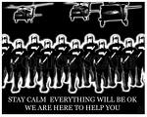
Necessity of the Militias of the Several States Free State vs. Police State
PANAMA REFINING CO. v. RYAN, 293 U.S. 388, 420-421 (1935)
The Constitution provides that 'All legislative Powers herein granted shall be vested in a Congress of the United States, which shall consist of a Senate and House of Representatives.' Article 1, 1. And the Congress is empowered 'To make all Laws which shall be necessary and proper for carrying into Execution' its general powers. Article 1, 8, par. 18. The Congress manifestly is not permitted to abdicate or to transfer to others the essential legislative functions with which it is thus vested. Undoubtedly legislation must often be adapted to complex conditions involving a host of details with which the national Legislature cannot deal directly. The Constitution has never been regarded as denying to the Congress the necessary resources of flexibility and practicality, which will enable it to perform its function in laying down policies and establishing standards, while leaving to selected instrumentalities the making of subordinate rules within prescribed limits and the determination of facts to which the policy as declared by the Legislature is to apply. Without capacity to give authorizations of that sort we should have the anomaly of a legislative power which in many circumstances calling for its exertion would be but a futility. But the constant recognition of the necessity and validity of such provisions and the wide range of administrative authority which has been developed by means of them cannot be allowed to obscure the limitations of the authority to delegate, if our constitutional system is to be maintained.
…
So also, from the beginning of the government, the Congress has conferred upon executive officers the power to make regulations-'not for the government of their departments, but for administering the laws which did govern.' United States v. Grimaud, 220 U.S. 506, 517 , 31 S.Ct. 480, 483. Such regulations become, indeed, binding rules of conduct, but they are valid only as subordinate rules and when found to be within the framework of the policy which the Legislature has sufficiently defined.
Constitutional Execution of Laws
Militias execute the laws passed by Congress
Unconstitutional Execution of Laws
Executive Agencies write and execute their own laws
ATF, EPA, FAA, FDA, TSA …
CLINTON, PRESIDENT OF THE UNITED STATES,ET AL . v. CITY OF NEW YORK 524 U.S. 417 (1998)
"Unilateral action by any single participant in the law-making process is precisely what the Bicameralism and Presentment Clauses were designed to prevent. Once a bill becomes law, it can only be repealed or amended through another, independent legislative enactment, which itself must conform with the requirements of Article I. Any rescissions must be agreed upon by a majority of both Houses of Congress. The President cannot single-handedly revise the work of the other two participants in the lawmaking process, as he did here when he vetoed certain provisions of these statutes."
Free State Police State

Slide 15
Government Tyranny
Definition
The arbitrary use of power or control under the color of law
Examples of Government Tyranny
Panama Refining Co. v. Ryan, 293 U.S. 388 (1935)
Clinton, President of U.S. v. City of New York, 524 U.S. 417
Public Law 105–206—July 22, 1998 Sec. 1001. (RRA98) Reorganization of the Internal Revenue Service.
(a) IN GENERAL.—The Commissioner of Internal Revenue shall develop and implement a plan to reorganize the Internal Revenue Service. The plan shall
(1) supersede any organization or reorganization of the Internal Revenue Service based on any statute or reorganization plan applicable on the effective date of this section;

Slide 16
Necessity of the Militias of the Several States to secure social and economic security
How the Militia structure can be used to reinstitute sound economic policies and constitutional lawful money

Slide 17
The Constitutional Fiscal System
The Confidence-Game Fiscal System
Tax
Tax
Spend
Borrow
Private Economy
Federal
Reserve
System
Spend
Borrow
Private
Economy
No “bills of credit”
“Bills of credit”
Legal Tender Notes
Money
Silver & Gold
“Bills of credit”
Legal Tender Notes
Free Coinage
Money
Silver & Gold
The constitutional system prohibits the government from creating money by emitting bills of credit (legal tender notes).
The government can tax or borrow money from the private economy to raise revenue
The government call sell property or service such as coining and minting to raise additional revenue.
If the government can create money, it has no need to borrow money.
If the government can create money, it has no need to tax (the redistribution of real wealth through inflation amounts to or is a tax).
Therefore whose interests are uniquely served by this system?

Slide 18
How the Militias can be used to facilitate the transition to lawful money
State Government
Tax
Borrow
Create Money
Adopt Money
Spend
Coin Money
Emit Bills of Credit
No State shall ... make any thing but gold and silver coin a tender in payment of debts
Alternative Money from Taxpayers
Alternative Money to Creditors
Private Economy
(Unorganized Individuals)
Militia
(Highly Organized)

Slide 19
Conclusion
The Militias of the Several States are necessary for:
The Security of a Free State
The execution of the laws of the United States
To repel invasions
To suppress insurrections
The social and economic stability of the United States and her citizens

Slide 20
The END

Slide 21
“The Laws of Nature and of Nature’s God”
“Consent of the People” and
“Do Ordain and Establish”
constitute an on-going process
“When in the Course of human events it becomes necessary for one people *** to assume among the powers of the earth, the separate and equal station to which the Laws of Nature and of Nature's God entitle them ***.”
That to secure these rights, Governments are instituted among Men, deriving their just powers from the consent of the governed, ***.
We the People
Constitution
Declaration of Independence
Preamble
“That whenever any Form of Government becomes destructive of these ends, it is the Right of the People to alter or to abolish it, and to institute new Government, laying its foundation on such principles and organizing its powers in such form, as to them shall seem most likely to effect their Safety and Happiness.”
We the People Do Ordain and Establish this Constitution
Second Amendment
The Power of the Purse
The Power of the Sword
“A well regulated militia, being necessary to the security of a free state, the right of the people to keep and bear arms, shall not be infringed.”
But when a long train of abuses and usurpations, pursuing invariably the same Object evinces a design to reduce them under absolute Despotism, it is their right, it is their duty, to throw off such Government, and to provide new Guards for their future security. -- Such has been the patient sufferance of these Colonies; and such is now the necessity which constrains them to alter their former Systems of Government. The history of the present King of Great Britain is a history of repeated injuries and usurpations, all having in direct object the establishment of an absolute Tyranny over these States. To prove this, let Facts be submitted to a candid world.
Congress
(We the People)
Congress
“in direct control and voters at elections
Tax Spend Borrow Money
Army
Navy
“The Militia of the Several States”
State
State
The Free Market
The President
“when in the actual service of the United States
“Execute the Laws of the Union”
“Suppress insurrections”
“Repel Invasions”
Willingness To Loan
Demand for U.S. Coinage
(“free coinage”)
Use of Alternative Moneys
by the States
by the People Individually
by both, through the Militia
We the People
“Take care that the Laws be faithfully executed”
Direct and Personal participation throughout the country in small local organizations
State
We the People
“*** reserving to the states respectively, the appointment of the officers, ***”
First Amendment
Influence at all times
Congress shall make no law *** abridging *** the right of the people peaceably to assemble, and to petition the government for a redress of grievances.
Factions
(The Federalist No. 10)
Ultimate break on the power of factions
(The Federalist No. 46)

Slide 22
The Constitutional Fiscal System
The Confidence-Game Fiscal System
Tax
Tax
Private Economy
Federal Reserve System
Private Economy
Spend
Borrow
Spend
Borrow
No “bills of credit”
“bills of credit”
“bills of credit”
Money
Silver & Gold
Free Coinage
Money
Silver & Gold
If the government can create money, it has no need to borrow money.
If the government can create money, it has no need to tax (the redistribution of real wealth through inflation will amount to a tax).
If the government can create money, it has no need to borrow money.
If the government can create money, it has no need to tax (the redistribution of real wealth through inflation will amount to a tax).
Therefore whose interests are uniquely served by this system?

Slide 23
State Government
Tax
Borrow
Create Money
Adopt Money
Spend
Coin Money
Emit Bills of Credit
No State shall ... make any thing but gold and silver coin a tender in payment of debts
Alternative Money from Taxpayers
Alternative Money to Creditors
Private Economy
(Unorganized Individuals)
Militia
(Highly Organized)

